Slide 1
Post Secondary Information
2017/2018
BLUEVALE C. I.
Notes:
‹#›

Slide 2
LEARNING GOALS:
To understand post-secondary options
To become familiar with research tools
To understand the application process
To alleviate some stress!

Slide 3
PREPARING FOR LIFE AFTER HIGH SCHOOL
DETERMINE YOUR OPTIONS FOR NEXT YEAR
5th Year
Workplace
Trade and Apprenticeship
College
University

Slide 4
5TH YEAR
Make sure you are ready to leave. Colleges and Universities do not treat grade 12 or 5th year students differently
Meet with your guidance counsellor to plan your 5th year appropriately

Slide 5
WORKPLACE
WHAT KIND OF JOB ARE YOU LOOKING FOR?
Seek help:
Exit Planning with your guidance counsellor
Community supports
Lutherwood Employment Centre
Conestoga College Career Centre
Workshops
WRDSB - Zoom into the Workplace workshop in the spring

Slide 6
APPRENTICESHIPS
Find a tradesperson willing to employ you.
Apply to the Ontario College Application Services (OCAS)
Conestoga College offers a number of programs that register you as an apprentice when you start the program.
Math and English are key subjects
Attend the presentation by Conestoga College on Trades and Apprenticeships in November at lunch in computer lab 1115
Contact the Ministry of Training, Colleges & Universities (MTCU)

Slide 7
COLLEGE VS. UNIVERSITY
COLLEGE
UNIVERSITY
Smaller Class Sizes
Hands on learning
Focus on career training and trades
Foundation programs (1yr)
Certificates, Diplomas (2-3 years)
Degrees (4 years)
Larger Class Sizes
Lecture style learning
Focus on academic and professional programs
Degrees (Bachelors, Masters)
3-4 year programs

Slide 8
ADMISSION REQUIREMENTS
COLLEGE
Gr.12 English (C or U)
Program Specific Requirements
Average varies, but is generally based on required courses only
Portfolio/Interview
UNIVERSITY
GRADE 12 ENGLISH (U)
5 ADDITIONAL U/M COURSES
PROGRAM SPECIFIC REQUIREMENTS
SUPPLEMENTAL INFORMATION FORM
OSSD

Slide 9
RESEARCH, RESEARCH, RESEARCH!!
COLLEGE
Ontario College Fair @ Enercare Centre (Ex. Place in Toronto)
Tuesday, October 24, 5-9pm and Wed., Oct. 25 9-2pm
College Information Program Day @ Conestoga College, Doon Campus
Tuesday, October 17 - field trip from BCI via school bus
10:30 am - 1:00pm
5:30-7:30 pm
All 28 Ontario Colleges will be present
BCI Mini College Day on Wednesday November 15th – 10 Ontario Colleges
Visit www.ontariocolleges.ca
Attend a campus tour or an open house

Slide 10
COLLEGE www.ontariocolleges.ca

Slide 11
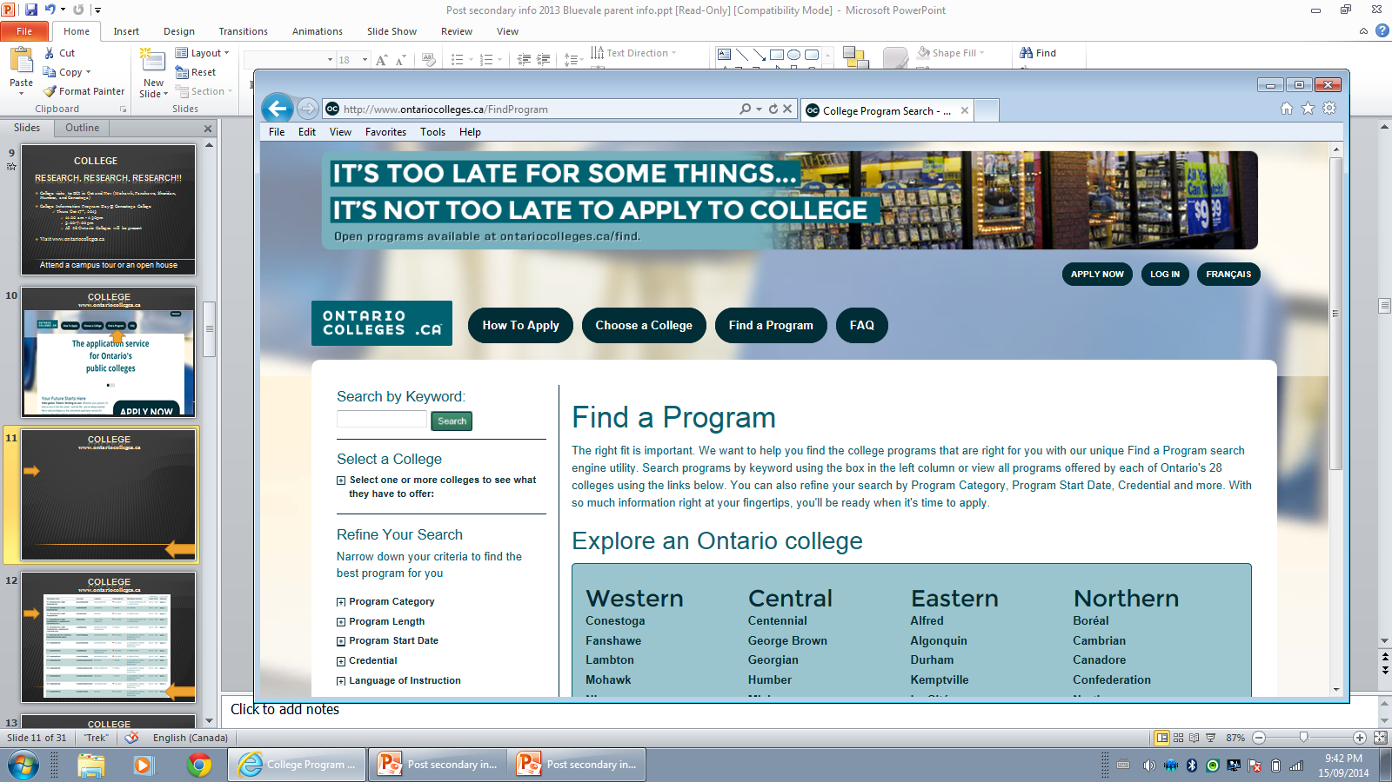
COLLEGE www.ontariocolleges.ca

Slide 12
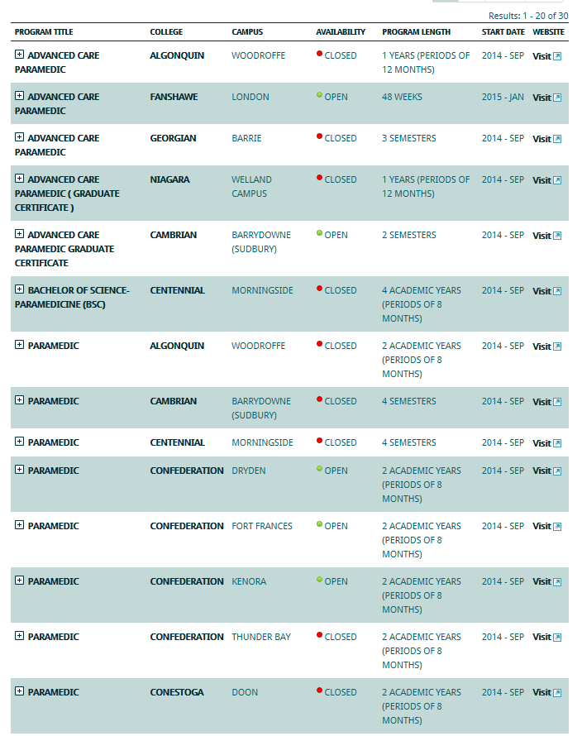
COLLEGE www.ontariocolleges.ca

Slide 13
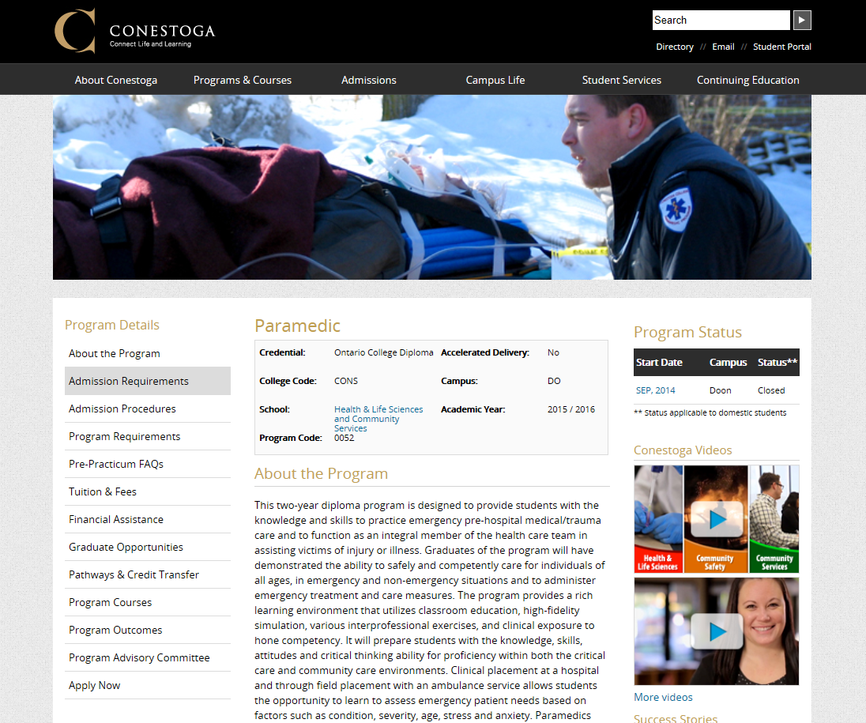
COLLEGE www.ontariocolleges.ca

Slide 14
UNIVERSITY
Ontario University Fair: Sept 22 – 24th @ The Metro Toronto Convention Centre (10 am – 5 pm daily)
BCI mini university day (17 Universities): Fri. Oct. 20th @ 8:40 - 11:00 am
University Information Program Presentations
Sep. 27th @ 12 – 2pm @ St. David CSS
Sept. 27th @ 7 - 9 pm @ Resurrection CSS
Sept. 28th @ 7 - 9 pm @ Monsignor Doyle CSS
Electronic info (einfo.ca), IPP research
Attend a campus tour or an open house

Slide 15
UNIVERSITY www.electronicinfo.ca

Slide 16
UNIVERSITY www.electronicinfo.ca

Slide 17
UNIVERSITY www.electronicinfo.ca

Slide 18
UNIVERSITY www.electronicinfo.ca

Slide 19
APPLICATION PROCESS
UNIVERSITY
$150 WILL ALLOW STUDENTS TO APPLY TO 3 UNIVERSITIES
$50 FOR EACH ADDITIONAL CHOICE
PIN # – WILL BE MAILED TO BCI AT THE END OF OCTOBER BEGINNING OF NOVEMBER
DEADLINE: JAN 17^{H} 2018
COLLEGE
$95 will allow students to apply to 5 college choices with no more than 3 programs at any one college
OEN number – located on student’s timetable
Can apply end of October
DEADLINE: FEB 1st 2018

Slide 20
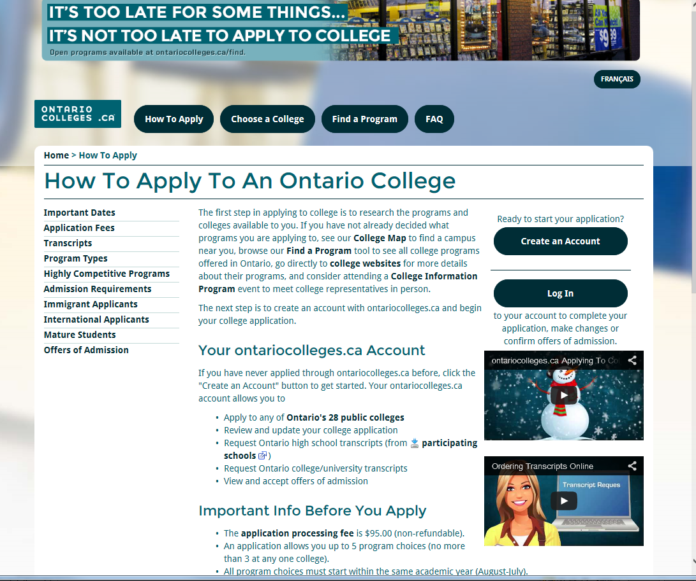
COLLEGE www.ontariocolleges.ca

Slide 21
DEADLINES FOR COLLEGE
October 15, 2017 – first date that an application will be sent to a college
February 1, 20178– application is due for equal consideration + first day colleges MAY release offers of admission
May 1, 2017 – Confirmation deadline
Mid-June 2018 – earliest date you may be required to make a financial commitment

Slide 22
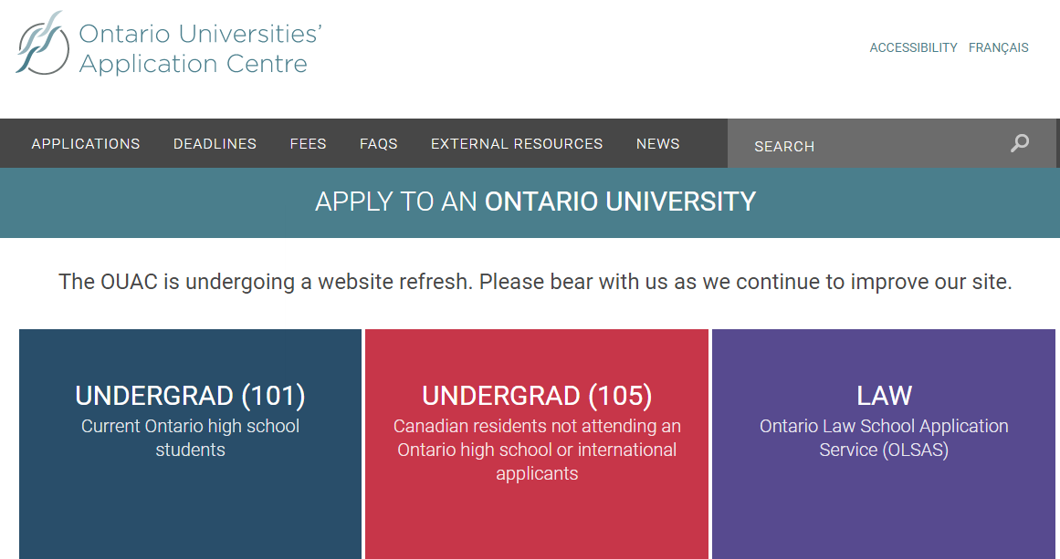
UNIVERSITY www.ouac.on.ca

Slide 23
DEADLINES FOR UNIVERSITY
January 17, 2018– 101 application is due for equal consideration
February 6, 2018 – recommended last date to make final changes to your application
May 29, 2018– Notification of decision (all offers are conditional)
June 1, 2018 – earliest date you may be required to respond to an offer and give a financial commitment

Slide 24
OUT OF PROVINCE
Applications are direct to each university.
Fees and due dates will vary
Program requirements will vary
OSSD is a standard requirement
Students need to check each school for specific requirements.
Those planning on applying to American Colleges or Universities will need to write the SAT’s or ACTs. Contact the coaches for info.

Slide 25
HOW DO I GET AN EARLY OFFER OF ADMISSION?
Apply early i.e. Beginning of December
Must have excellent marks in grade 11
Only 5 percent of all of the University of Waterloo’s offers are based solely on grade 11 marks
Our first upload of grade 12 marks is February 15
Our second upload of grade 12 marks is April 26
All offers of admission are conditional – final upload of marks is in July

Slide 26
COST OF POST SECONDARY
$10,000 – $20,000
*depending on program and location.
**only an estimate of total costs.
Costs include:
Tuition
Student Fees
Residence
Meal Plan
Transportation
Miscellaneous
Books & Supplies

Slide 27
FUNDING SOURCES
Personal Savings
Bank Loan
Earnings from employment (while attending school)
Parental Contribution - RESP
Scholarships / Bursaries
Government Student Loans (OSAP)
Commencement Awards

Slide 28
MORE INFORMATION
BCI Website - Guidance
http://bci.wrdsb.ca/guidance
Follow us on Twitter
@BCI_Guidance
Pick up handout (information sheet)

Slide 29
THANK-YOU FOR LISTENING

