Slide 1
EDSS GRAD PARENT INFORMATION NIGHT
PATHWAYS FOR THE FUTURE

Slide 2
AGENDA
Welcome
How to be successful—Kim Enns-Hildebrand
The Options:
Workplace—Mike Forler
Apprenticeship—Mike Forler
College—Deb Duimering
University—Kim Enns-Hildebrand
Timelines—Kim Enns-Hildebrand
Costs and Financial Aid—Deb Duimering
Transition to Post-secondary
QUESTION PERIOD

Slide 3
How to be Successful
Start early
Consider alternative paths to reach your goal
Ponder options further from home
Have a back up plan

Slide 4
The World of Work

Slide 5
Keys to Finding a Job
Coop in high school
Resume
Cover letter
Letters of recommendation
Network
Continuing education
Volunteer

Slide 6
Workplace Connections
Manufacturing Day - October 6, Ed Centre
Workplace Employment Fair – Sem 2, Ed Centre
ZOOM in the Workplace - May 2, Conestoga College
Jill of All Trades - May 30, Conestoga College
Employment Ontario Workshops – See Guidance
Woolwich Community Services
Job postings
Conestoga College job search assistance
Lutherwood Employment Services

Slide 7
APPRENTICESHIPS

Slide 8
Apprenticeships
Hands on training—2 to 5 years
Learn with a mentor
Earn while you learn
In school and workplace components
The Ontario College of Trades regulates the skilled trades
New apprentices can apply for an interest free loan for tools and equipment

Slide 9
The Process
Find a Sponsor/Employer to sign you on as an apprentice
Apply for registration as an Apprentice with Employment Ontario
Employment Ontario will contact you and your sponsor to sign and register a Training Agreement
Once registered with the province, apply for membership to the Ontario College of Trades
Attend a Community College for the school portion
Receive a Certificate of Qualification Journeyperson (3 to 5 years)

Slide 10
Apprenticeship Connections
EDSS Tech Courses
SHMS—earn certificates
Participate in Skills Canada
Coop placements
www.collegeoftrades.ca
Earn While you Learn

Slide 11
Community Colleges

Slide 12
COLLEGE OPTIONS
Program Choices
1 year Certificate
2 or 3 year Diploma
4 year Applied Degree
Joint Degrees
eg. RN

Slide 13
How to Apply
OCAS—Ontario College Application Service
5 choices for $95
Maximum 3 at one college
Research—course requirements and grade differentials
Admission is based ONLY on required subjects, not average of all Grade 12 courses
www.ontariocolleges.ca

Slide 14
College Research
In-school Application Workshops
Sign up for in-school College Rep Presentations
Parent Information Night - NEW – Conestoga College
October 12 - 6-7:30pm
Ontario College Fair—Conestoga College
October 17
10:30 am to 1:00 pm
5:30 pm to 7:30 pm Free parking in the evening
Ontario College Fair—Toronto
October 24—5:00 to 9:00 pm
October 25—9:00 am to 2:00 pm

Slide 15
UNIVERSITY

Slide 16
University Application
OUAC—Ontario University Application Centre
Must get PIN from Guidance
Choices: 3 or more
Admission is based on 6 Grade 12 U/M courses (usually including required courses)
$150 for 3 choices
$50 per additional
$50 for any changes except changing program choice at the same institution

Slide 17
University Research
Student Life Expo
October 28-29 in Toronto
Sign up for in-school University Presentations
eINFO—www.electronicinfo.ca
Ontario Universities only
UNIVERSITYSTUDY.ca
Universities across Canada

Slide 18
Timelines

Slide 19
Application Timelines
Late October or early November
OUAC—students receive IDs and PIN
OCAS—students access OCAS website and create login and password
December 15—EDSS target date for applying on-line
OUAC deadline—January 17, 2018
OCAS deadline—February 1, 2018

Slide 20
January to June
University early offers—anytime after applying
Most University offers go out in late April
Mid-June
Students not accepted to University of choice
apply to openings listed on OUAC
See Guidance Counsellor
College early offers - February 1
Both Colleges and Universities have Acceptance deadlines and Deposit deadlines
What if they apply to both College & University?

Slide 21
Financial Planning

Slide 22
What to expect with Fees:
Tuition (including incidental fees)
$4,000 to $5,000 per year for College Diploma Programs
$8,000 to $18,000 per year for Bachelor Degree Programs
Additional costs include:
Books—$1000 to $2000/year – check Used Book sites!
Equipment – Specialized Laptop or Software
Parking/transportation
Coop fees

Slide 23
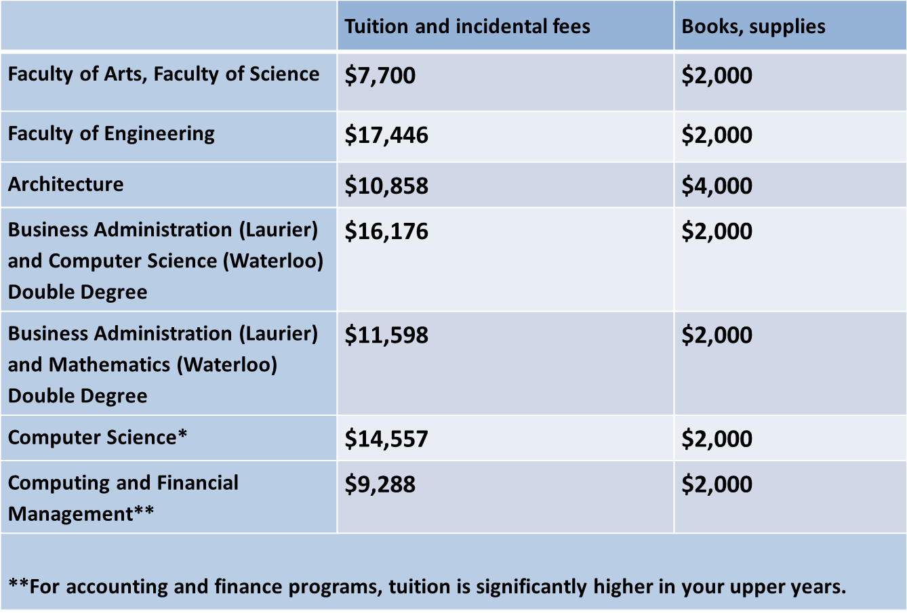
Tuition for Two Terms (8 months)

Slide 24
Residence: On versus Off
On Campus
Cost varies based on style of accommodation and type of meal plan
Approximately $10,000-$12,000 for residence and food for two semesters of study
Off Campus
U of W website
$7,000 and up for rent, plus utilities, groceries

Slide 25
Realistic Estimates (2 Semesters away from home)
$22,000 to $30,000 per year for University studies
$18,000 to $22,000 for College studies

Slide 26
How To Find The Money
Scholarships – awarded based on merit
Bursaries – awarded based on need
OSAP – awarded based on family income

Slide 27
Types of Scholarships Available
Community service
Athletic
Academic
Area of study
Leadership
Community or School Involvement
Specific College/Universities have their own Scholarships and Bursaries

Slide 28
Bursaries:
Awarded based on financial need
Often require community involvement
EDSS has several – Please check the EDSS Guidance website PDF

Slide 29
OSAP: Ontario Student Assistance Program
osap.gov.on.ca
Apply online when you apply to college/university
Application is sent to the school to which the student will be attending
NEW: OSAP funds can be applied directly to tuition before you receive your tuition payment notice
Free tuition for lower income families
Try the OSAP Estimator!

Slide 30
Where to look?
University & College Websites
E.D.S.S. Guidance Website
Insurance Company
Club or Sport Affiliations
Scholarship Websites
Employer (student / parent)

Slide 31
Transition

Slide 32
My Child is off to College/University: What’s my role?
Do I get a report of grades and/or progress?
No. Universities and colleges only communicate with students
My child’s grades have dropped significantly compared to their achievement in high school. Is this normal?
Yes
Many students experience a significant drop in grades due to higher demands on their time as well as level of work expected
Encourage students to attend office hours, join study group
Asking for help is a sign of strength!

Slide 33
How can I help with a smooth transition?
Attend on-campus days in the spring and summer
Know the resources/supports available on campus
Be sure they contact information for campus supports before Day 1 of program!
Student health centre
Tutoring
Writing help centre
Counselling centre
Keep the lines of communication open so you can help if needed
You know what is “normal” for your own child

Slide 34
School Website - Guidance

Slide 35
QUESTION PERIOD

