Slide 1
Wilmot, Wellesley & Woolwich (WWW) Bus Cancellations
for Breslau P.S. 2017 - 2018
If you live within the red shaded area and you are a bused student, you will be bused to school on the Wilmot, Wellesley and Woolwich bus cancellation days. If you live outside of the red area, you will not be bused to school on these days.
AM routes:
Buses that will run completely:
100, 103 and 105
Buses that will run partially:
101 (will only pick up KENNEDY RD & DOVERCOURT RD and STARLIGHT AVE & SHALLOW CREEK DR)
104 (will only pick up FLANDERS RD & LA SALLE ST, FLANDERS RD & TOWNSEND DR (west corner) and
TOWNSEND DR & TOWNSEND DR)
PM routes:
Buses that will run completely:
100, 103, and 105
Buses that will run partially:
101 (will only drop off STARLIGHT AVE & SHALLOW CREEK DR and KENNEDY RD & DOVERCOURT RD)
104 (will only drop off FLANDERS RD & TOWNSEND DR (west corner) and TOWNSEND DR &
TOWNSEND DR)
**The only time buses will be cancelled in the red shaded area are when schools are closed for a SNOW DAY or when ALL transportation is cancelled for the day**

Slide 2
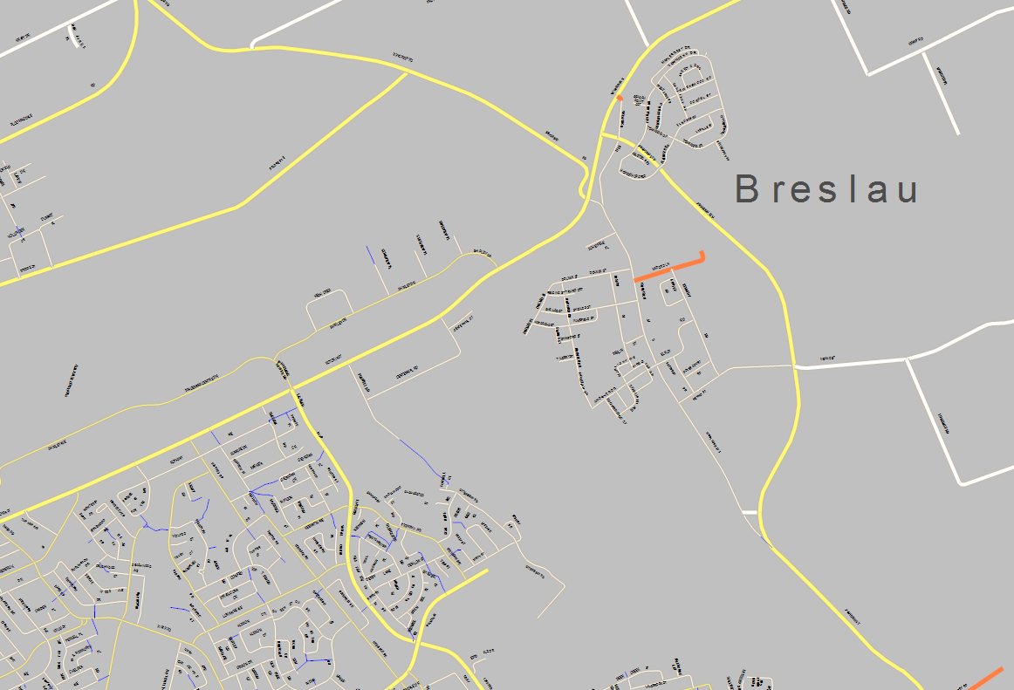
Area 1
Area 2

Slide 3
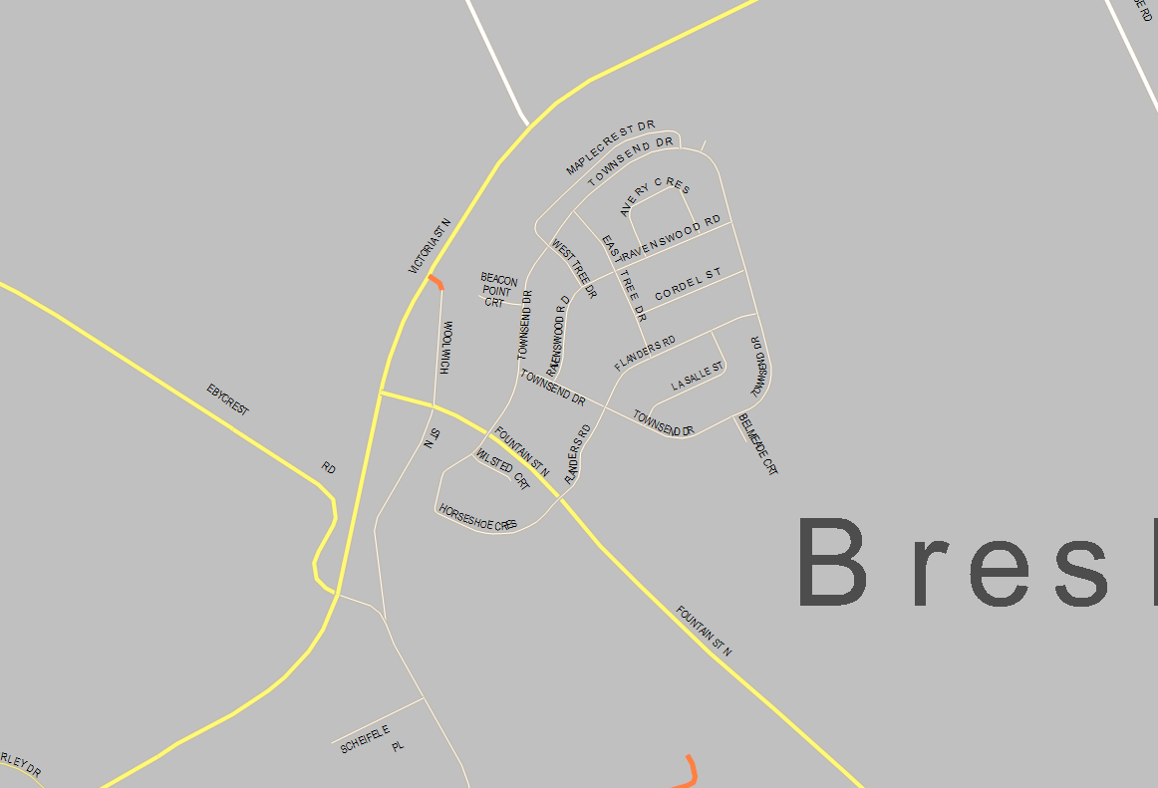
Area 1

Slide 4
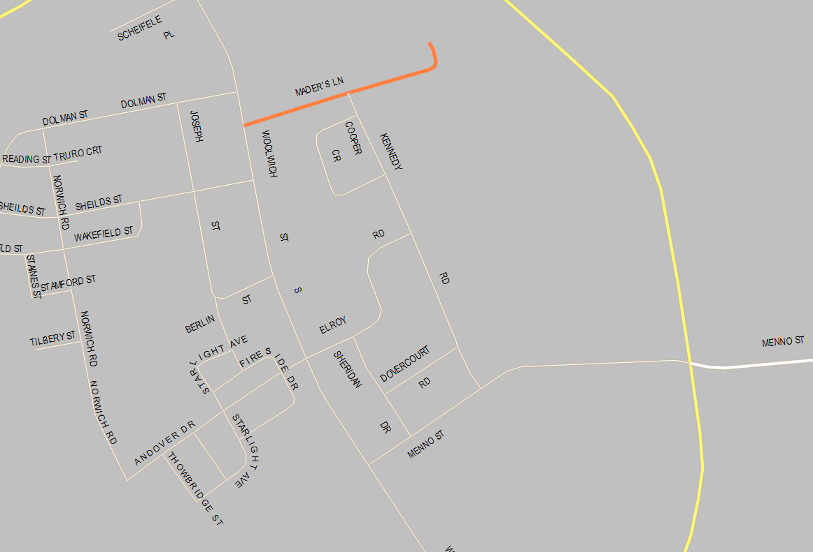
Area 2

