Slide 1
Course Selection for Grade 10 Pre IB
(students going into grade 11 IB)

Slide 2
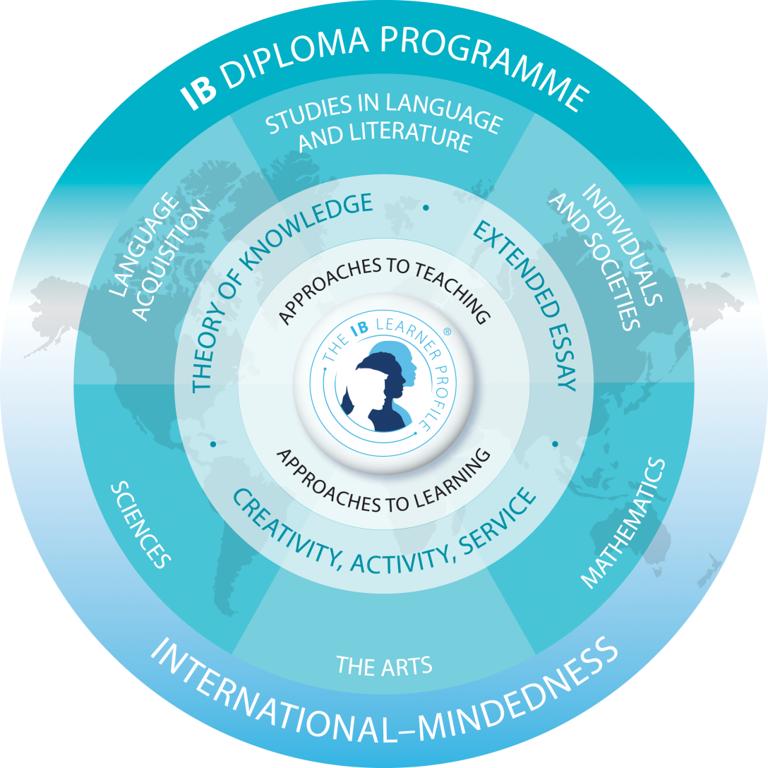
Full Diploma

Slide 3
Full Diploma
You must choose one course from each GROUP—3 HL plus 3 SL
1: English HL
2: French B SL or Spanish Ab Initio SL
3: History HL or Psych HL
4: Biology HL or Chemistry HL
5: Mathematics Analysis (double credit) or Math Applications (single credit)
6: Art, Music, Business Management, Bio, Chem, Physics SL—choose both grade 11 and 12 Course Codes
*Maximum of 2 sciences
Plus Choose TOK (HZT 4UW)
EE and CAS will be done outside of your timetable

Slide 4
Guidelines for IB: Full Diploma
Full Diploma Students Must:
Choose 3 HL courses
Choose 3 SL courses
You must have one subject from each GROUP
Choose Theory of Knowledge in Grade 11
Complete Extended Essay and CAS requirement over Grade 11 and 12
You may not take more than 2 IB sciences
A third Ontario Science can be taken at summer/night school or on-line
In May/June, we will have an assembly to go over CAS and EE information

Slide 5
Partial IB (Course Students)
You may choose any combination of courses
Maximum of 3 HLs
Some combinations will not fit into our timetable and you need to be prepared for conflicts
Fees will be determined by the number of courses you select
You will not complete TOK, EE or CAS
You must satisfy the 40 Hours Community Service for you Ontario Diploma by completing the proper form

Slide 6
Guidelines for IB: Partial Diploma
Students who choose to do SOME IB courses should:
Choose between 2 and 5 IB courses
Any combination of SL and HL may be selected but our timetable works best with no more than 3 HLs
Students may not usually:
Take Theory of Knowledge at the IB level

Slide 7
How do I decide?
We can not TELL you whether to do Full Diploma or Partial Courses
You must research requirements of University Programs you wish to pursue
Come to Course Selection Info Night on Wednesday Feb 13th to hear presentations from the different subject areas
Ultimately, you must thoughtfully decide which route you wish to pursue

Slide 8
IB Pathways for University
University Pathway | HL | SL
Arts and Humanities | English History OR Psychology Biology | Spanish OR French Math Applications Music OR Art OR Bus Mgmt
Business | English History OR Psychology Biology | Spanish OR French Math Ana OR Math App Music OR Art OR Bus Mgmt
Medical/Health Sciences | English History OR Psychology Biology | Spanish OR French Math Analysis Chemistry
Engineering and Math | English History OR Psychology Chemistry | Spanish or French Math Analysis Physics
Architecture | English History OR Psychology Biology | Spanish or French Math Analysis Physics OR Art
*All FD students must complete Theory of Knowledge, EE and CAS

Slide 9
Electives—GROUP 6
Business: Business Management-SL
Music: IB Music-SL
Science: Chemistry SL, Physics SL,
Biology SL
Visual Arts: IB Art SL

Slide 10
Fees
 | Grade 11 (Paid May gr 10) | Grade 12 (Paid May gr 11)
Full Diploma | $1100 | $1100
6 courses (no EE, TOK, CAS) | $1000 | $1000
5 courses | $885 | $885
4 courses | $770 | $770
3 courses | $655 | $655
2 courses | $540 | $540
1 course | $850 all due year 1 | -

Slide 11
Grade 9 and 10 Pre IB Course Selection Info Night
Wednesday February 13
7 pm
Cafeteria
Students and Parents are invited to attend
Presentations by: Art, Business, History/Psych, Music, Science

Slide 12
Questions?

