Slide 1
Welcome! Please fill all available seats from FRONT to BACK. Thank you!

Slide 2
Centennial P.S. Grade 8 to 9 Transition Information Night

Slide 3
HELPING YOU PLAN FOR SUCCESS
Provide introductory information about the transition process
Connect students and families with sources for further information
Guidance Contacts:
Mrs. Spoltore and Mme Simmons

Slide 4
YOUR BROCHURE
Secondary School information nights
Magnet programs
Course selection
Graduation requirements
Contact info for each home and magnet secondary school

Slide 5
GENERAL TIMELINES
November 2018 -Discussion about transition to Grade 9 begins
December 2018 -Evening info meetings at secondary schools begin
-Class guidance visits begin (share transition information)
January 2019 -Confirm registration procedures, destination schools
January 18, 2019 -Magnet applications due to secondary schools
February 8, 2019 - Magnet declaration of intent
February 15, 2019 -Term 1 report cards go home
-Prepare for online course registration
February 15, 2019 -Online course registration (MyWay) opens*
February 26, 2019 -Online course registration (MyWay) closes
-Signed course confirmation pages returned to school

Slide 6
HOME SECONDARY SCHOOLS
Students are expected to attend their home school, unless they are applying for a Board-designated specialty (“magnet”) program
Home school determined by home address
It is important that each student confirms his/her home secondary school
https://bpweb.stswr.ca School Finder

Slide 7
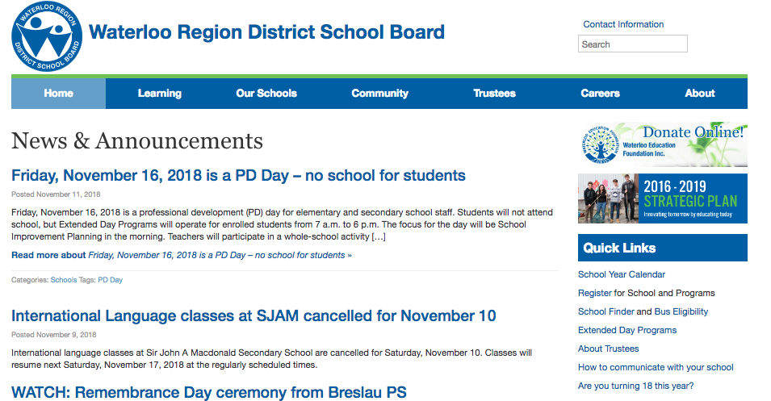
SCHOOL FINDER at WRDSB.CA

Slide 8
OUT-OF-BOUNDARY REQUESTS
Typically, high schools do not consider out-of-boundary requests except for medical or safety reasons
Requests will not be honoured for other reasons
Students requesting attendance at a different school from their home school, must submit an 8-9 Transfer Request form (available from the office) to Centennial office TBD

Slide 9
SECONDARY SCHOOL “MAGNET” PROGRAMS
Cameron Heights offers an International Baccalaureate (I.B.) Program
Eastwood Collegiate offers an Integrated Arts Program
Kitchener-Waterloo CI offers French Immersion or Extended French
KCI and SJAM offer the Fast Forward school-to-work program – designed to develop sector certification
Waterloo C.I. offers ESL/ELD and Advanced Strings Program*
*ONLY for students currently enrolled in Strings, or who can demonstrate
previous experience/private lessons

Slide 10
PROGRAM APPLICATION
Current ESL/ELD, French Immersion and/or Strings students may continue in these programs without special application
All other students must apply and/or audition for specialty programs

Slide 11
SECONDARY SCHOOL FRENCH PROGRAMS
Core French students continue in that program
Destination Schools for French Immersion Students
If Your Home School Is… | French Immersion is offered at… | Extended French is offered at… | Enriched Academic French is offered at…
KCI | @ KCI | @ KCI | -
WCI | @ KCI | @ WCI | -
SJAM | @ KCI | @ KCI | @SJAM

Slide 12
ONTARIO SECONDARY SCHOOL DIPLOMA
30 Credits (A credit is 110 hours of successful study in any subject area)
18 Compulsory credits or subjects
12 Optional credits or elective subjects (3 electives/year)
40 Hours of community involvement
Successful performance on the grade 10 literacy test

Slide 13
COMMUNITY INVOLVEMENT
Minimum 40 hours by end of Grade 12
Wide range of volunteer activities recognized
Can begin July 2019, right after Grade 8
Students complete and track required hours and submit to high school guidance dept.

Slide 14
GRADE 10 LITERACY TEST
Students take a literacy test in grade 10 (March-April) and must pass the test to graduate
Achievement is recorded on student record
Based on language and communication expectations of the curriculum, up to and including grade nine
Remedial help is offered before retake

Slide 15
MAKING CHOICES for GRADE 9
Students and parents need to make decisions about:
Which compulsory courses to select (academic or applied) - may be a combination of both types
Teachers will provide course recommendations (applied or academic) based on students’ learning styles. Please carefully consider their recommendations.
2. Which elective courses to choose (open courses)

Slide 16
MAKING CHOICES for GRADE 9
Compulsory Courses:
Applied / Academic
English
Mathematics (EQAO)
Science
French
Canadian Geography
Electives:
Open
The Arts (music, visual arts, drama)
Business Studies (intro to business and information technology)
Technology Education
Health & Physical Education
Food and Nutrition
Individual and Family Living

Slide 17
APPLIED COURSES
* Expose students to both theoretical and practical applications, but emphasis is on PRACTICAL APPLICATIONS
* Concepts relate to familiar real-life
situations and provide students with the opportunities for practical, hands-on application of concepts.

Slide 18
ACADEMIC COURSES
* Cover enduring concepts plus additional material
* Study of both theoretical and practical applications,
with greater emphasis on THEORY as a basis for
future learning and problem solving
Analysis
Investigation
Interpretation

Slide 19
OPEN COURSES (Electives)
Open courses have one set of expectations
Courses tend to be based on experiential learning (e.g. Art, Drama, Technology, Phys.Ed., etc.)

Slide 20
CHANGING ACADEMIC OR APPLIED STREAMS
Students are able to move from APPLIED courses in grade nine to ACADEMIC courses in grade ten (Except Math: Student in grade 9 applied wanting to take grade 10 academic, must take grade 9 academic first
Students can move from ACADEMIC courses in grade nine to APPLIED courses in grade ten
Important to choose the right courses; changes during the term are very difficult and often not possible

Slide 21
GRADE ELEVEN AND
TWELVE COURSES
Workplace / Apprenticeship
College / Apprenticeship
College / University
University
Career exploration important

Slide 22
POINTS TO REMEMBER
Streams chosen in grade 9 DO NOT LIMIT streams chosen in grade 10, but additional coursework may be required in order to make the change
FOUR year program is intended, but NOT required
Grade 10 LITERACY TEST – successful completion required for graduation
40 hours of community involvement is also required for graduation

Slide 23
TIMELINE REVIEW
November 2018 -Discussion about transition to Grade 9 begins
December 2018 -Evening info meetings at secondary schools begin
-Class guidance visits begin (share transition
information)
January 2019 -Confirm registration procedures, destination schools
January 18, 2019 -Magnet applications due to secondary schools
February 8, 2019 - Magnet - declaration of intent
February 15, 2019 -Term 1 report cards go home
-Prepare for online course registration
February 15, 2019 -Online course registration (MyWay) opens*
February 26, 2019 -Online course registration (MyWay) closes
-Signed course confirmation pages returned to school

Slide 24
Questions ?
For more information, please visit our Guidance Google classroom using the code: esgdpt4.
Students are also encouraged to check the information bulletin board across from the guidance office.

Slide 25
Guidance Google
Classroom Code:
esgdpt4

Slide 26
Help Needed!
Please stack BLUE chairs on
the chair racks .
Thank you!
THANK YOU FOR COMING!

