Slide 1

The 2015 Health and Physical Education Curriculum
Overview for Parents
Notes:
Speaker’s Notes:
[Welcoming Remarks - Personalize for your own context]
Implementation of the Revised Health and Physical Education Curriculum, Grade 1 -12 in Ontario Schools begins in September 2015.
This presentation was developed jointly by the Ontario Principals’ Council and the Catholic Principals’ Council of Ontario.
[Note: Throughout these notes the term parent refers to parents, caregivers and guardians]

Slide 2

The 2015 Health and Physical Education Curriculum
Notes:
Speaker’s Notes:
[Welcoming Remarks - Personalize for your own context]
Implementation of the Revised Health and Physical Education Curriculum, Grade 1 -12 in Ontario Schools begins in September 2015.
This presentation was developed jointly by the Ontario Principals’ Council and the Catholic Principals’ Council of Ontario.
[Note: Throughout these notes the term parent refers to parents, caregivers and guardians]

Slide 3
This session will provide information on
1
Changes to the Health and Physical Education (HPE) Curriculum
2
The roles of educators and parents in supporting student learning
3
Resources available to support parents
Notes:
Speaker’s Notes:
The goal of this presentation is to provide you with a deeper understanding of what students will learn through the HPE curriculum, and share some of the resources that are available online in a number of languages.

Slide 4
Quote from Strategy
When parents are engaged and involved, everyone benefits and our schools become increasingly rich and positive places to teach, learn and grow.
“
“
Supporting the Ontario Leadership Strategy, 2012, p.1
Notes:
Speaker’s Notes:
Parents play a central role in their child’s learning. Studies show that student perform better in school if their parents are involved in their education. Parents are the primary educators of their children with respect to learning values, appropriate behavior, and ethnocultural, spiritual and personal beliefs and traditions. Parents are their children’s first role model (HPE Elementary Curriculum, pg 13).

Slide 5

Renewed Vision for Education in Ontario
Achieving Excellence
Ensuring Equity
Enhancing Public Confidence
Promoting Well-Being
Notes:
Speaker’s Notes:
The Health and Physical Education curriculum supports all aspects of the renewed vision for education in Ontario. A copy of the Renewed Vision can be found on line at http://www.edu.gov.on.ca/eng/about/renewedVision.pdf
Our renewed goals for education are:
Achieving Excellence: Children and students of all ages will achieve high levels of academic performance, acquire valuable skills and demonstrate good citizenship. Educators will be supported in learning continuously and will be recognized as among the best in the world.
Ensuring Equity: In Ontario, we envision an inclusive education system in Ontario in which all students, parents, and other members of the school community are welcomed and respected; every student is supported and inspired to succeed in a culture of high expectations for learning.
All children and students will be inspired to reach their full potential, with access to rich learning experiences that begin at birth and continue into adulthood.
Promoting Well-Being: All children and students will develop enhanced mental and physical health, a positive sense of self and belonging, and the skills to make positive choices.
Enhancing Public Confidence: Ontarians will continue to have confidence in a publicly funded education system that helps develop new generations of confident, capable and caring citizens.
These four goals are interconnected – success in one contributes to success in the others. Our progress over the last 10 years tells us that when educators, students, parents and guardians, and our many other partners focus on a small number of clearly defined goals, those goals can be achieved.

Slide 6

The curriculum includes:
Overall Expectations
Specific Expectations
Optional Examples and Prompts (sample teacher questions and student responses)
Notes:
Speaker’s Notes
Like all Ontario curriculum, the health and physical education curriculum has overall and specific expectations, which define the knowledge and skills students are expected to know and be able to demonstrate in each subject at each grade. The curriculum also includes optional prompts and examples.
It is important to note the optional prompts and sample responses are meant to show what conversation and topics could look like in a classroom, but these are not mandatory. They are not a script, but are included to help prompt thinking, guide planning and anticipate questions that could arise in class. Teachers should use their professional judgment in using the examples and sample questions as they develop their lessons.
Additional Information:
For clarity on prompts and examples of student responses refer to: page 20 in the 1-8 and page 25 in the 9-12 document
When playing slide show, click to see examples of overall expectations, specific expectations, examples and prompts

Slide 7
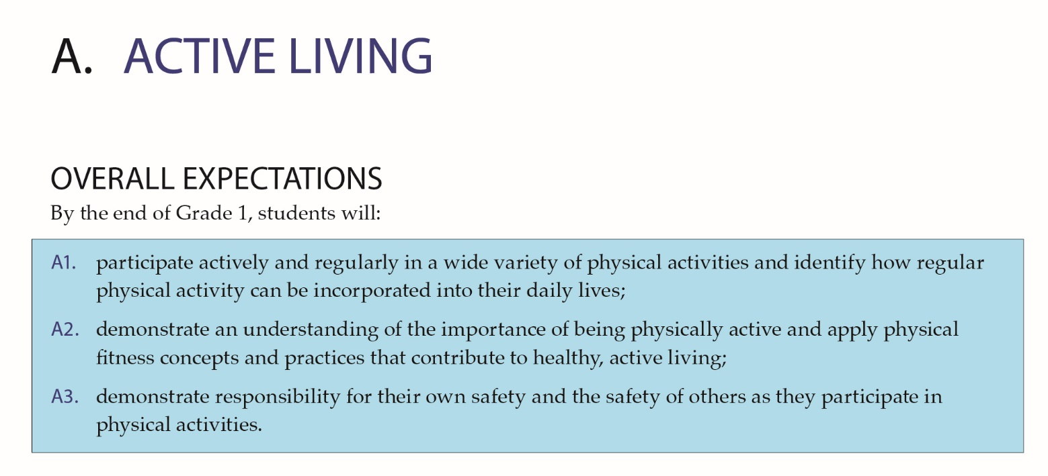
Notes:
Speaker’s Notes
Like all Ontario curriculum, the health and physical education curriculum has overall and specific expectations, which define the knowledge and skills students are expected to know and be able to demonstrate in each subject at each grade. The curriculum also includes optional prompts and examples.
It is important to note the optional prompts and sample responses are meant to show what conversation and topics could look like in a classroom, but these are not mandatory. They are not a script, but are included to help prompt thinking, guide planning and anticipate questions that could arise in class. Teachers should use their professional judgment in using the examples and sample questions as they develop their lessons.
Additional Information:
For clarity on prompts and examples of student responses refer to: page 20 in the 1-8 and page 25 in the 9-12 document
When playing slide show, click to see examples of overall expectations, specific expectations, examples and prompts

Slide 8
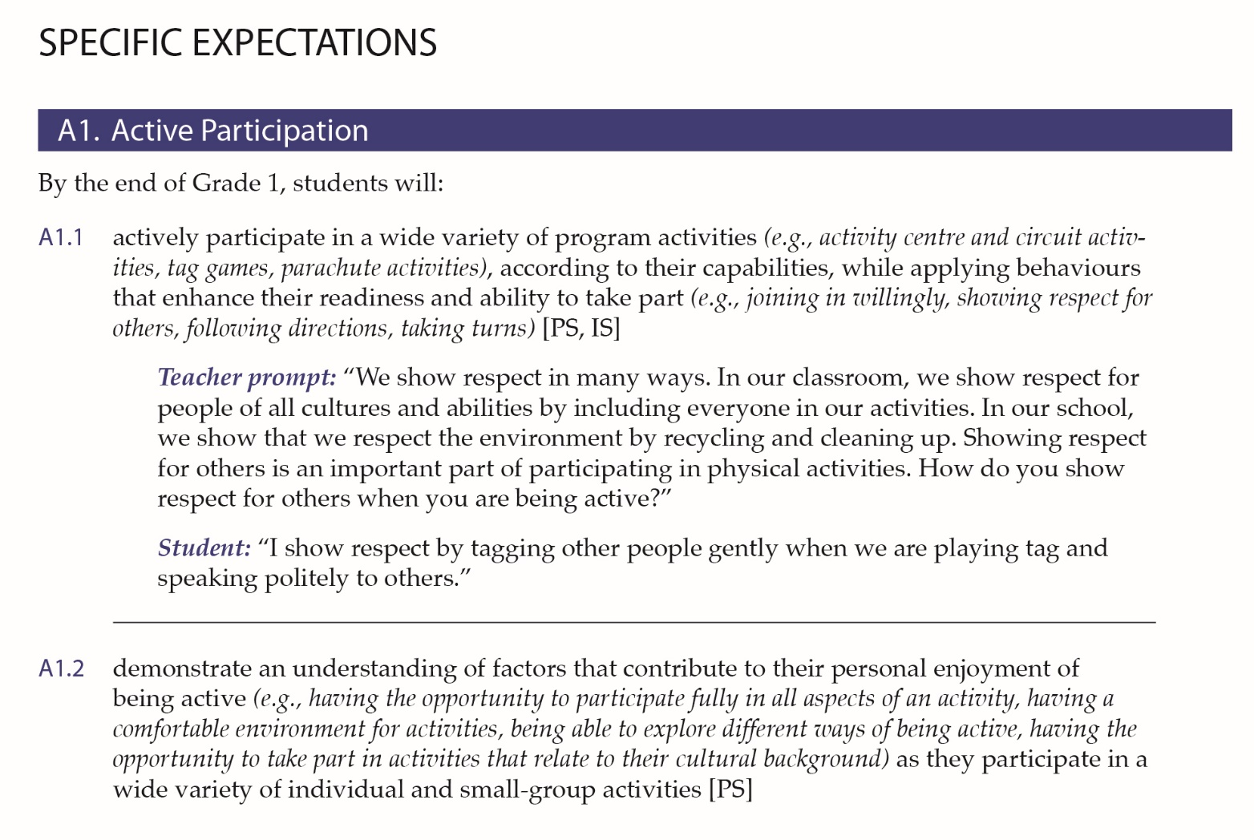
Notes:
Speaker’s Notes
Like all Ontario curriculum, the health and physical education curriculum has overall and specific expectations, which define the knowledge and skills students are expected to know and be able to demonstrate in each subject at each grade. The curriculum also includes optional prompts and examples.
It is important to note the optional prompts and sample responses are meant to show what conversation and topics could look like in a classroom, but these are not mandatory. They are not a script, but are included to help prompt thinking, guide planning and anticipate questions that could arise in class. Teachers should use their professional judgment in using the examples and sample questions as they develop their lessons.
Additional Information:
For clarity on prompts and examples of student responses refer to: page 20 in the 1-8 and page 25 in the 9-12 document
When playing slide show, click to see examples of overall expectations, specific expectations, examples and prompts

Slide 9

Ontario Curriculum…
Is based on research and extensive consultation with thousands of people, including educators, parents, students, education partners and experts at a variety of stages throughout the process.
Is updated to ensure that what students learn is current, relevant and meets the needs of Ontario’s diverse learners.
Notes:
Speaker’s Notes:
All Ontario curriculum is based on research and extensive consultation and the implementation of the curriculum is mandatory in publicly funded Catholic and public schools.
Curriculum is updated to ensure that what students learn is relevant and current and meets the needs of Ontario’s diverse learners.
Thousands of people were involved in the review and development of the Health and Physical Education curriculum – educators, students, parents, public health, stakeholders, universities/faculties of education and a wide range of experts.
In Fall 2014 there was an additional parent consultation where a member of each elementary school council was invited to complete an online survey.
Research, expert advice and input from a range of people, including parents, teachers and students, helped to inform the content of the curriculum.

Slide 10


Youth Realities
Notes:
Speaker’s Notes:
The world of our youth today is constantly changing. A current and updated curriculum helps students develop the knowledge and skills they need to thrive in today’s world. The following brief video describes some of the skills our learners require to be successful in the future.
Show video: www.edu.gov.on.ca/eng/about/excellent.html

Slide 11
Students will learn to…
Understand themselves and others
Think critically and make healthy choices
Develop and maintain healthy relationships
Be safe physically and emotionally
Be physically active for life
Notes:
Speaker’s Notes:
The updated HPE Curriculum will help today’s students meet the opportunities and challenges of growing up by supporting them to:
-understand themselves and others
-think critically and make and promote health choices
-develop and maintain healthy relationships
-be safe physically and emotionally
-be physically active for life and thrive
The following few slides will provide some examples of the content and concepts students will be learning in these areas.
Additional Information:
More detailed information is found in the Parent Guides available on the Ministry Website and referenced at the end of this presentation.

Slide 12
Understand themselves and others
Younger students learn:
  What makes them unique
  How important it is to respect and understand differences in others
  To identify, set, track and adjust personal fitness goals
Older students learn:
  To understand and deal with mental health and related challenges
  How to work with others to find solutions to health and safety issues (e.g., the dangers of texting while driving)
Notes:
Speaker’s Notes:
Students are learning to understand themselves and others.

Slide 13
Think critically and make healthy choices
Younger students learn:
  The benefits of less screen time and more outdoor time
  Hygiene practices like hand washing to prevent the spread of diseases
Older students learn:
  How to make healthy food choices, taking into account things like cost, availability, nutrition and other issues
  Understand the effects of alcohol, tobacco, illegal drugs and prescription medication
Notes:
Speaker’s Notes:
Students are developing their ability to think critically and make healthy choices

Slide 14
Develop and maintain healthy relationships
Younger students learn:
  Teamwork and communication skills through physical activities
  How to be a good friend and respectfully communicate with others
Older students learn:
  Consent requires clear and intentional communication of personal boundaries and respect for the boundaries of others
  The importance of respecting themselves and others including people of all gender identities, sexual orientations, mental and physical abilities, and social and cultural backgrounds
Notes:
Speaker’s Notes:
Students are learning skills that will help them to develop and maintain healthy relationships

Slide 15
Be safe physically and emotionally
Younger students learn:
  To listen and show respect when others ask them to stop doing something
  To make safe choices, like wearing a helmet when riding a bike
Older students learn:
  The social, emotional and legal implications of posting or forwarding sexually explicit photos (i.e. sexting)
  To watch for hazards when they are active in outdoor sports
Notes:
Speaker’s Notes:
Throughout the curriculum, students are learning to be safe – physically and emotionally.

Slide 16
Be physically active for life
Younger students learn:
  To move with confidence and skill in a variety of physical activities
  To be physically active for their health and well-being, for fun, friendship and stress management
Older students learn:
  To choose daily physical activities that they enjoy, suit their abilities, fit into their daily lives and help them meet other fitness goals
  To use what they know in order to be healthy and active and be role models for others
Notes:
Speaker’s Notes:
In Health and Physical Education, students have an opportunity to participate in a variety of activities and sports, to develop skills for being physically active for life.

Slide 17

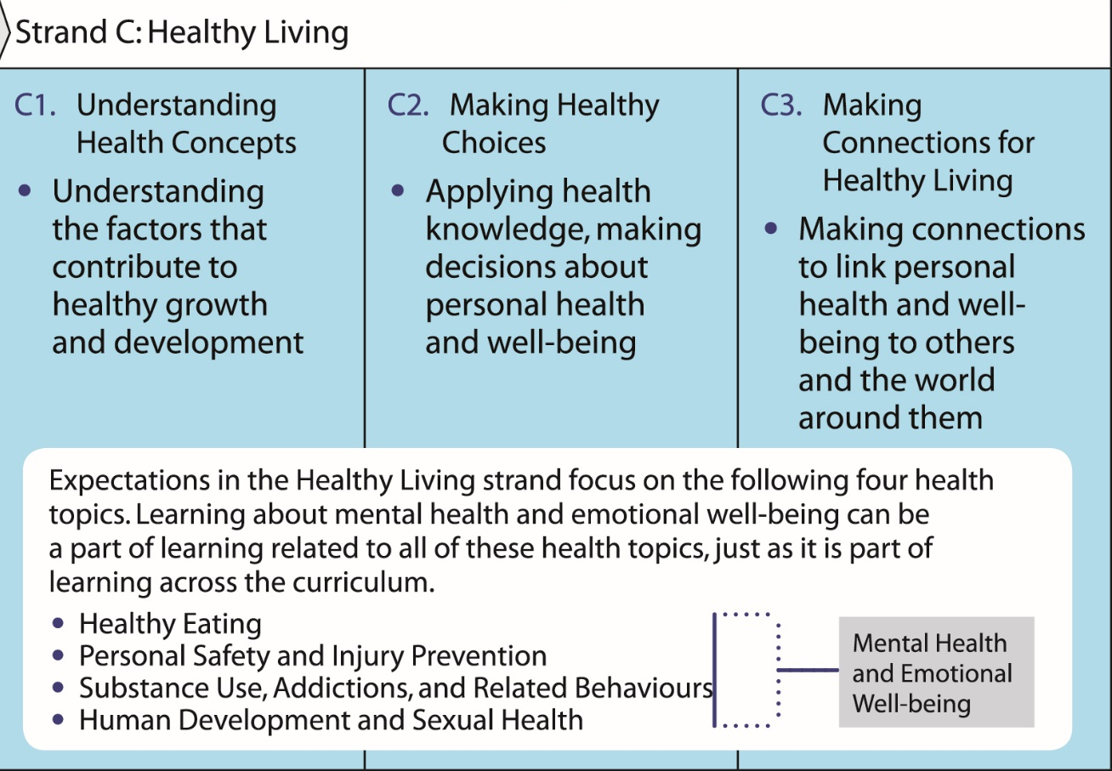
Healthy Living: A Closer Look
Notes:
Speaker’s Notes:
The way that students learn about Health Education has changed. The updated curriculum is not about memorizing health facts and diagrams. Students are learning about things that are important to their safety and well-being. They are learning about healthy eating, safety and injury prevention, substance use and addictions, mental health as well as sexual health. They learn to apply their knowledge to make healthy choices and to consider how their health is influenced by (or influences) the world around them.
Human development and sexual health is one part of the overall health and well-being. It involves learning about oneself and others, about skills for healthy relationships and about social and emotional skills.

Slide 18

Grades 1-3: Human Development and Sexual Health
Students are learning about:
The names of body parts
An initial understanding of how bodies work
Skills for healthy, respectful relationships with peers and families
Their senses, hygiene, oral health and stages of development
Physical health as one part of overall health and well-being
Feelings and emotional awareness and to get help if needed
Social and emotional health (e.g., getting along with others, recognizing their feelings, learning coping skills, etc.)
Notes:
Additional Information:
Learning about human development and sexual health is one part of learning about overall health and well-being. It involves learning about oneself and others, about skills for healthy relationships and about social and emotional skills.
Use this slide to provide more information about the human development and sexual health part of the curriculum. The information is taken from the parent guide (Human Development and Sexual Health, Grades 1-6).
The terminology used in the prompts and examples relating to Human Development and Sexual Health is factual and straightforward, as experts advise that this approach can help de-stigmatize concepts associated with sexuality. If parents have questions or concerns about specific topics in the curriculum, it may be helpful to explain to the purpose of optional prompts and examples.

Slide 19
Grades 4-6: Human Development and Sexual Health
Students are learning:
About the physical changes that occur during puberty
About the emotional and interpersonal changes and stresses that come with puberty
To understand reproductive and bodily processes
More about healthy relationships
Notes:
Speaker’s Notes:
Learning about human development and sexual health is one part of learning about overall health and well-being. It involves learning about oneself and others, about skills for healthy relationships and about social and emotional skills.
Use this slide to provide more information about the human development and sexual health part of the curriculum. The information is taken from the parent guide (Human Development and Sexual Health, Grades 1-6).
The terminology used in the prompts and examples relating to Human Development and Sexual Health is factual and straightforward, as experts advise that this approach can help de-stigmatize concepts associated with sexuality. If parents have questions or concerns about specific topics in the curriculum, it may be helpful to explain to the purpose of optional prompts and examples.

Slide 20
Grades 7-12: Human Development and Sexual Health
Students are learning:
Identity, personal safety, decision making and relationships with peers, family and romantic partners
Delaying sexual activity
Preventing sexually transmitted infections and pregnancy
Factors that influence decisions (e.g., peers, media and information)
Resources related to sexual health such as public health services, community health agencies, reliable and accurate websites
Notes:
Speaker’s Notes:
Learning about human development and sexual health is one part of learning about overall health and well-being. It involves learning about oneself and others, about skills for healthy relationships and about social and emotional skills.
Use this slide to provide more information about the human development and sexual health part of the curriculum. The information is taken from the parent guide (Human Development and Sexual Health, Grades 7-12).
The terminology used in the prompts and examples relating to Human Development and Sexual Health is factual and straightforward, as experts advise that this approach can help de-stigmatize concepts associated with sexuality. If parents have questions or concerns about specific topics in the curriculum, it may be helpful to explain to the purpose of optional prompts and examples.

Slide 21





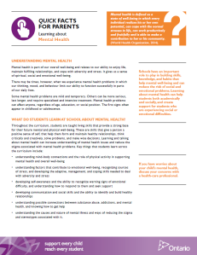
Resources for Parents
Curriculum Guides and Overviews:
Grade-by-Grade Curriculum Overviews
Guide to Revised HPE Curriculum, Grades 1-12
Guides to Human Development and Sexual Health in the HPE
Curriculum, for Grades 1-6 and for Grades 7-12
Overview of Sexual Health Component (Ontario.ca\HPE)
Quick Facts for Parents – Learning About:
  Healthy Relationships and Consent
  Online Safety, including Risks of Sexting
  Mental Health
  Concussions
  Staying Safe
  Active Transportation
Notes:
Speaker’s Notes:
The Ministry of Education has created a series of resources for parents about the Health and Physical Education curriculum, including guides for each grade.
The materials provide an overview about what students will learn in each grade, and why the learning is important to a child’s safety and well-being. There are also ideas for how you can support your child’s learning at home, and links to more information.
These materials include:
Parent Guide: Revised Health and Physical Education Curriculum, Grades 1 to 12 – overview of the whole curriculum
Two Parent Guides – one for Grades 1-6, and one for Grades 7-12 – that focus on the Human Development and Sexual Health part of the curriculum. Please note that these guides have been produced by the Ministry and available on the website.
Quick Facts for parents: Healthy Relationships and Consent – research based information and considerations for parents to support their child’s learning at home
Quick Facts for parents: Online Safety, including sexting – research based information and considerations for parents to support their children
Additional Quick Facts new for Fall 2015: Mental Health, Concussions, Staying Safe, Active Transportation
Parent materials are available in a variety of languages on the ministry website

Slide 22
How can you support your child at home?
Be Involved
Be a learner
Be a role model
Be a guide
Notes:
Speaker’s Notes:
Here are some ideas from the ministry’s parent materials for how parents can support their child’s learning and healthy development at home.
Being Involved:
Consider what you can do together that is fun and also healthy – physically activity
Listen with full attention
Communicate with school
Answer questions in a factual straightforward way
Being a Learner:
Ask your child and your child’s teachers about what they are learning at school
Learn the basics about staying safe online especially when using social media
Find about community services and resources that are available locally
Be informed about the correct information
Being a Role Model:
Consider your influence on your child when crossing the road, driving, make food choices
Building understanding of your child’s perspective by questioning and sharing viewpoints
Being a Guide:
Help your child understand their strengths and set goals,
Encourage active transportation when possible
Help your child to recognize their feelings and what is stressful for them, and help them to find ways to manage them.

Slide 23

Working Together
Building partnership with home and school…
Notes:
Speaker’s Notes:
As a school, our priority is to build positive relationships between home and school and to provide a welcoming school climate for all students and their families. As a part of effective teaching practice, teachers communicate with parents about what their children are learning – in all parts of the program. We encourage parents to review the documents and digest the information. If you have specific questions about your child’s HPE program, please set up a time to meet your child’s teacher to discuss this in further detail. We invite ongoing communication about all aspects of what your child is learning at school.
Parents, students, teachers and the community working together make a differences for student learning and well-being.
Additional Information:
Open Forum Questioning maybe challenging to allow all voices to be heard and give the time to each individual question
Encourage ongoing communication between parents and classroom teachers
The Parent Engagement Monograph will provide some ideas for how school staff can work together with the parents to support effective relationships and support the well-being of all students
See: www.edu.gov.on.ca/eng/literacynumeracy/inspire/research/CBS_parentEngage.pdf

Slide 24

Thank you
Notes:
Speaker’s Notes:
Thank you for your time.

