Slide 1
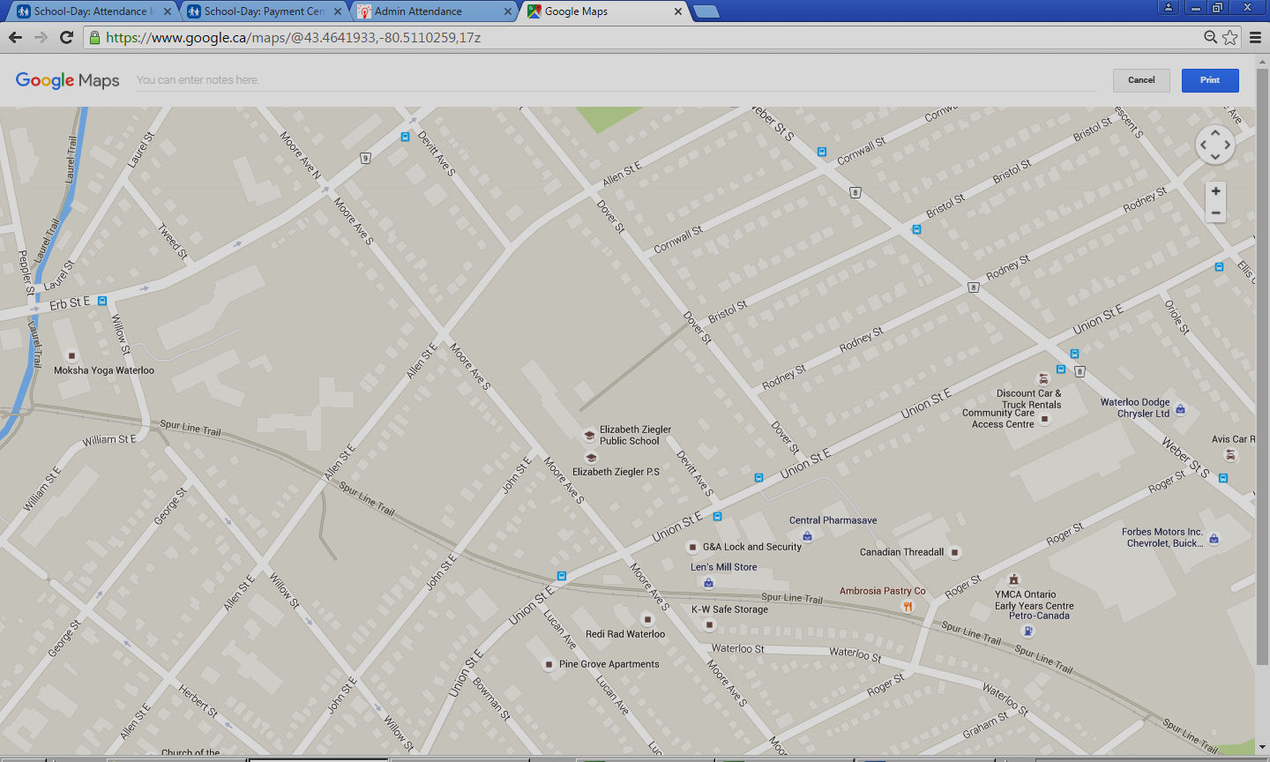
Parking Available in the Vicinity of Elizabeth Ziegler School
Please do not use the school parking lot for student pickup and drop off

