Slide 1
Welcome to Kindergarten
See you soon!
Take a moment to introduce yourselves in the chat and share something special about your family!
Notes:
This slide can be shown while waiting for attendees to arrive

Slide 2
Please Mute your microphone if you are not speaking. | Please turn off your camera as this helps the presentation run smoothly. | To “add to the discussion” please post in the chat.
Notes:
We are so excited that you’ve joined us for a fun and engaging event. You probably have lot of questions, and we have lots of information to share as well!
However, to ensure that the online presentation runs smoothly we are asking that participants mute themselves and turn off their camera. This will help to prevent technical issues that can occur when individuals do not have sufficient bandwidth to support the presentation. Also this ensures your privacy as we are recording the session so that you can view it again and we can share it with those who weren't able to join us live!

Slide 3
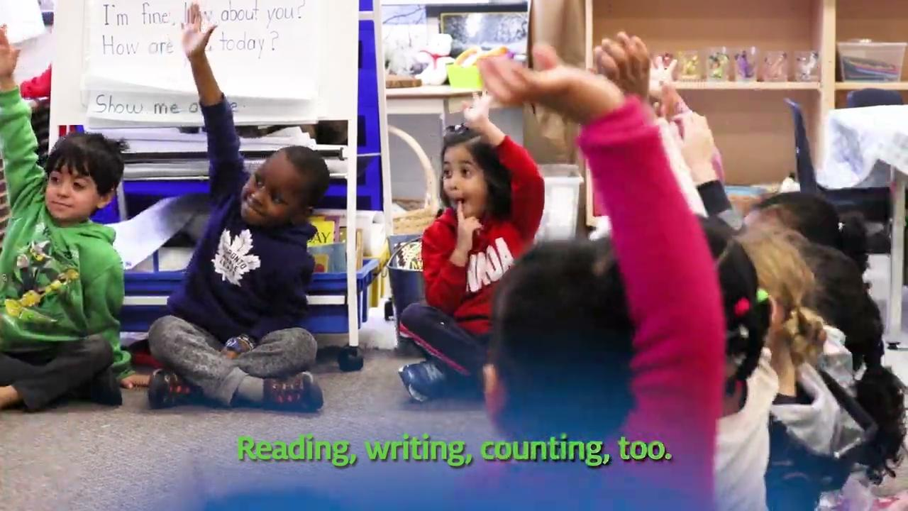
Kindergarten Here I Come!
Notes:
We’re about to get started - let’s enjoy singing along to this video! (34sec)
(Kindergarten Here I Come)

Slide 4
We Welcome All Languages!
For families who have a first language that is not English, there is a link being posted in the chat that will provide you with instructions to view the information in your first language.
Здравствуйте
Hola
مرحبا
ਸਤ ਸ੍ਰੀ ਅਕਾਲ
नमस्कार
hello
Kamusta
Notes:
Translatable doc template
For families who have a first language that is not English, we have created a template for a document that can be easily translated. You will have to update this document after the slide deck is complete. We will review that process later in this presentation.
You will need to add the link to the translatable slide to the chat stream during the live presentation.

Slide 5
Welcome To Kindergarten at Glencairn!
Notes:
A note here about having your WTK bag handy

Slide 6
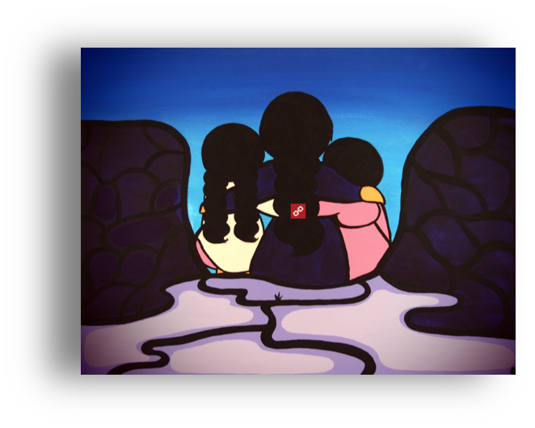
Notes:
Territorial Acknowledgment
“Family” by Christina McKay (2017) of OMAZINIBII’IGEG Artist Collective (Children of the Earth High School)
The Kindergarten Program, 2016: Learning and development happen within the context of relationships among children, families, educators and their environments.

Slide 7
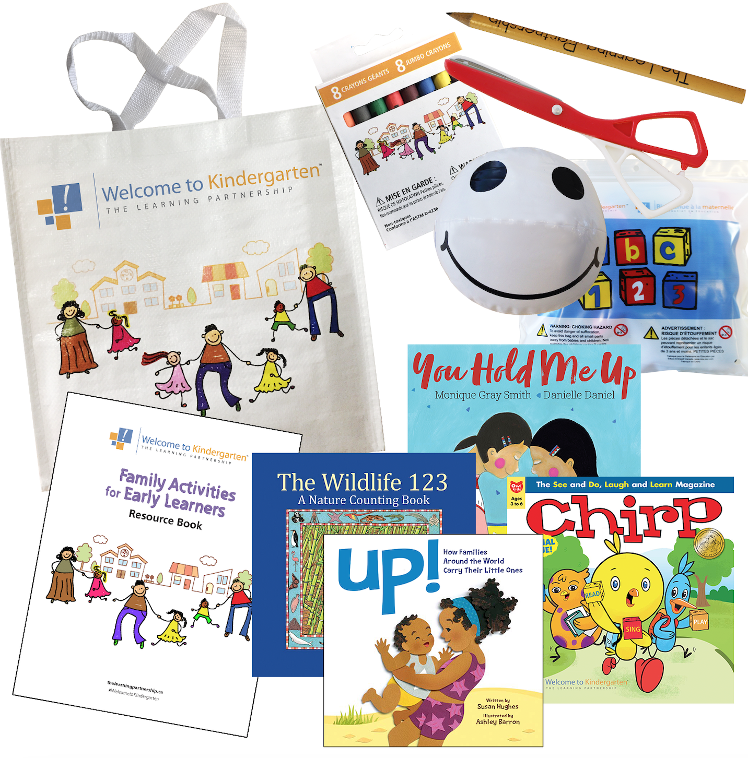
CREDITS
Your Welcome to Kindergarten Bag…
Your Welcome to Kindergarten bag is filled with many amazing materials and resources for talking, reading, singing and
playing together!
Pick an item or activity that you can enjoy together every day!
click on the picture to see a video about what’s in the bag
Notes:
https://www.youtube.com/watch?v=8uiCa4fRkMY (2:06) We’re going to unpack the bag together and have some fun...but before we get started, let’s meet our amazing team!

Slide 8
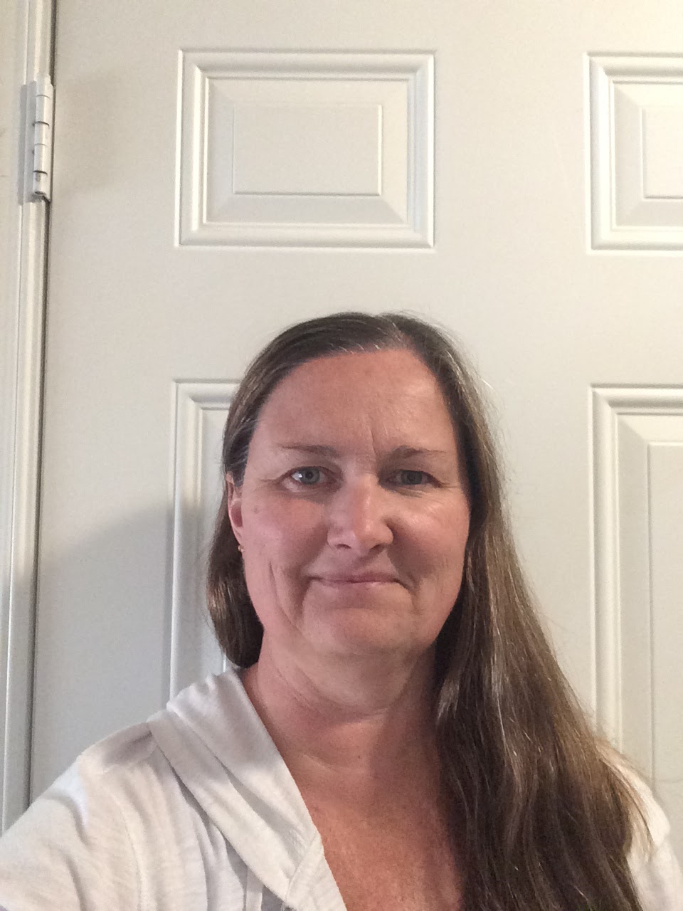
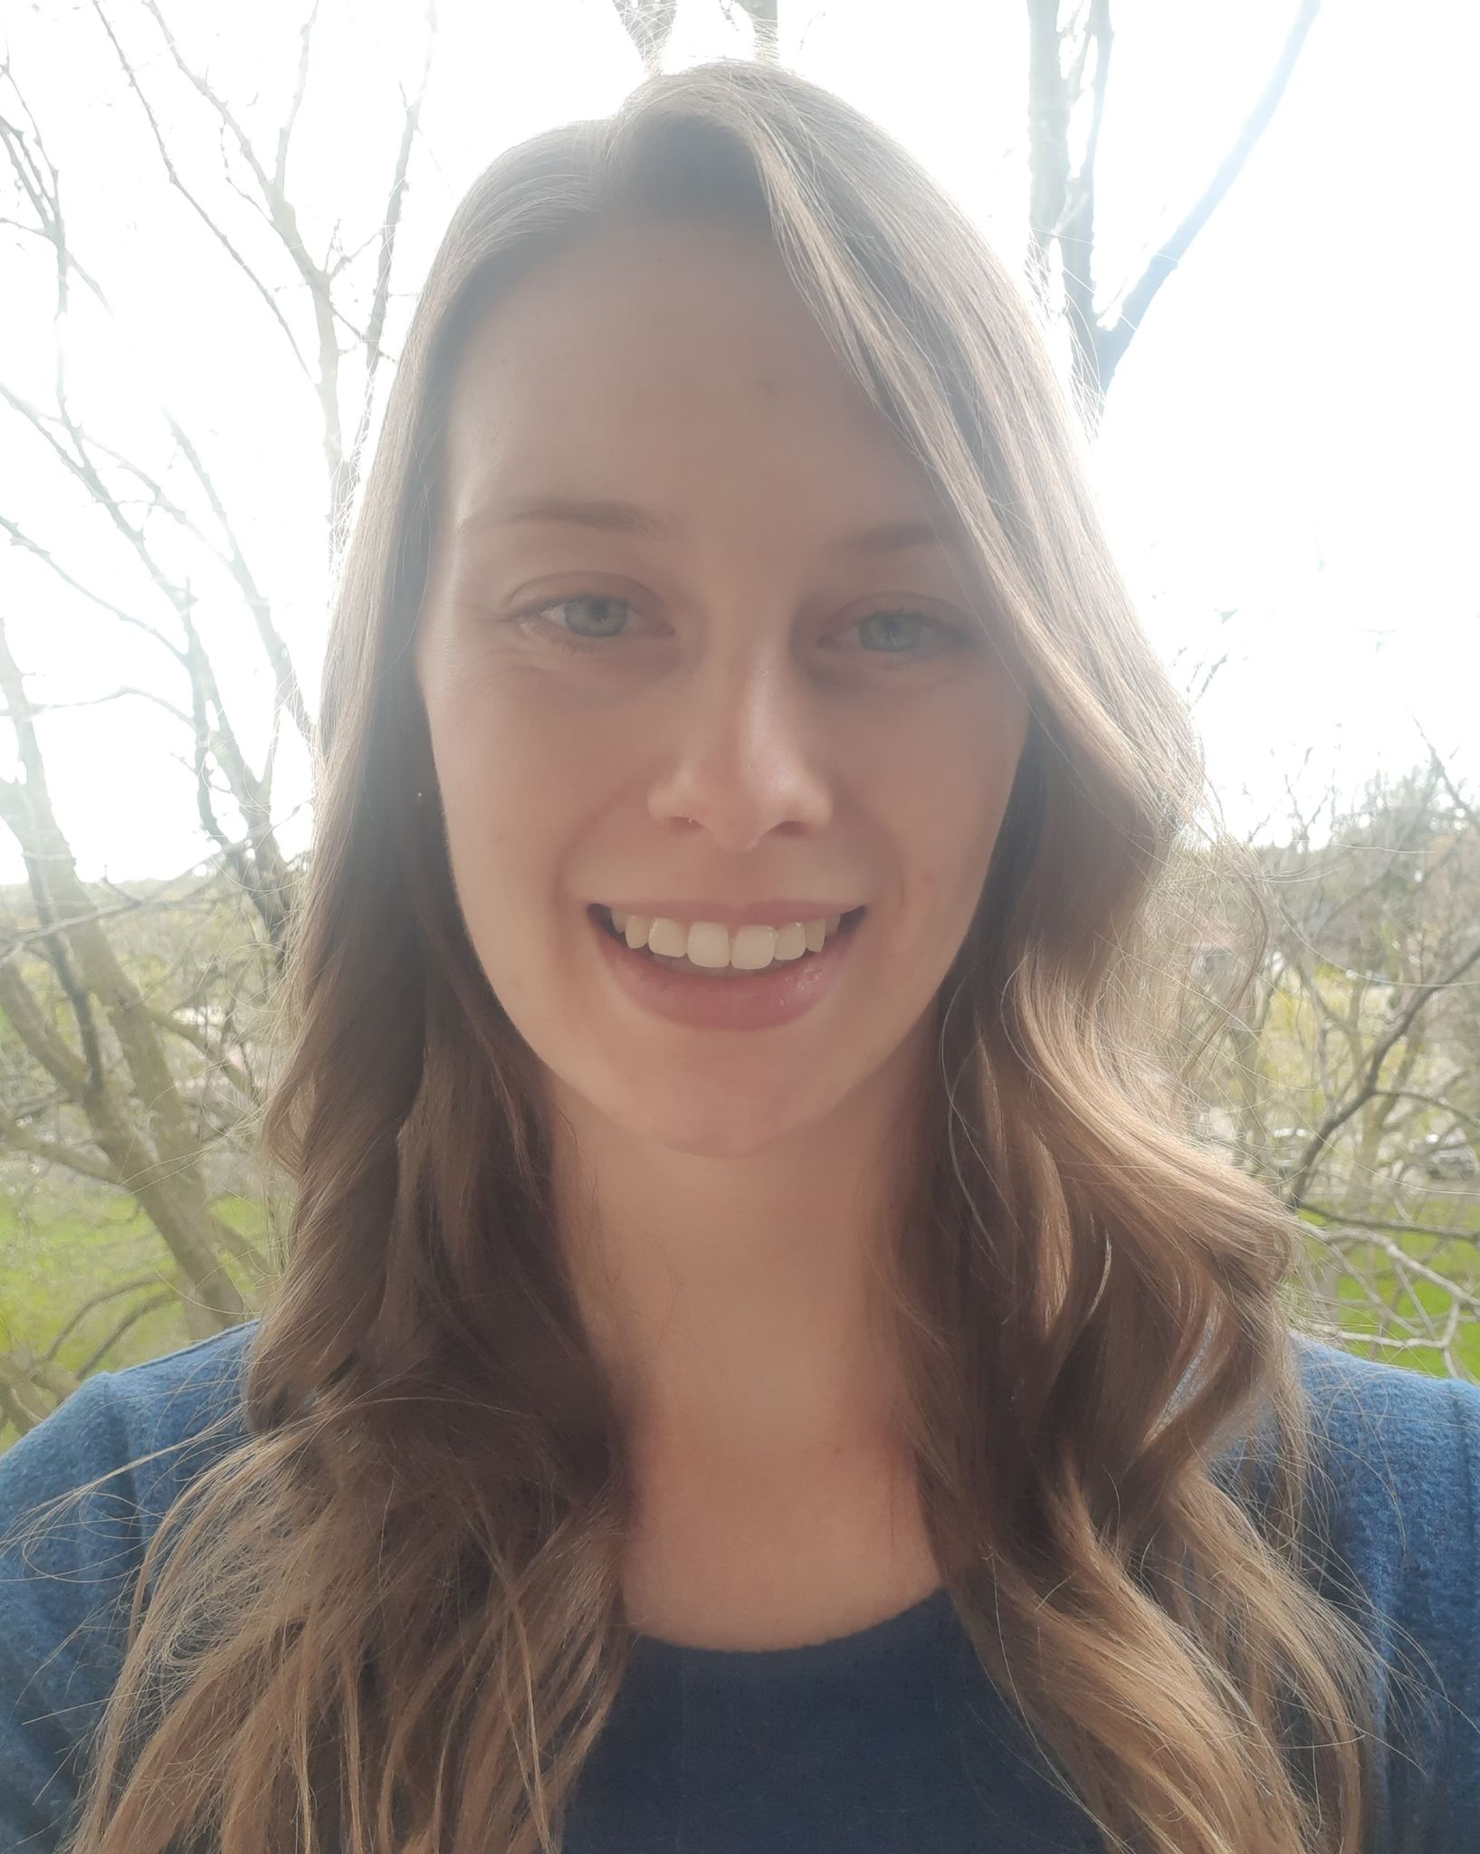
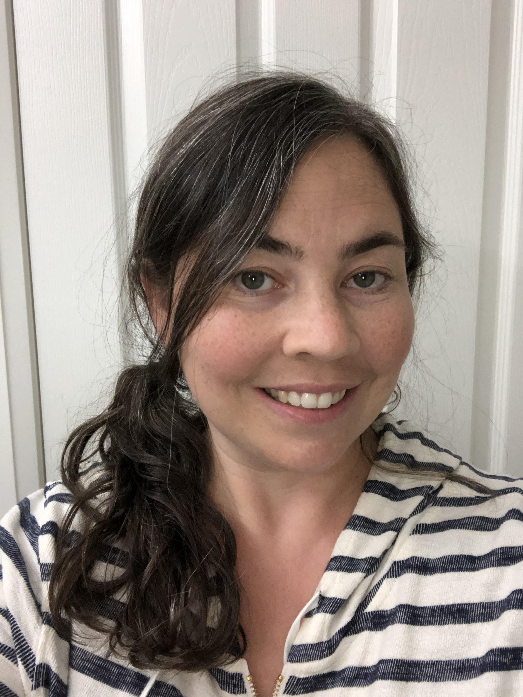
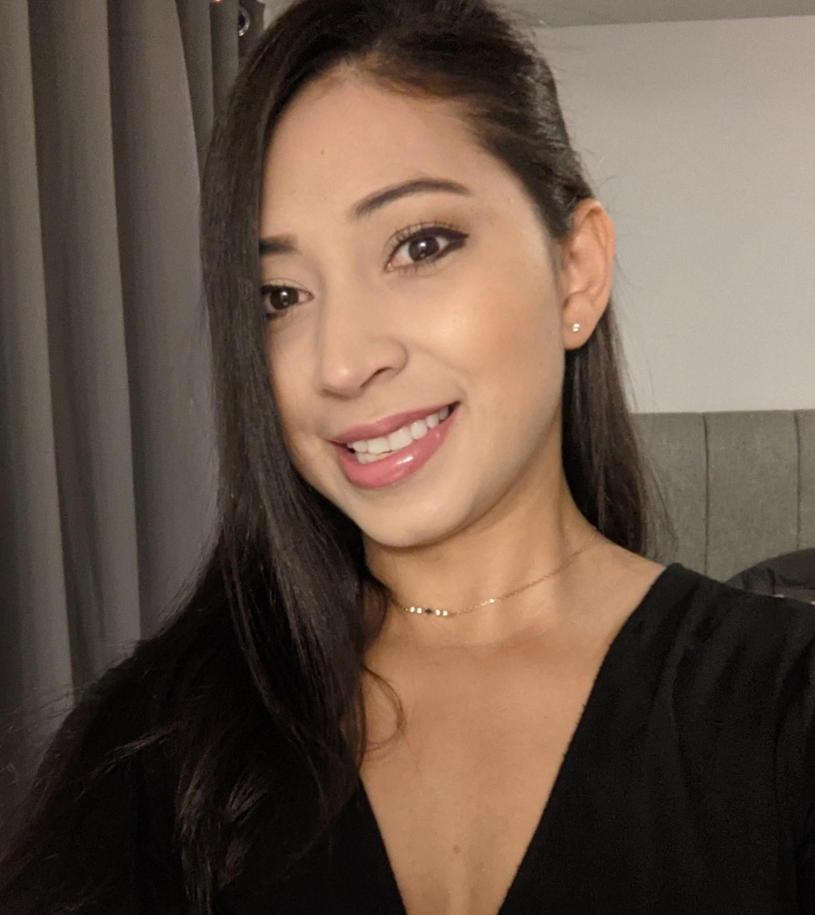
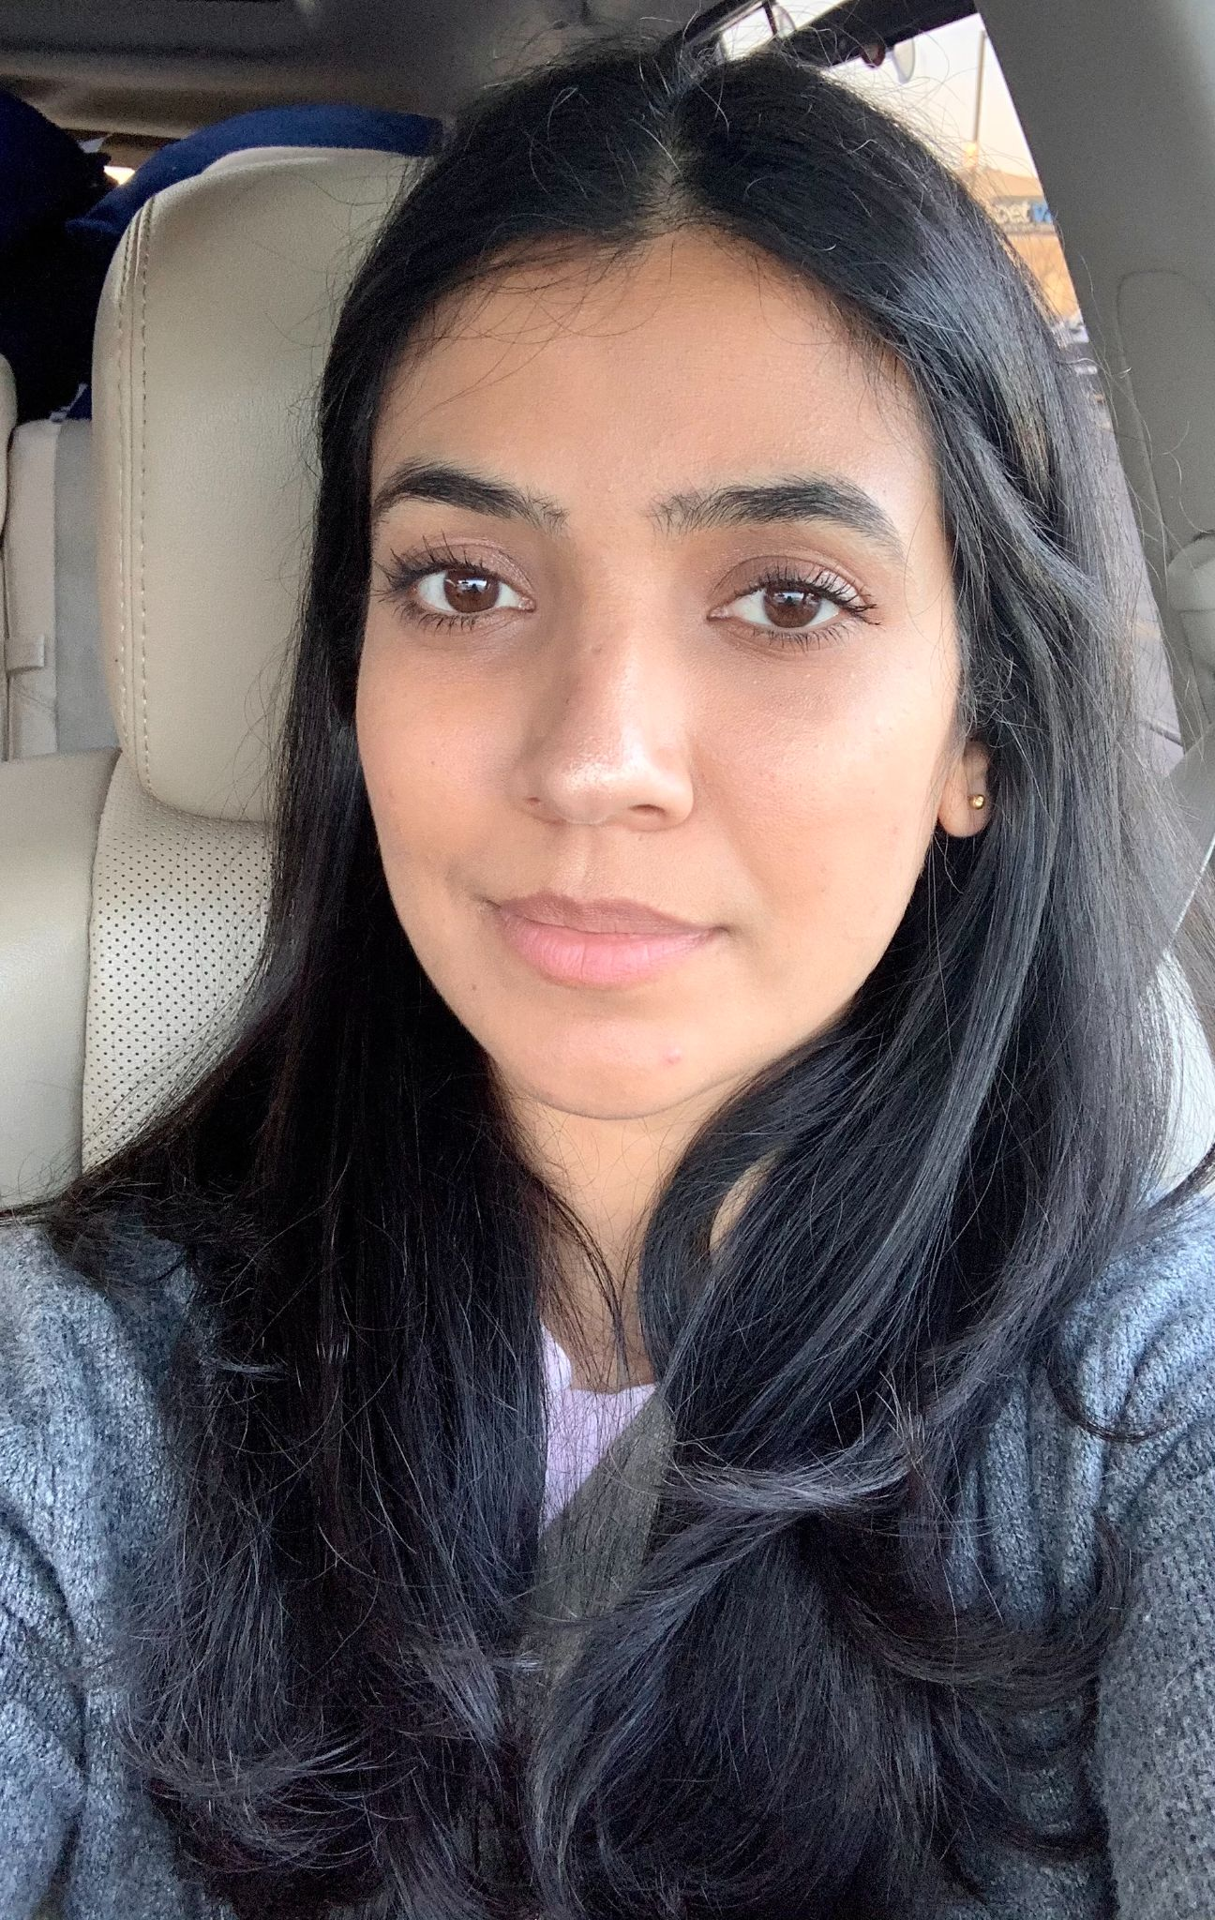
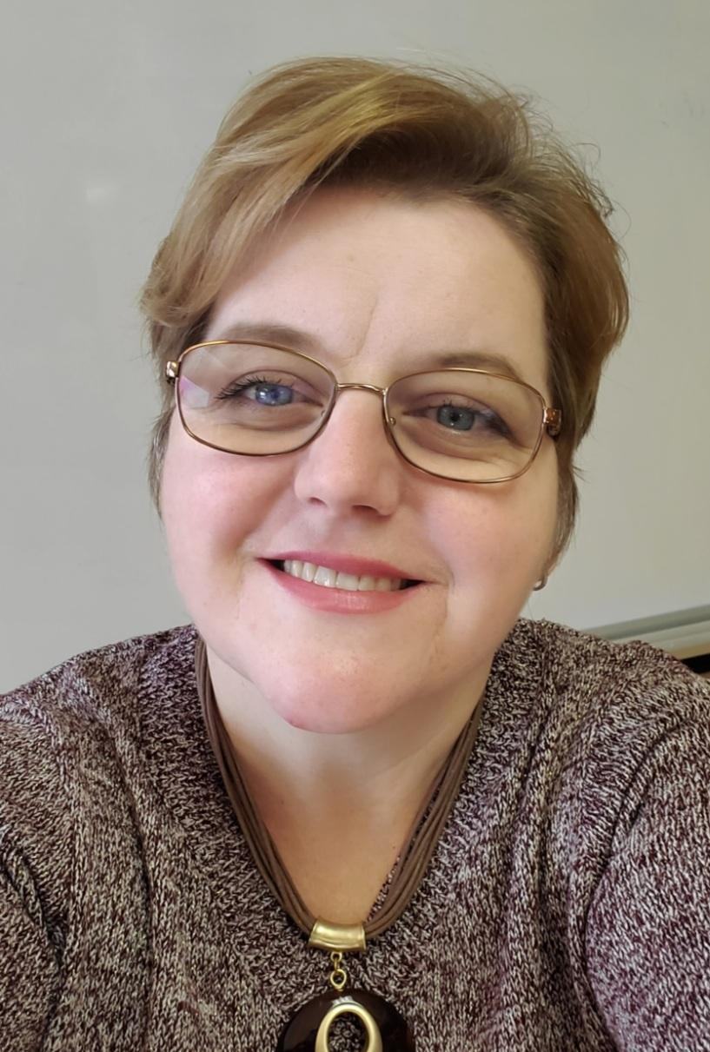
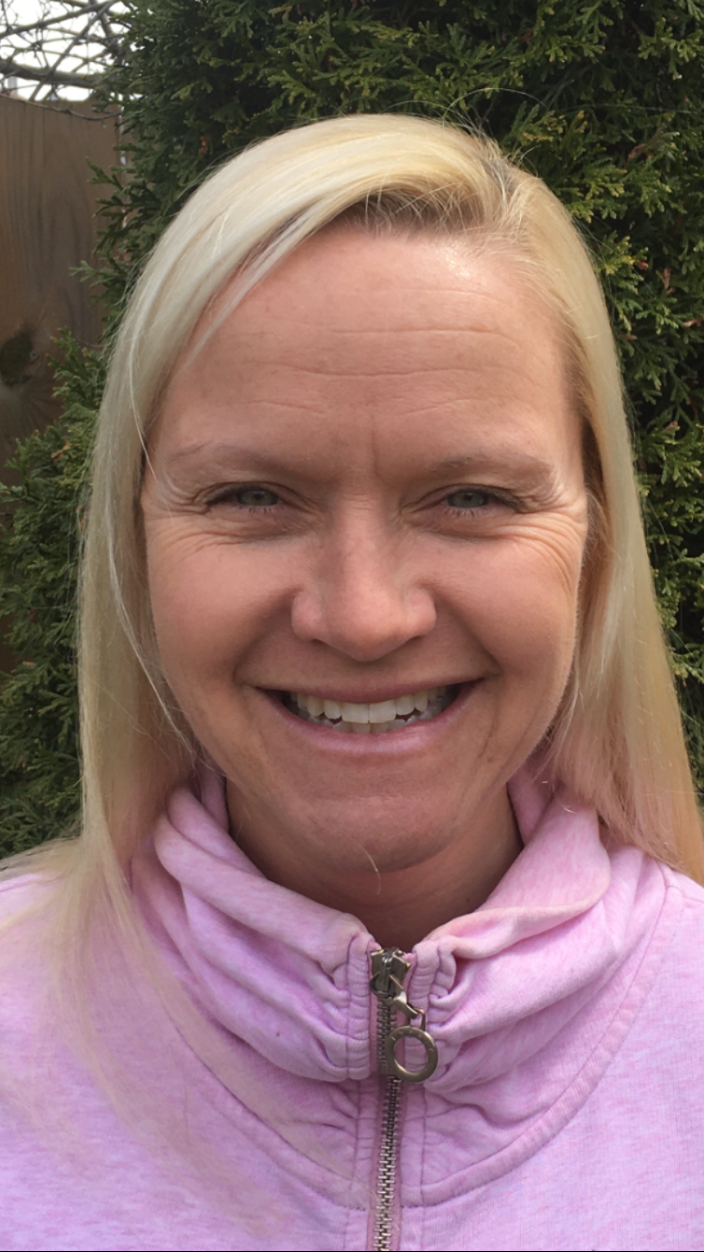
Meet your Educators
CREDITS
Hi!
We’re Mrs. Martin, Mrs. Shier, Mrs. Nicolas, Mrs. Martin, Mrs. Dhaliwal, Mrs. Stumpf, Mrs. C., and Mrs. Williams.
We are so excited that you are coming to Kindergarten!

Slide 9
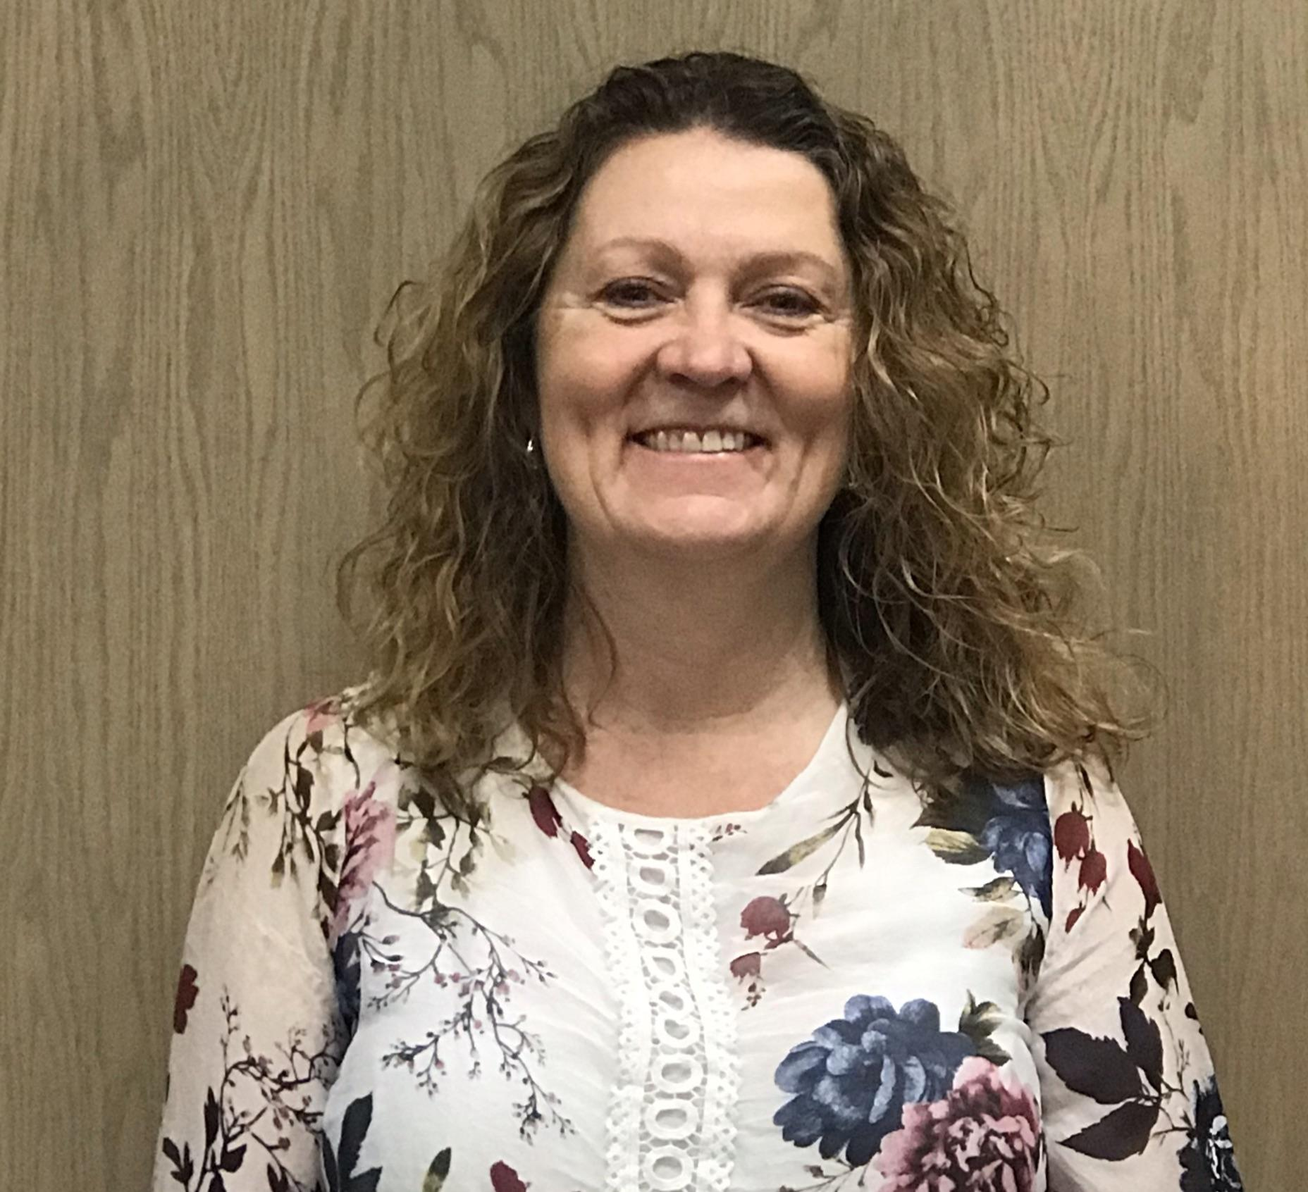
CREDITS
Meet your school team!
Ms. Meredith is our principal and we have a school mascot.

Slide 10
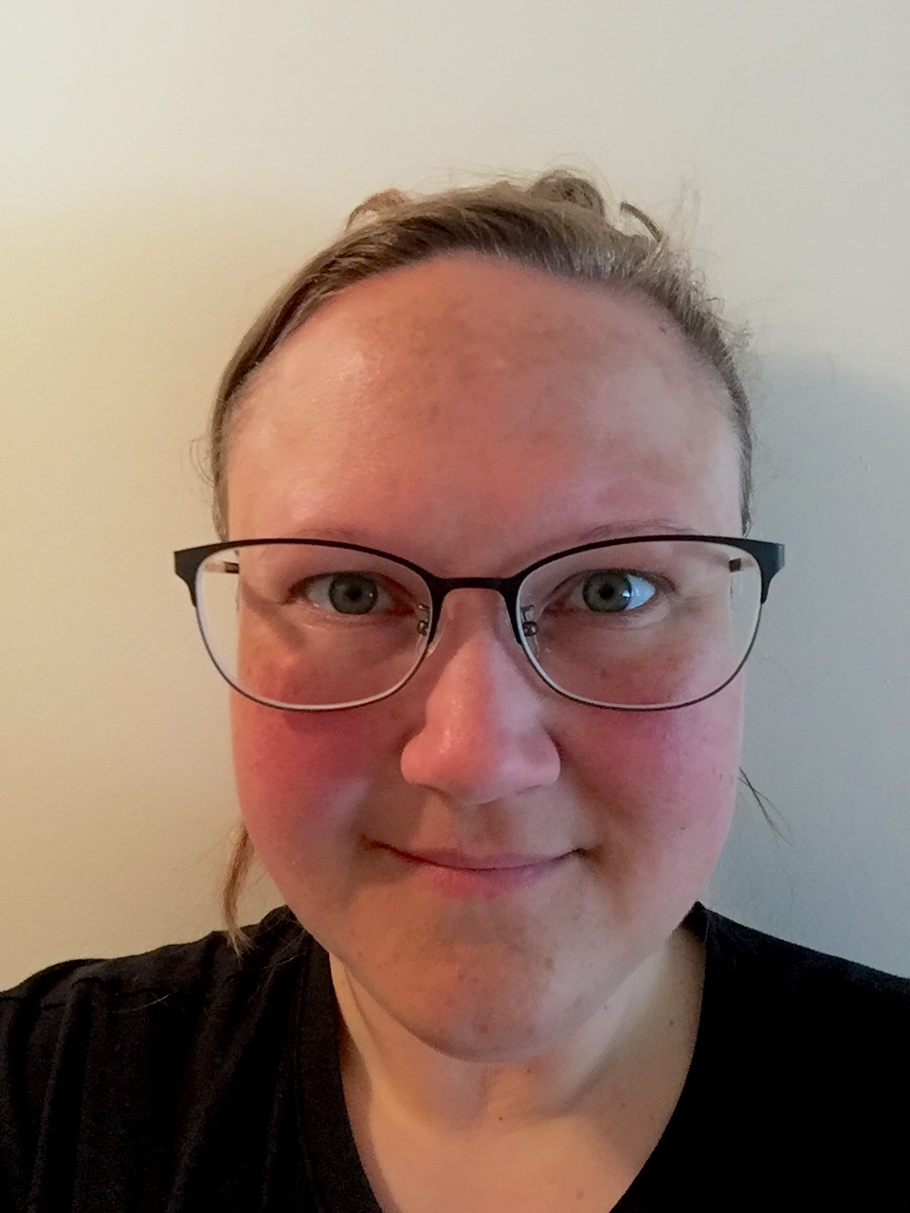
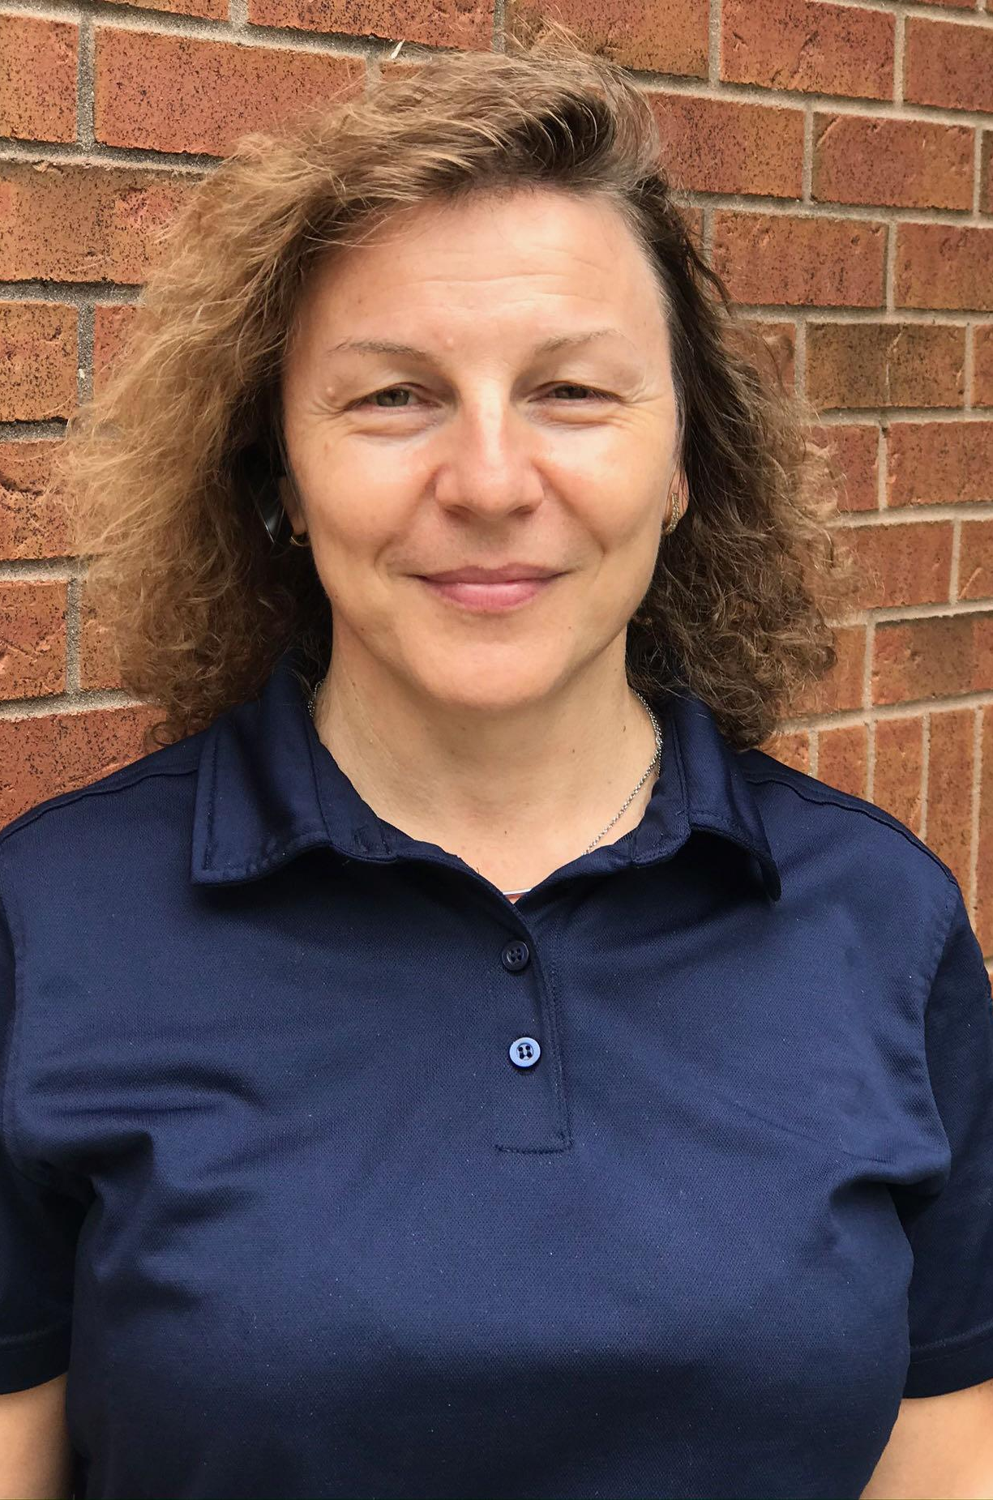
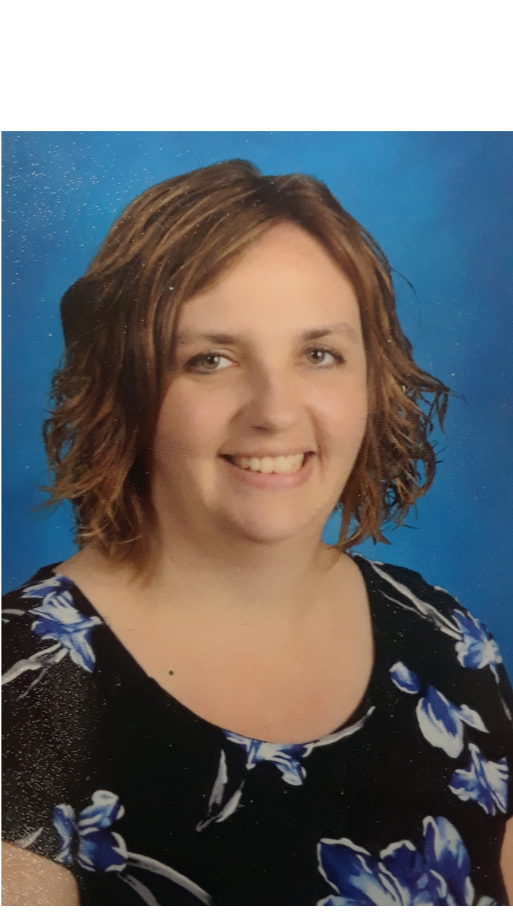
More great people at our School!
Here are more awesome people at our school:
Mrs. Young works in the office.
Ms. Dowdall works in the library.
And Mrs. Milli is all around, taking great care of our school too!

Slide 11
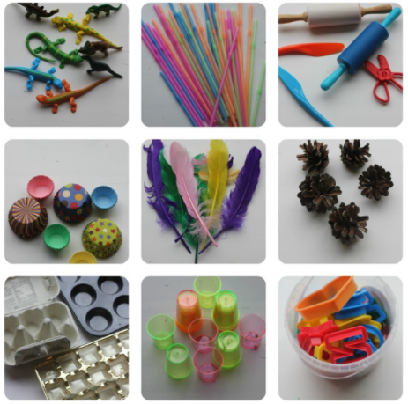
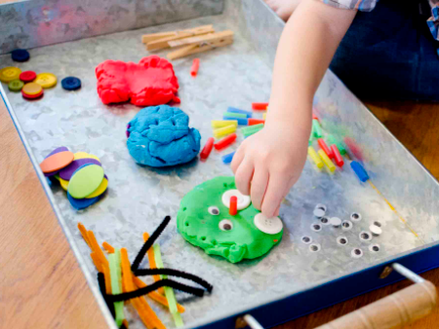
CREDITS
Playing with Playdough
There are so many Benefits of Playdough!
Playdough can be bought or made out of some basic ingredients. The WTK Family Activities for Early Learners Guide Resource Book includes a simple recipe.
Not only will your child have fun, they will learn so many things!
Here is a short video to learn more about learning with playdough!
Using props found at home, help your child to create!
Notes:
5 min.
Mrs. Martin. is going to talk with us about how much learning & fun can happen when we’re playing with playdoh!
Hey everybody...inside the bags you will find a little package of play doh! I’ll invite you to take it out and play with it together while we’re talking about how much your child can learn while they’re using this simple material!
There are so many benefits to playdough! While your child is playing and creating with playdough, they’re growing so many skills that they can use in other areas of their learning too!
The act of manipulating the playdough by squeezing, rolling, squishing and more all helps to grow your child’s fine motor skills and strength that they will use for other things like printing, using scissors, and doing up zippers
Playdough is also an awesome way to explore and grow your child’s creativity! They can create anything that comes to their imagination, and as they’re creating, they have the opportunity to explain their thinking and understand why they chose to do what they did, which also grows their communication skills!
Playdough is also a great material to use when learning about math and literacy- we had lots of fun this year creating words, letters, and numbers out of our playdough! Maybe you will make the first letter of your name right now! I can make an M for the first letter of my name!
Playdough can be bought or you can make it! Inside of your bag there is a Welcome to Kindergarten Resource book which includes a simple recipe for making your own playdough
Now we will watch a short video about learning with playdough!
Share link for the translations of this resource (2 page information about TALK, READ, SING, PLAY in 29 languages)

Slide 12
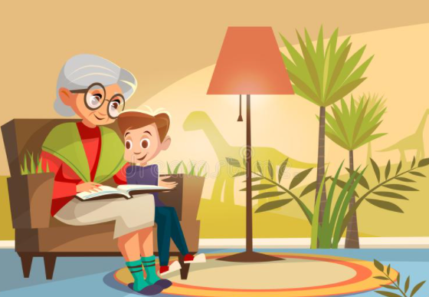
CREDITS
Talking and Reading Together
The WTK Resource bag contains several books to enjoy together. Find a time each day to sit and read with your child.
Practice the three Cs of reading: Cuddle, Conversation and Choice.
Every time you hold a book and read (in any language) with your child, so many important skills are developing!
There is no app to replace your lap ~ spend time reading with your child!
Notes:
5 min.
Now, Mrs. Shier is going to talk with us about one of the beautiful books in the bag - pull out the book and show it.
Invite families to unpack one of the books from the bag and turn the pages together while we’re talking (e.g., “Hey everybody...inside the bag you will find several beautiful books! We’re going to invite you to take one out and turn the pages together while we’re talking about how much your child can learn while reading and talking about stories together!”)
Now, families...if you would like to get more ideas about how reading stories can be a fun way of learning together at home, check out this video…

Slide 13
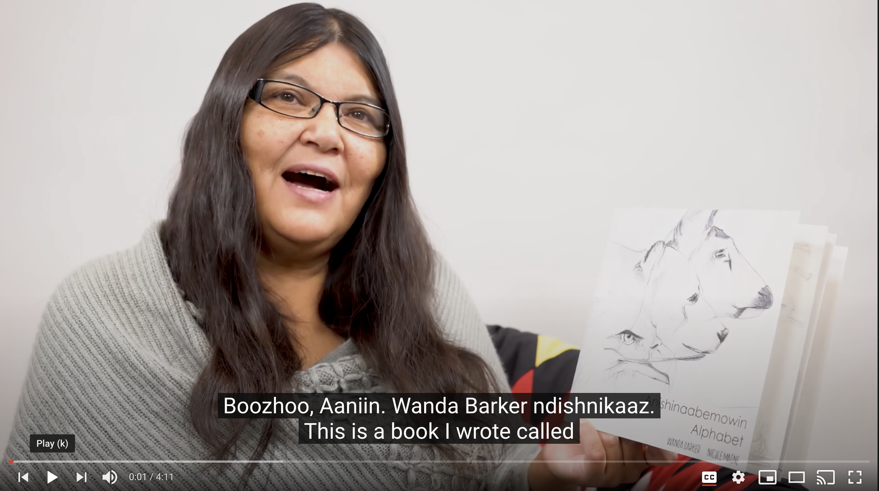
Talking and Reading Together
Love to read? Click the images below to check out some more great books!
Notes:
Mrs. Shier
And - share links for e-books - some are also available in languages other than English!

Slide 14
Talking and Reading Together
Click on the books to find fun activities...these books are also in your bag!
Have fun with your new books! Click the images below to learn more:
Click on each of the books below to find fun activities you can do with your child.
All of these are in your bag!
Take a look at these videos to find ways to use the materials in your bag!
Notes:
Mrs. Shier -Let families know that these slides will be available on our school website, so they are welcome to visit in the future and visit the links at any time!

Slide 15
Music and Movement
Listening and moving to music is a fun, healthy family activity!
The Welcome to Kindergarten Album is free to download Lyrics and there are lots fun music Activities that can be used anywhere!
Move to music (using actions and props, play games)
Use music to calm or get excited!
Enjoy music from around the world
Clap, march, or tap to the beat of your favourite song!
Notes:
5 min.
Now, Mrs. C. is going to lead us in some fun movement activities
So much learning & fun can happen when we’re enjoying music & movement!
Some suggestions for ways to enjoy music:
Using the WTK song, “Jump Up, Jump Down”, try moving to the actions described in the song.
Move along while waving and tossing light objects like ribbons, scarves, and tissues.
Play ball games together and practice rolling, tossing, passing and catching
Use music to calm or energize!
Move to music and pretend to move like an animal (e.g., rabbit, elephant, snake, butterfly)
Enjoy music from around the world
Now families...if you would like to get more ideas about how enjoying music & movement can be a fun way of learning together at home, check out this video…

Slide 16
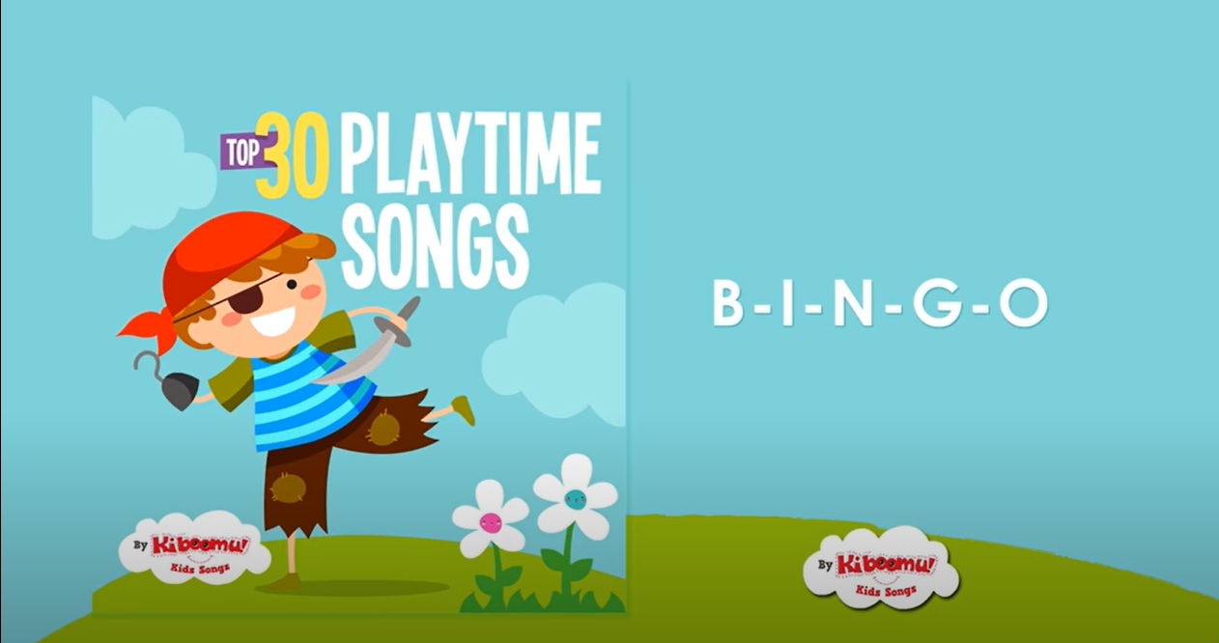
Music and Movement
Love to sing and move? Click the images below to check out some more great music!
Notes:
Mrs. C.- here are some links to other music for children (click the images)

Slide 17
Welcome to Kindergarten Key Messages
Talk Read Sing Play, Every Day!
Talking Builds:
Relationships
Vocabulary
Listening and speaking skills
An appreciation for family stories and oral traditions
Reading Builds:
Vocabulary
A sense of story
Knowledge
Print, letter and number awareness
You are your child’s first and best teacher!
Follow your child’s lead as you play and discover together
Talk and read with your child in your first language
Help your child to share and take turns
Encourage your child to make choices and decisions
Celebrate your child’s learning
Singing Builds:
Oral language
Memory
Rhythm & rhyme
Belonging
Enjoyment of music
Patterning
Playing Builds:
Decision making
Cooperation
Physical skills
Curiosity
Self-regulation
Creative thinking
Measurement, geometry
and spatial sense
Notes:
Mrs. Nicolas: I’m going to go quickly go over some overall WTK Key messages that might be helpful to you!
As a parent you are your child’s first and best teacher, so it’s important to… (read points)
It’s also very important to Talk, Read, Sing & Play Every Day with your child! (read points)
*Talking Builds
*Reading Builds
*Singing Builds
*And Lastly, Playing Builds
***And now, I will now be passing it on to Mrs. Stumph as she will be talking about places in our school

Slide 18
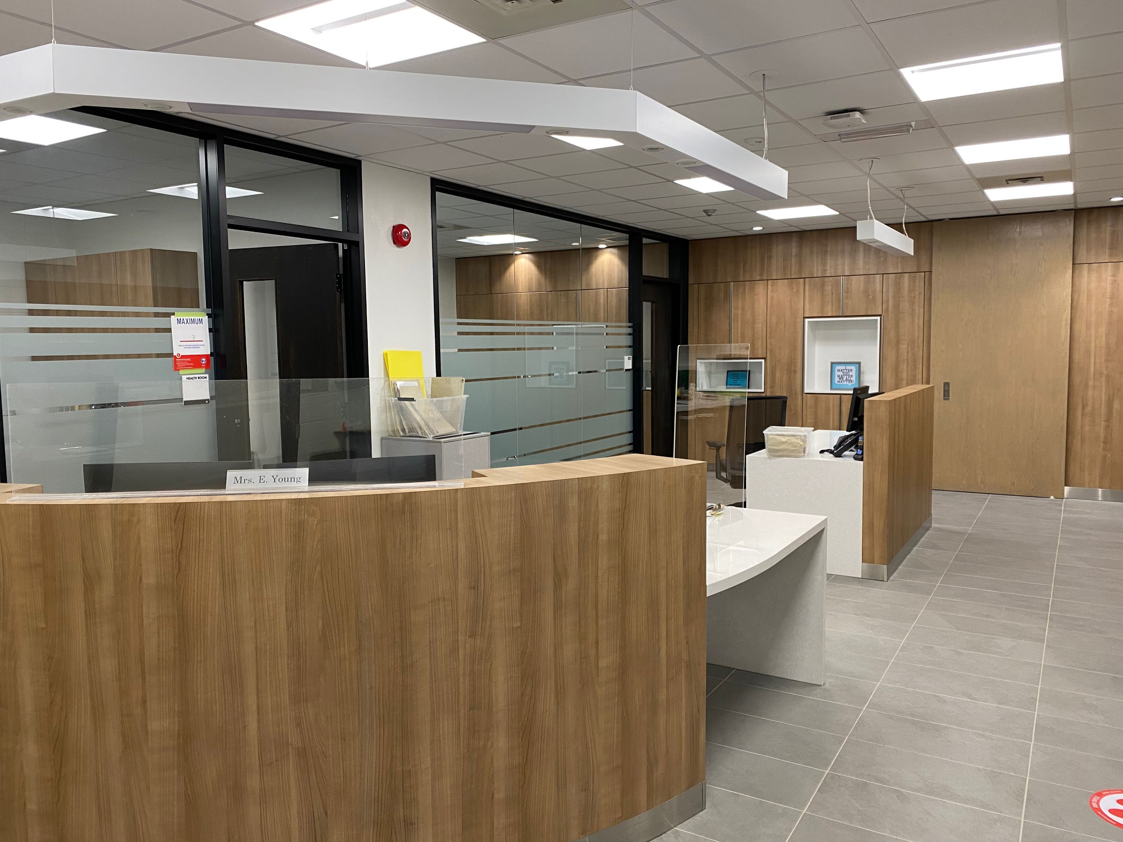
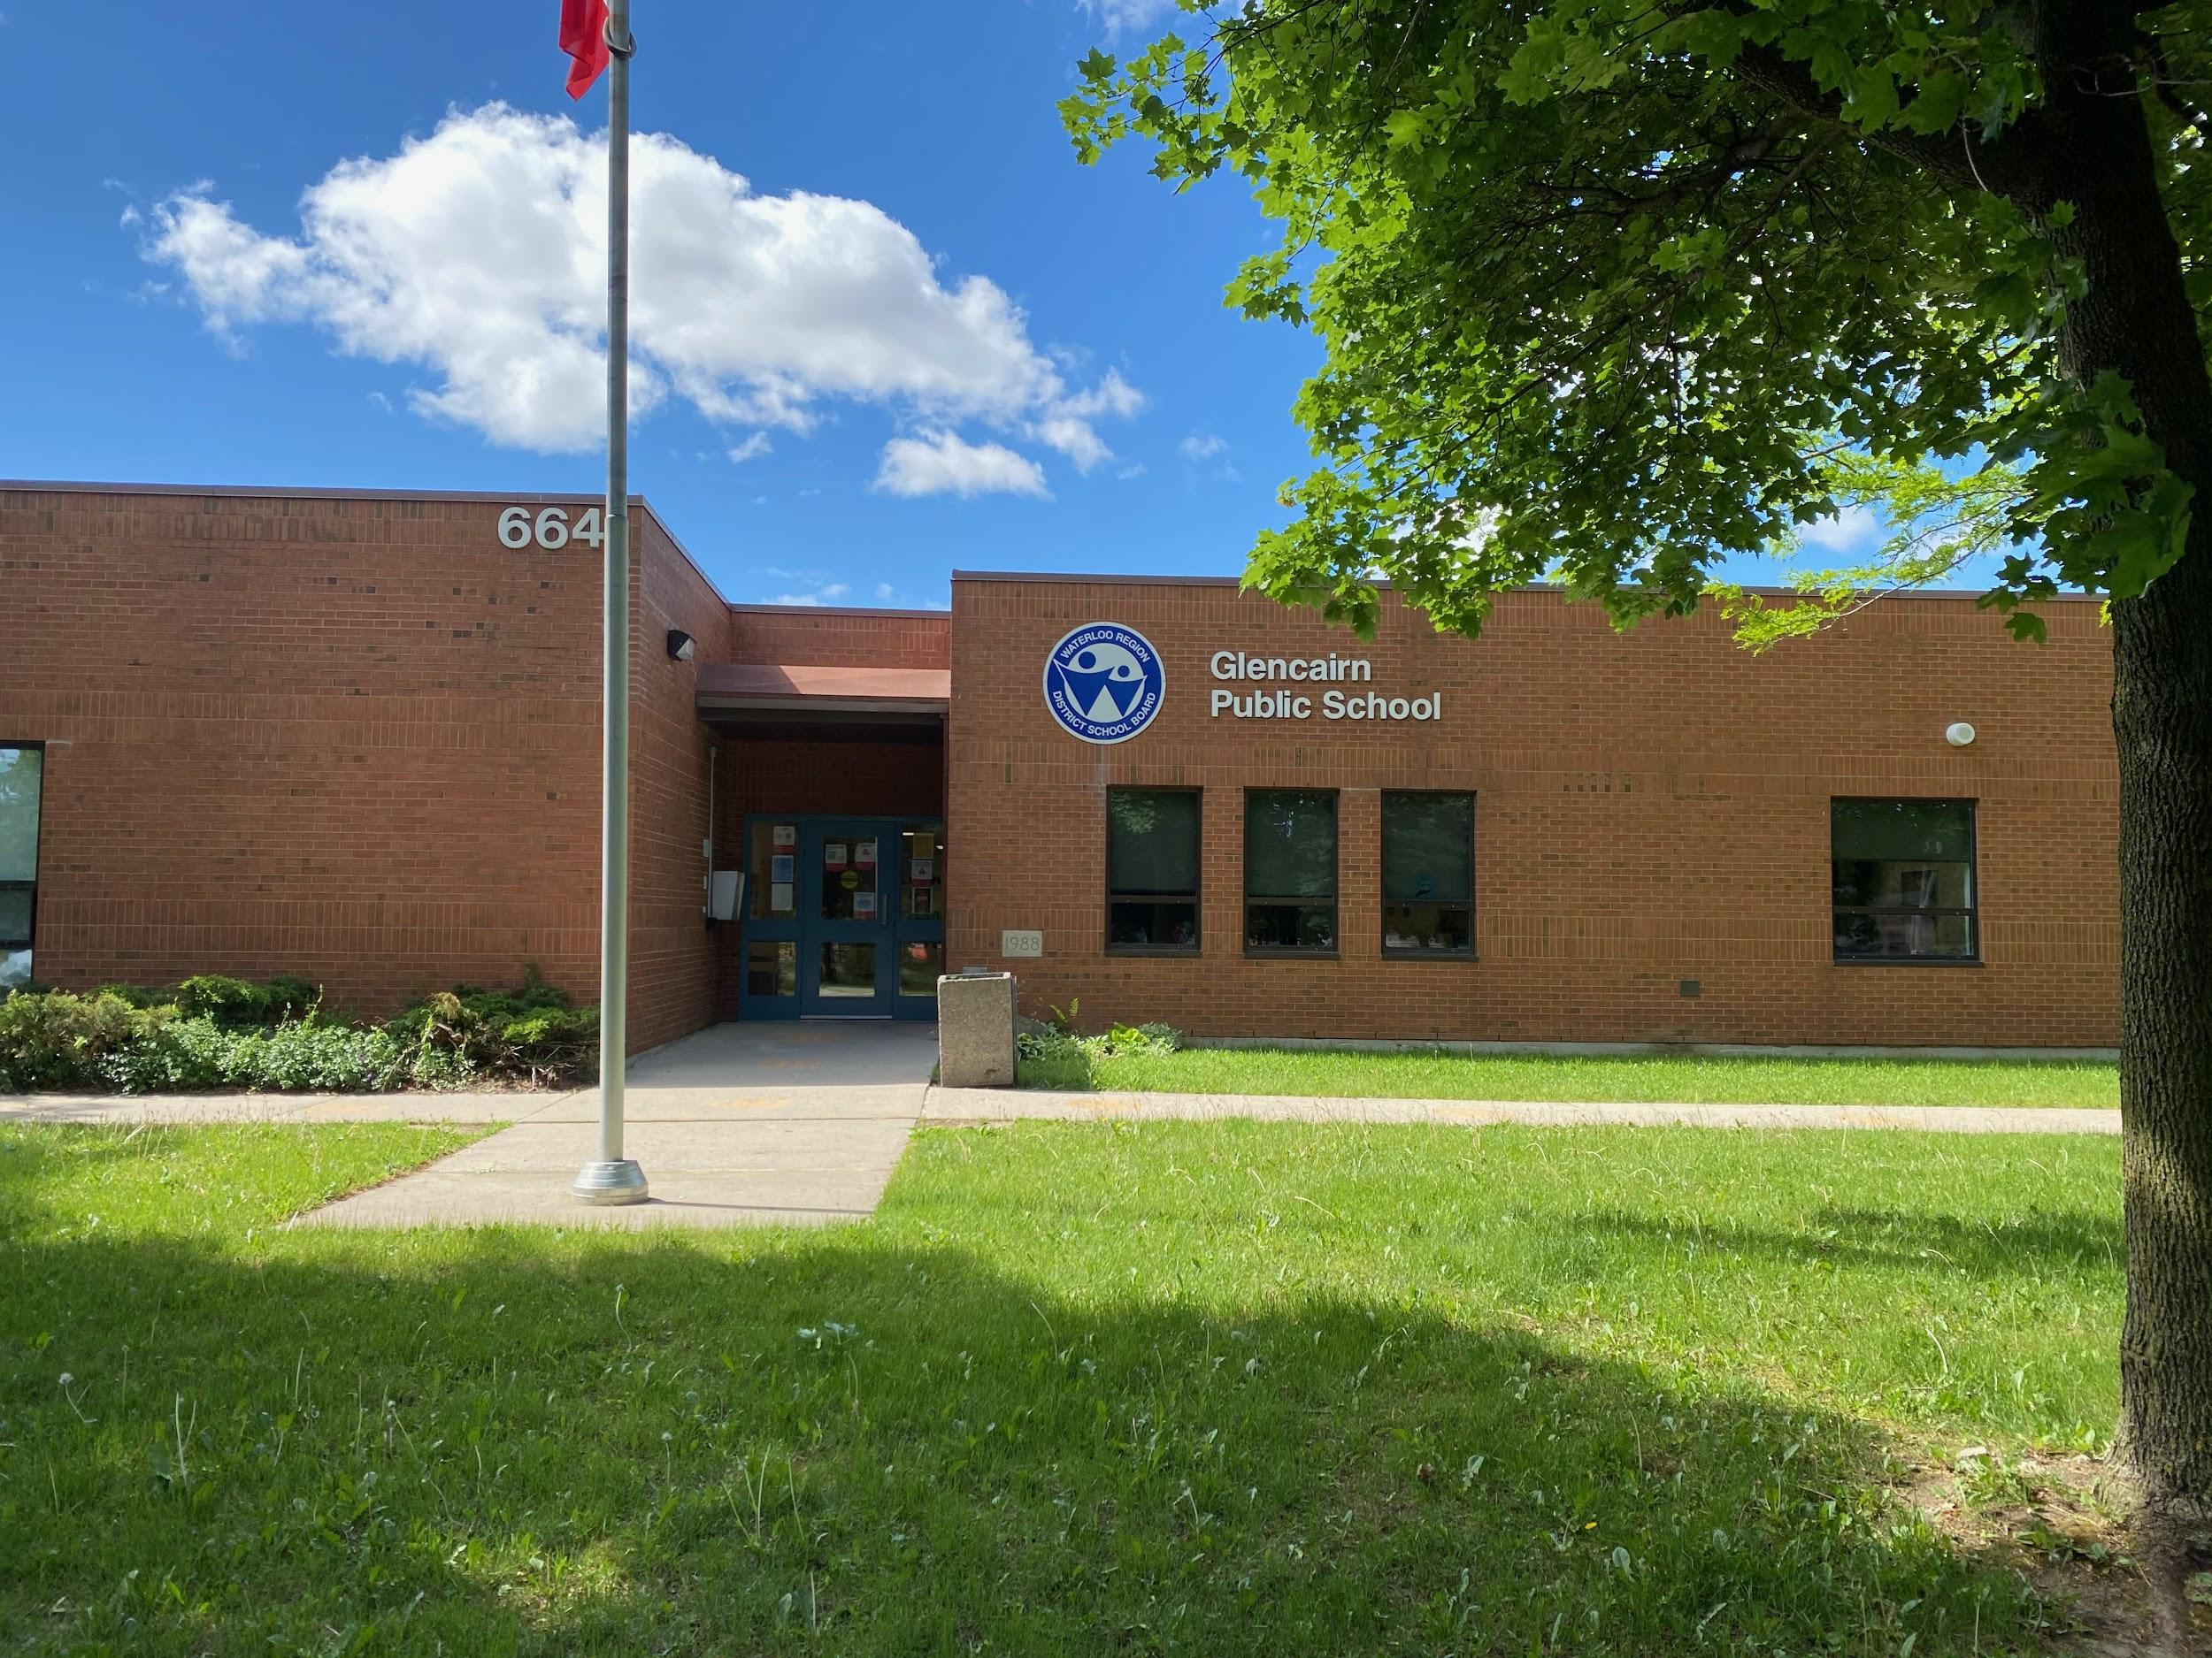
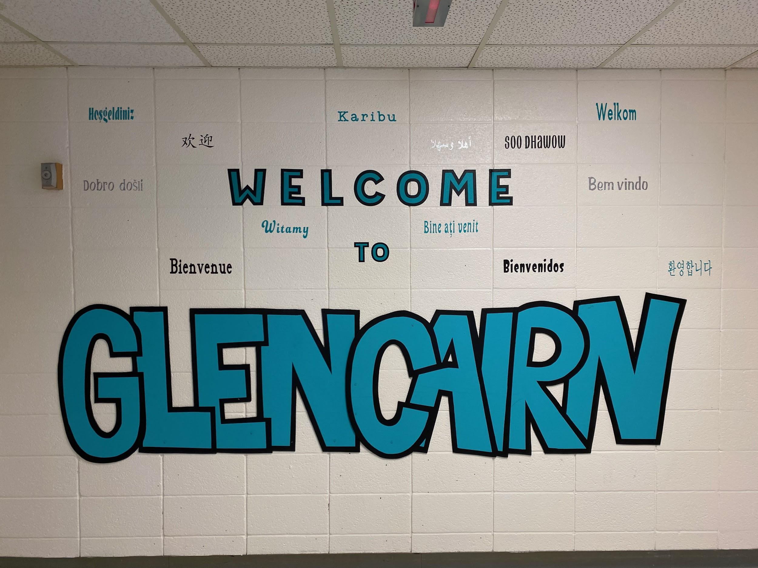
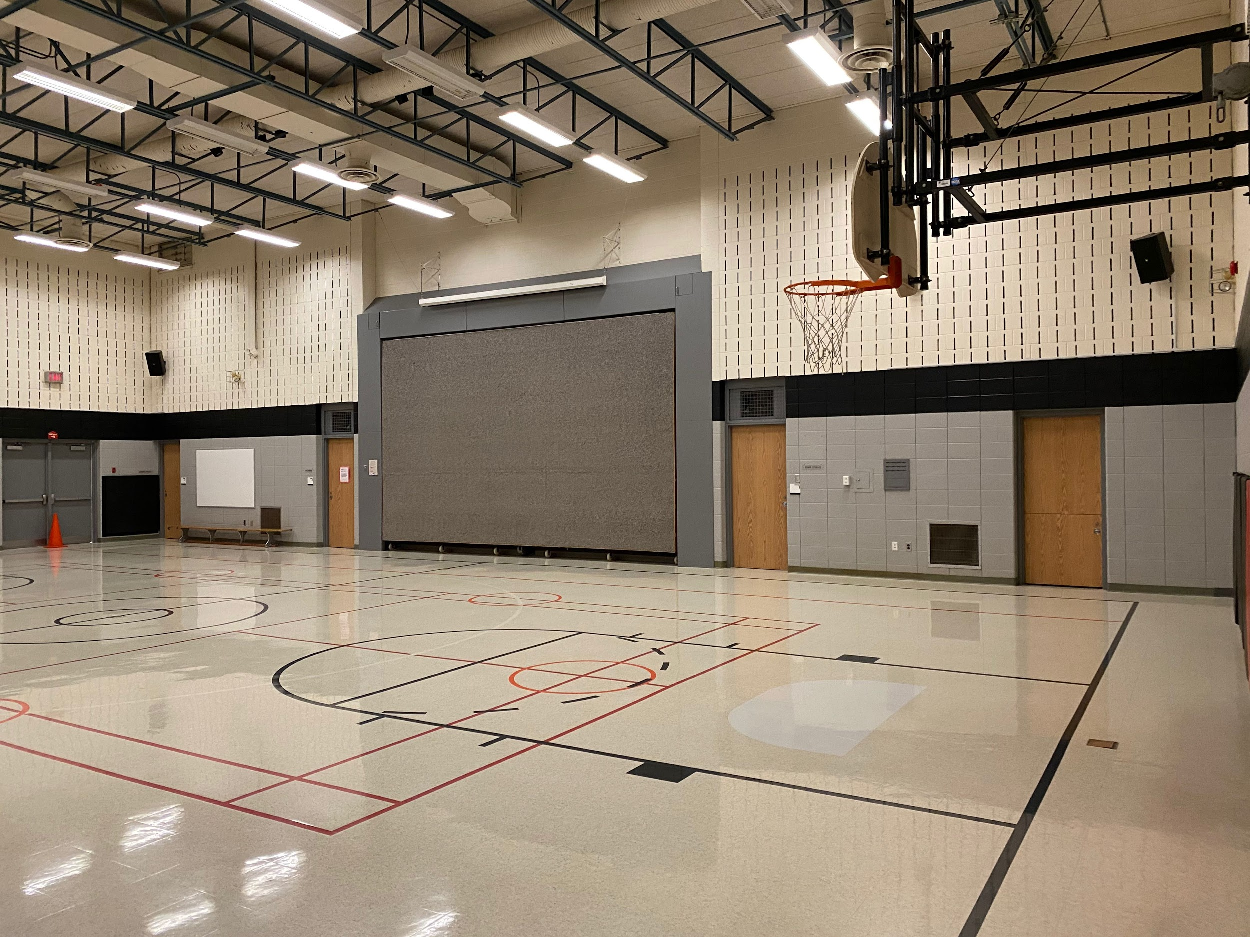
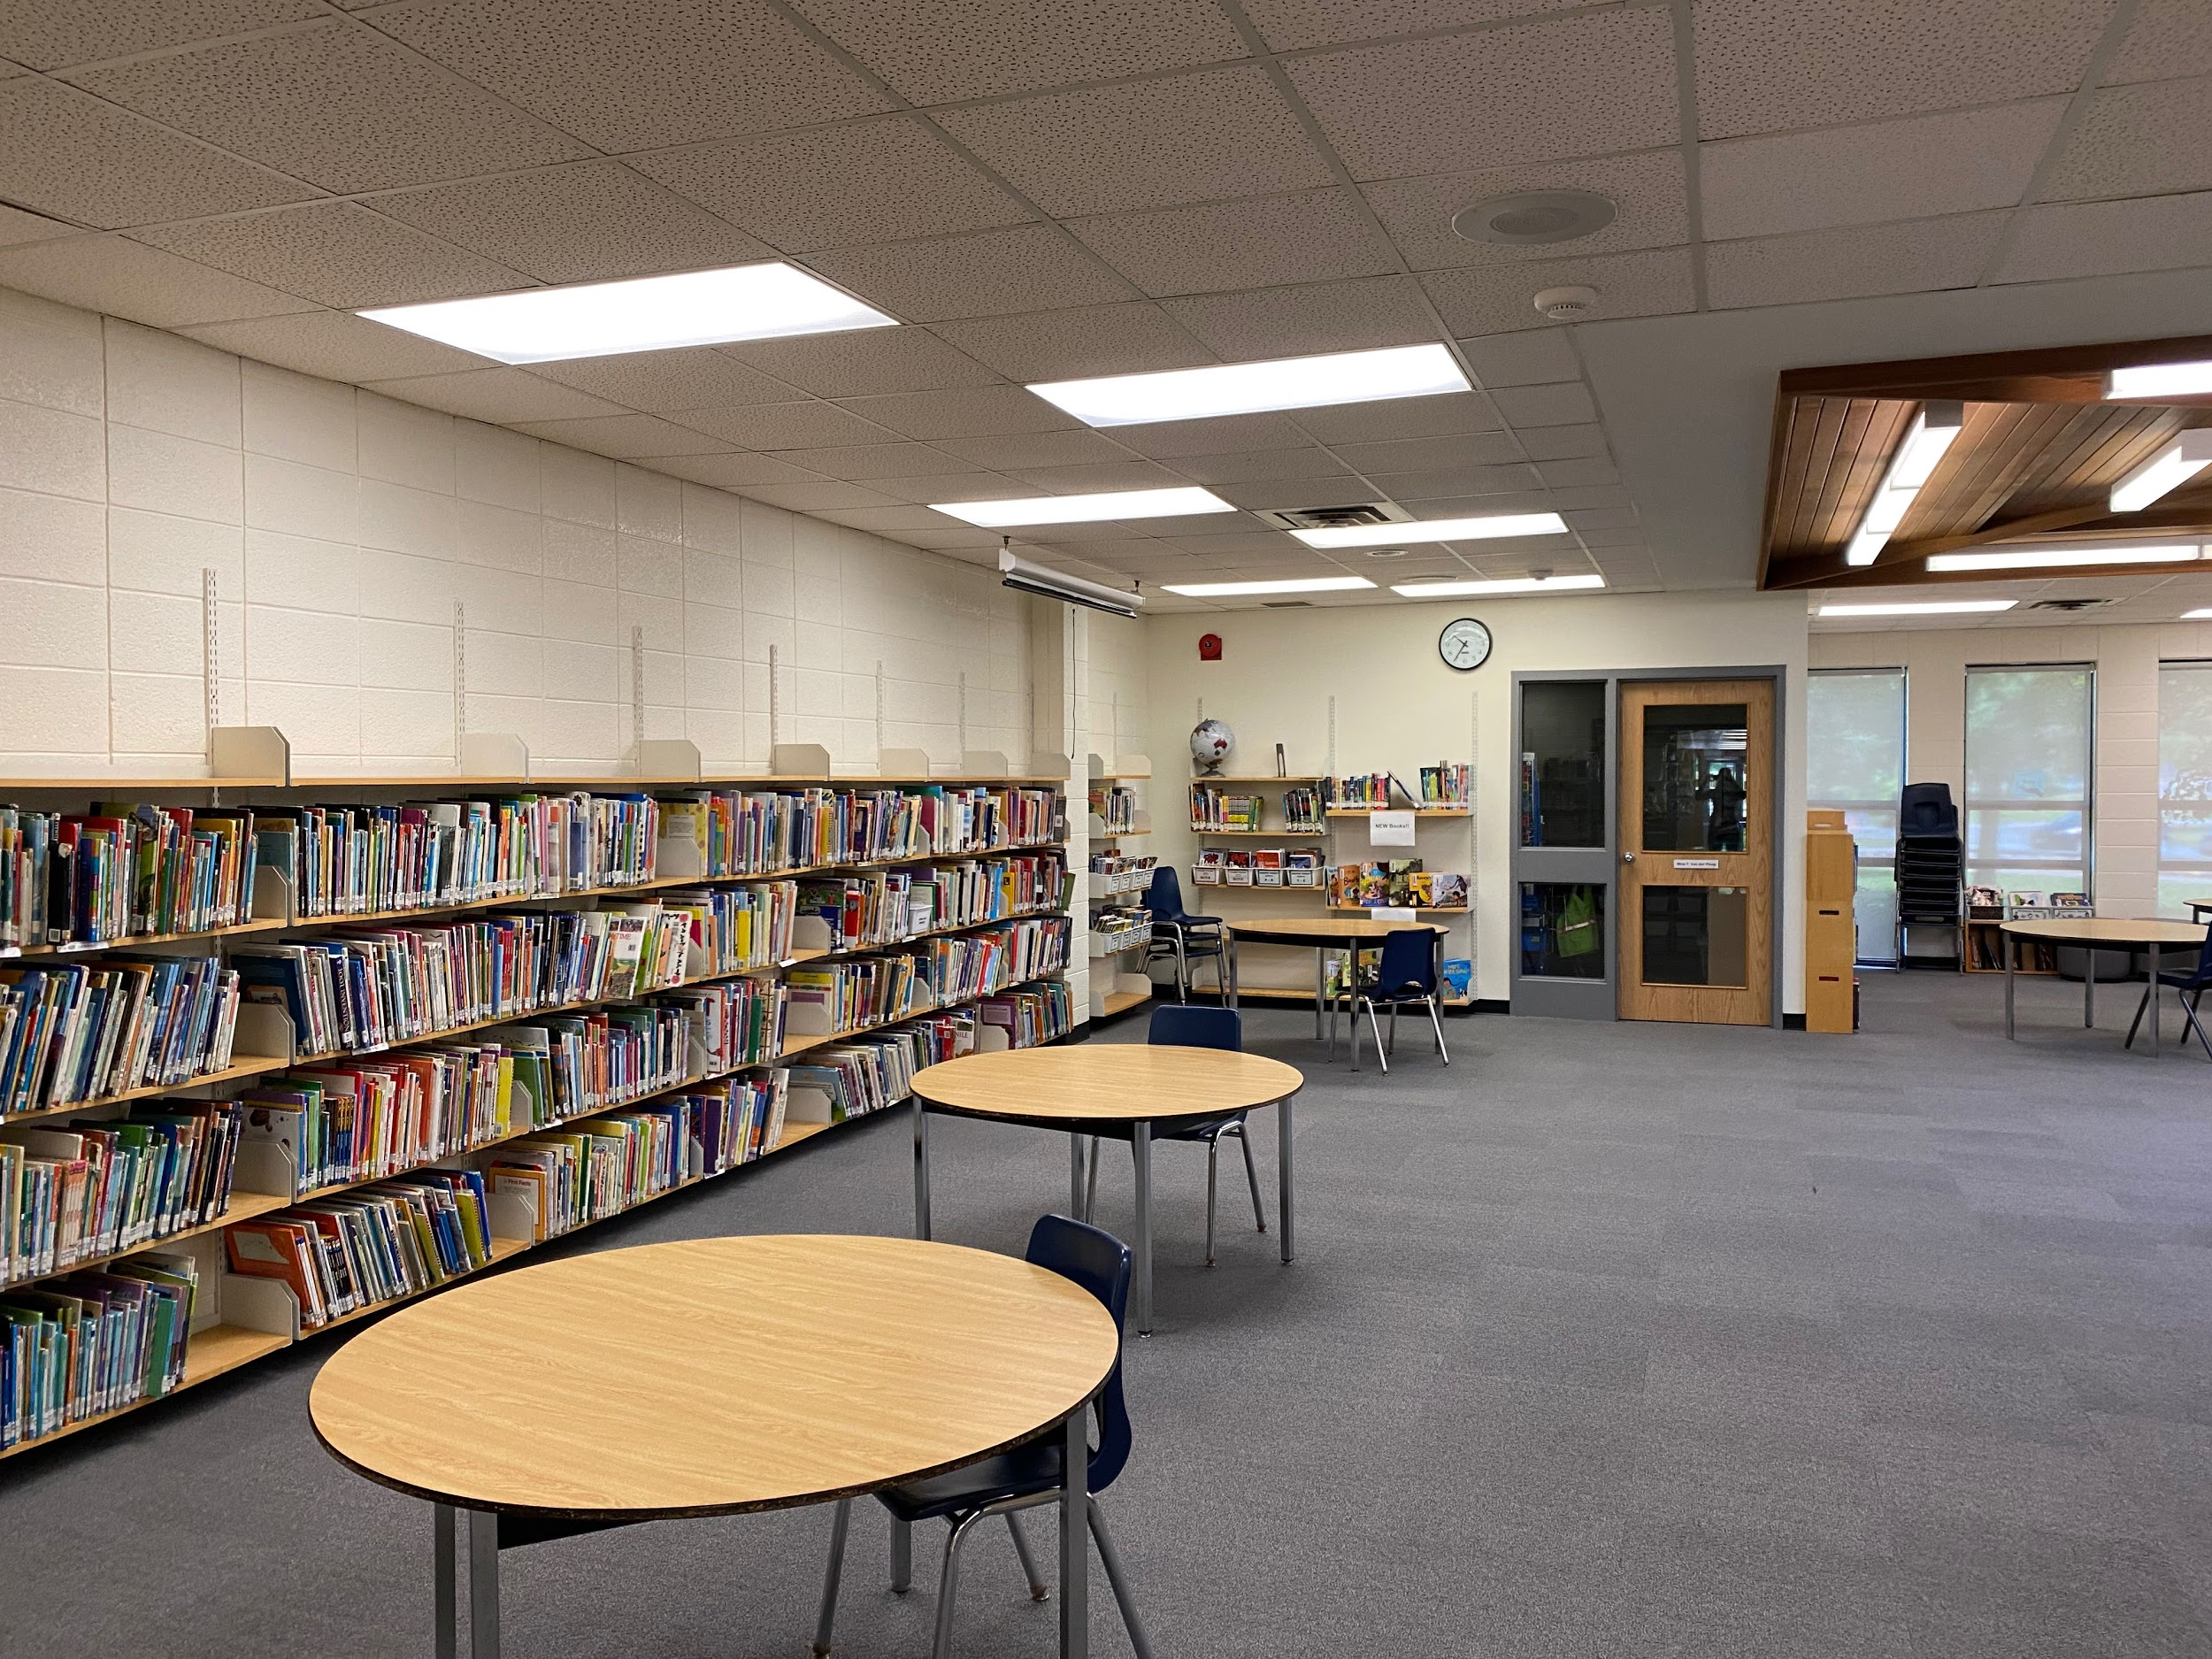
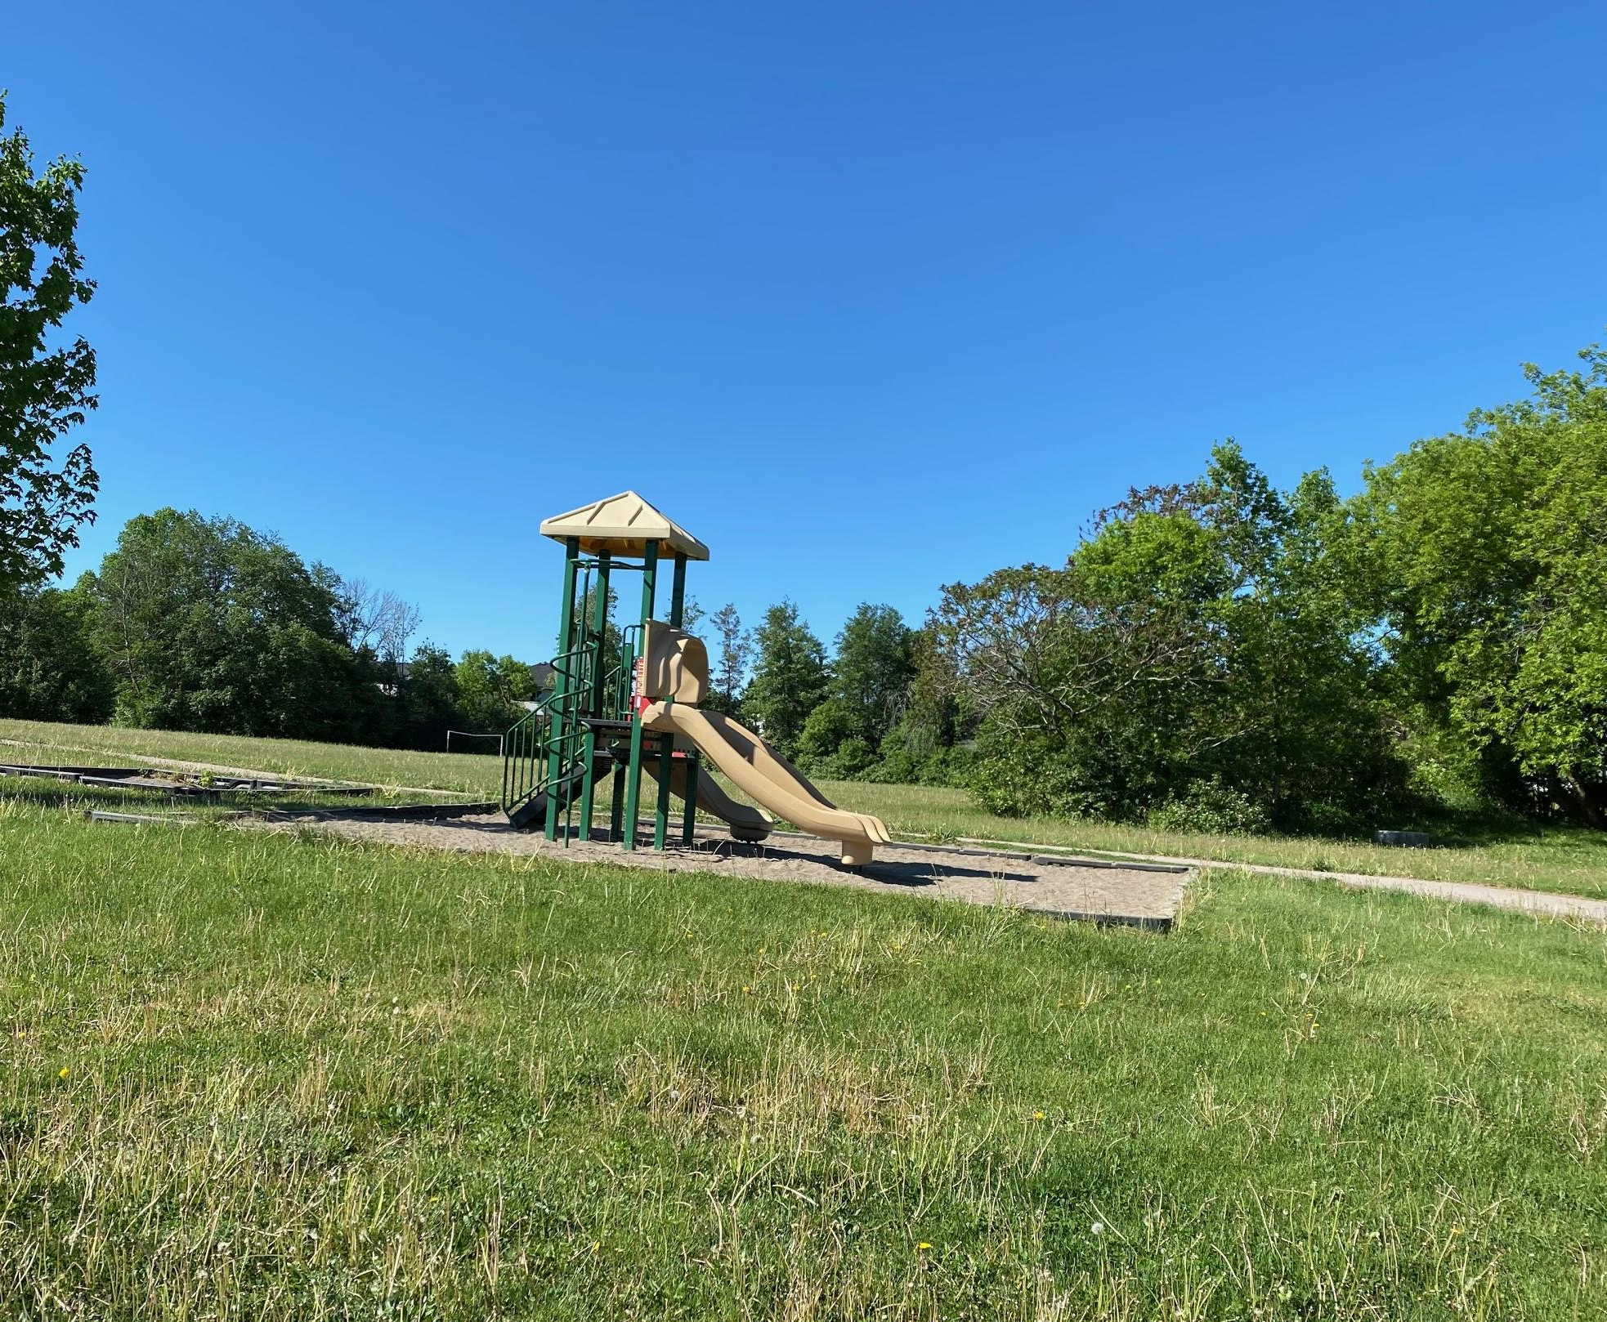
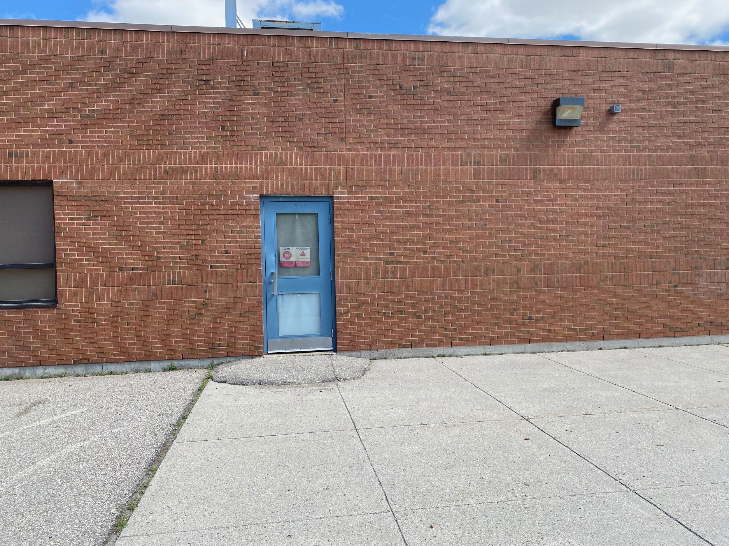
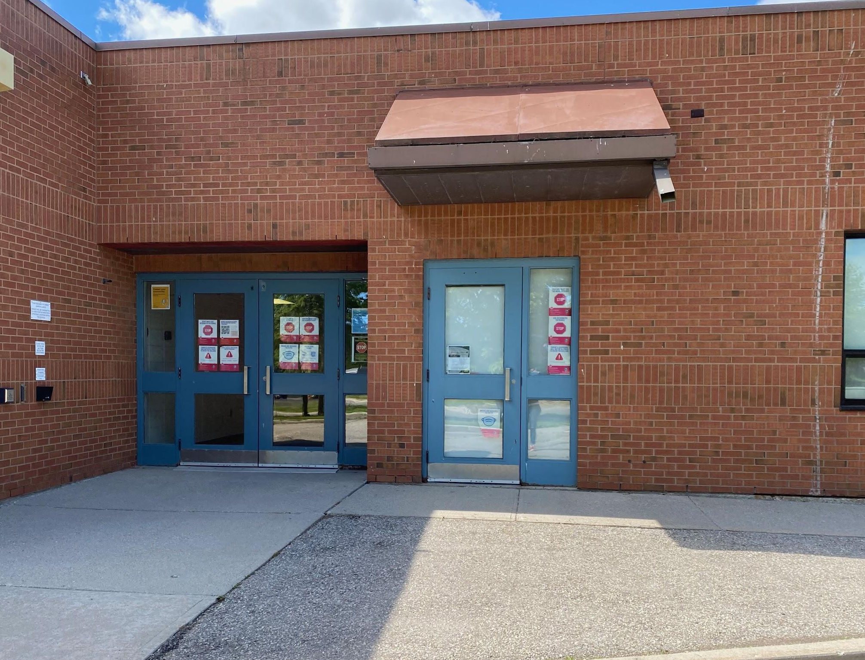
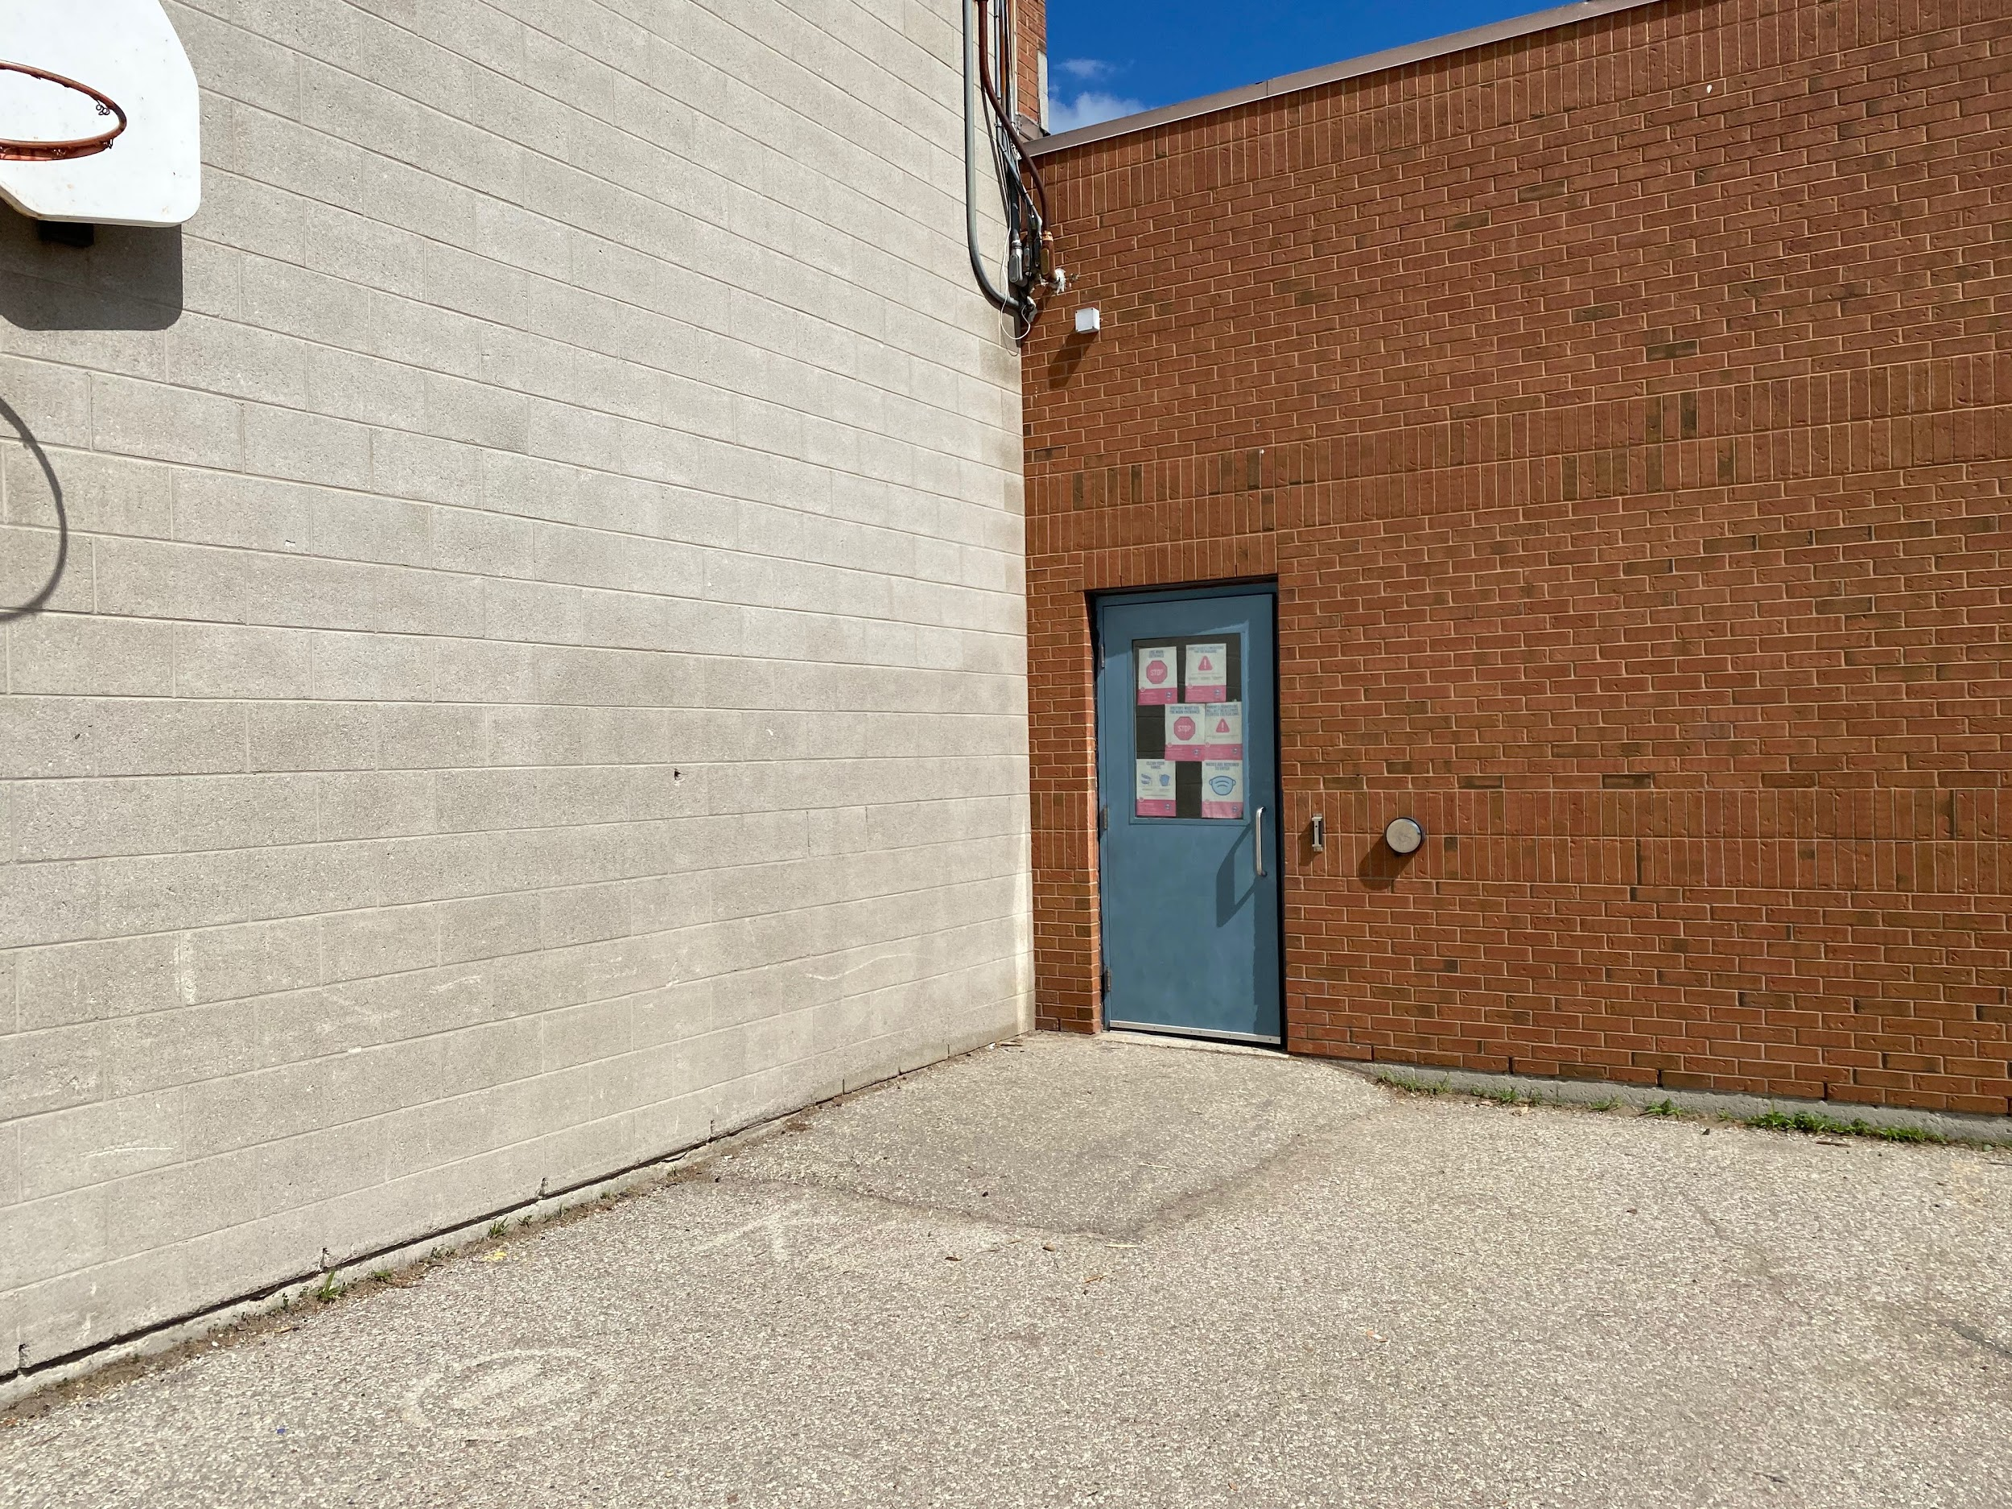
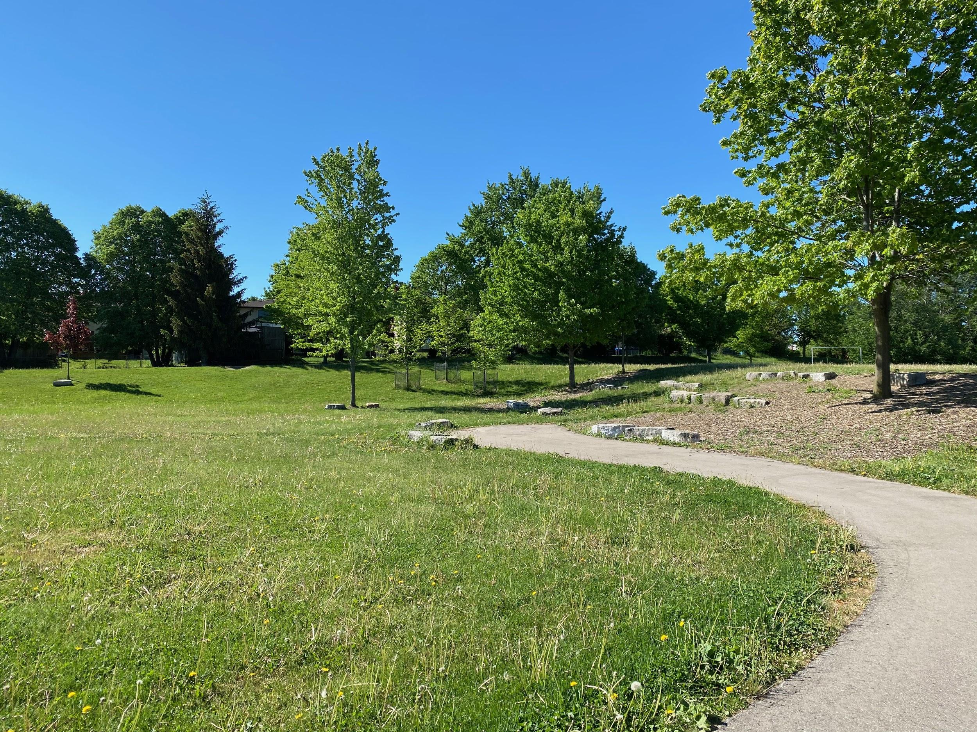
Places in our School
The Office
School main entrance
The Gymnasium
The Library!
Kindergarten Playground
Kindergarten Entrance (A6)
Friendship Grove Play Area
Kindergarten Entrance (C11)
Kindergarten Entrance (C6)
Notes:
Mrs. Stumpf: You might be curious to know a little bit about what your school looks like! Here are some pictures of important places in the school. First is the main entrance, which is used to get to the main office. You can also see a photo of our wonderful library, gym, and some of our outdoor learning areas.

Slide 19
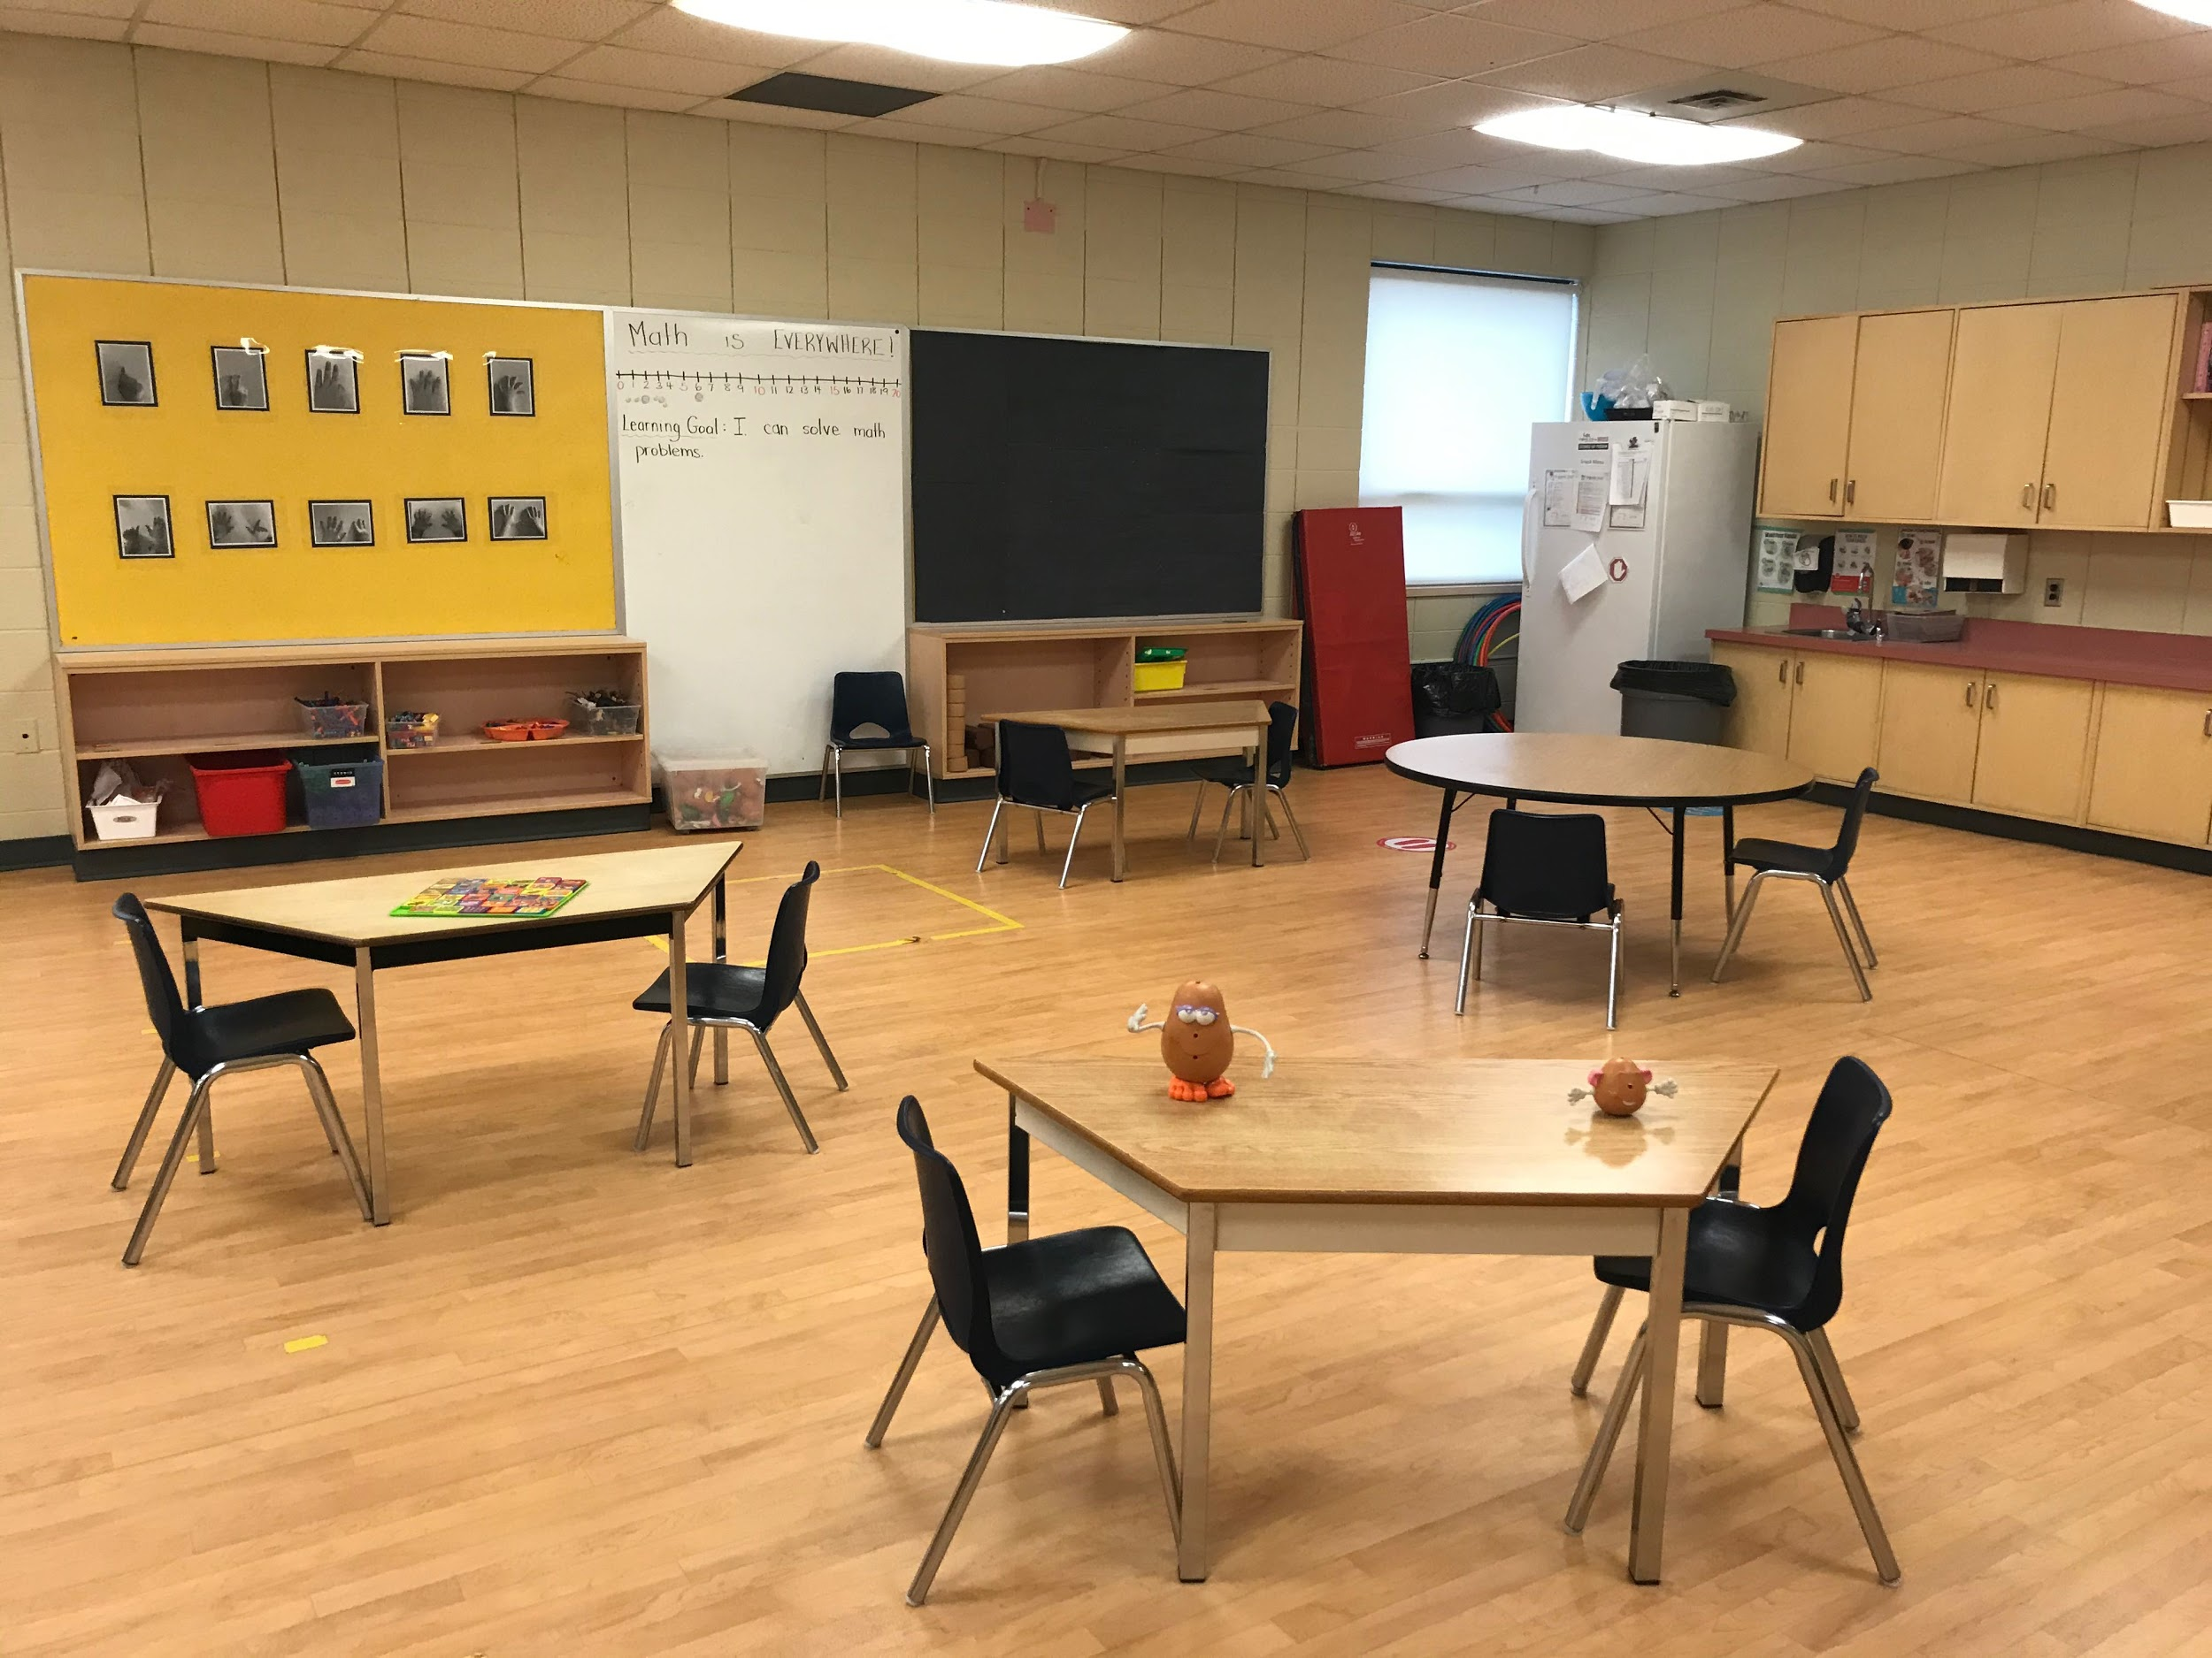
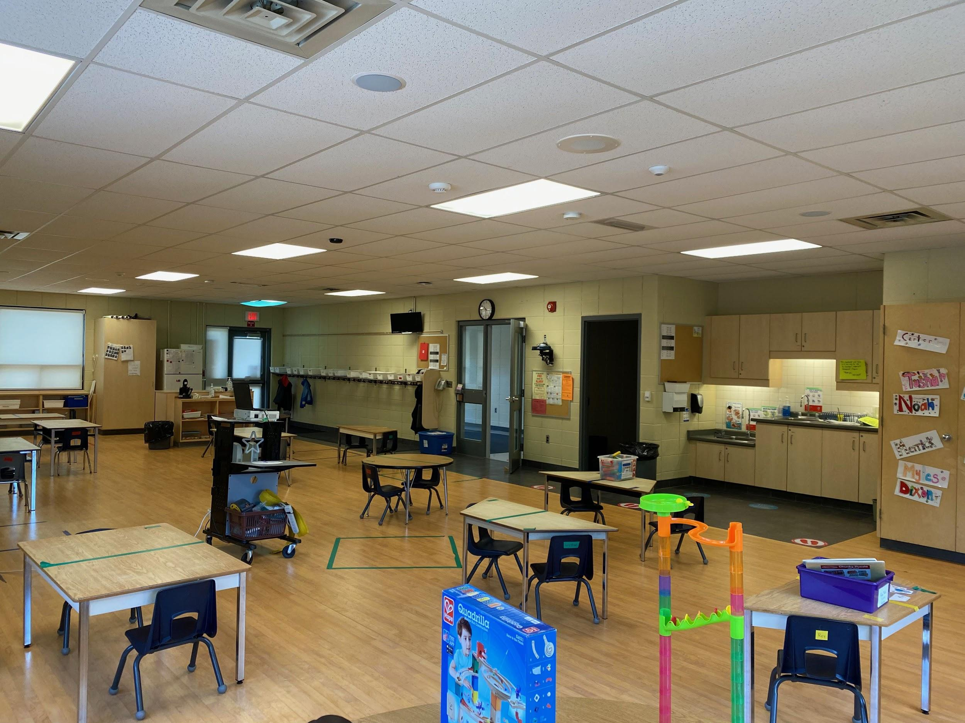
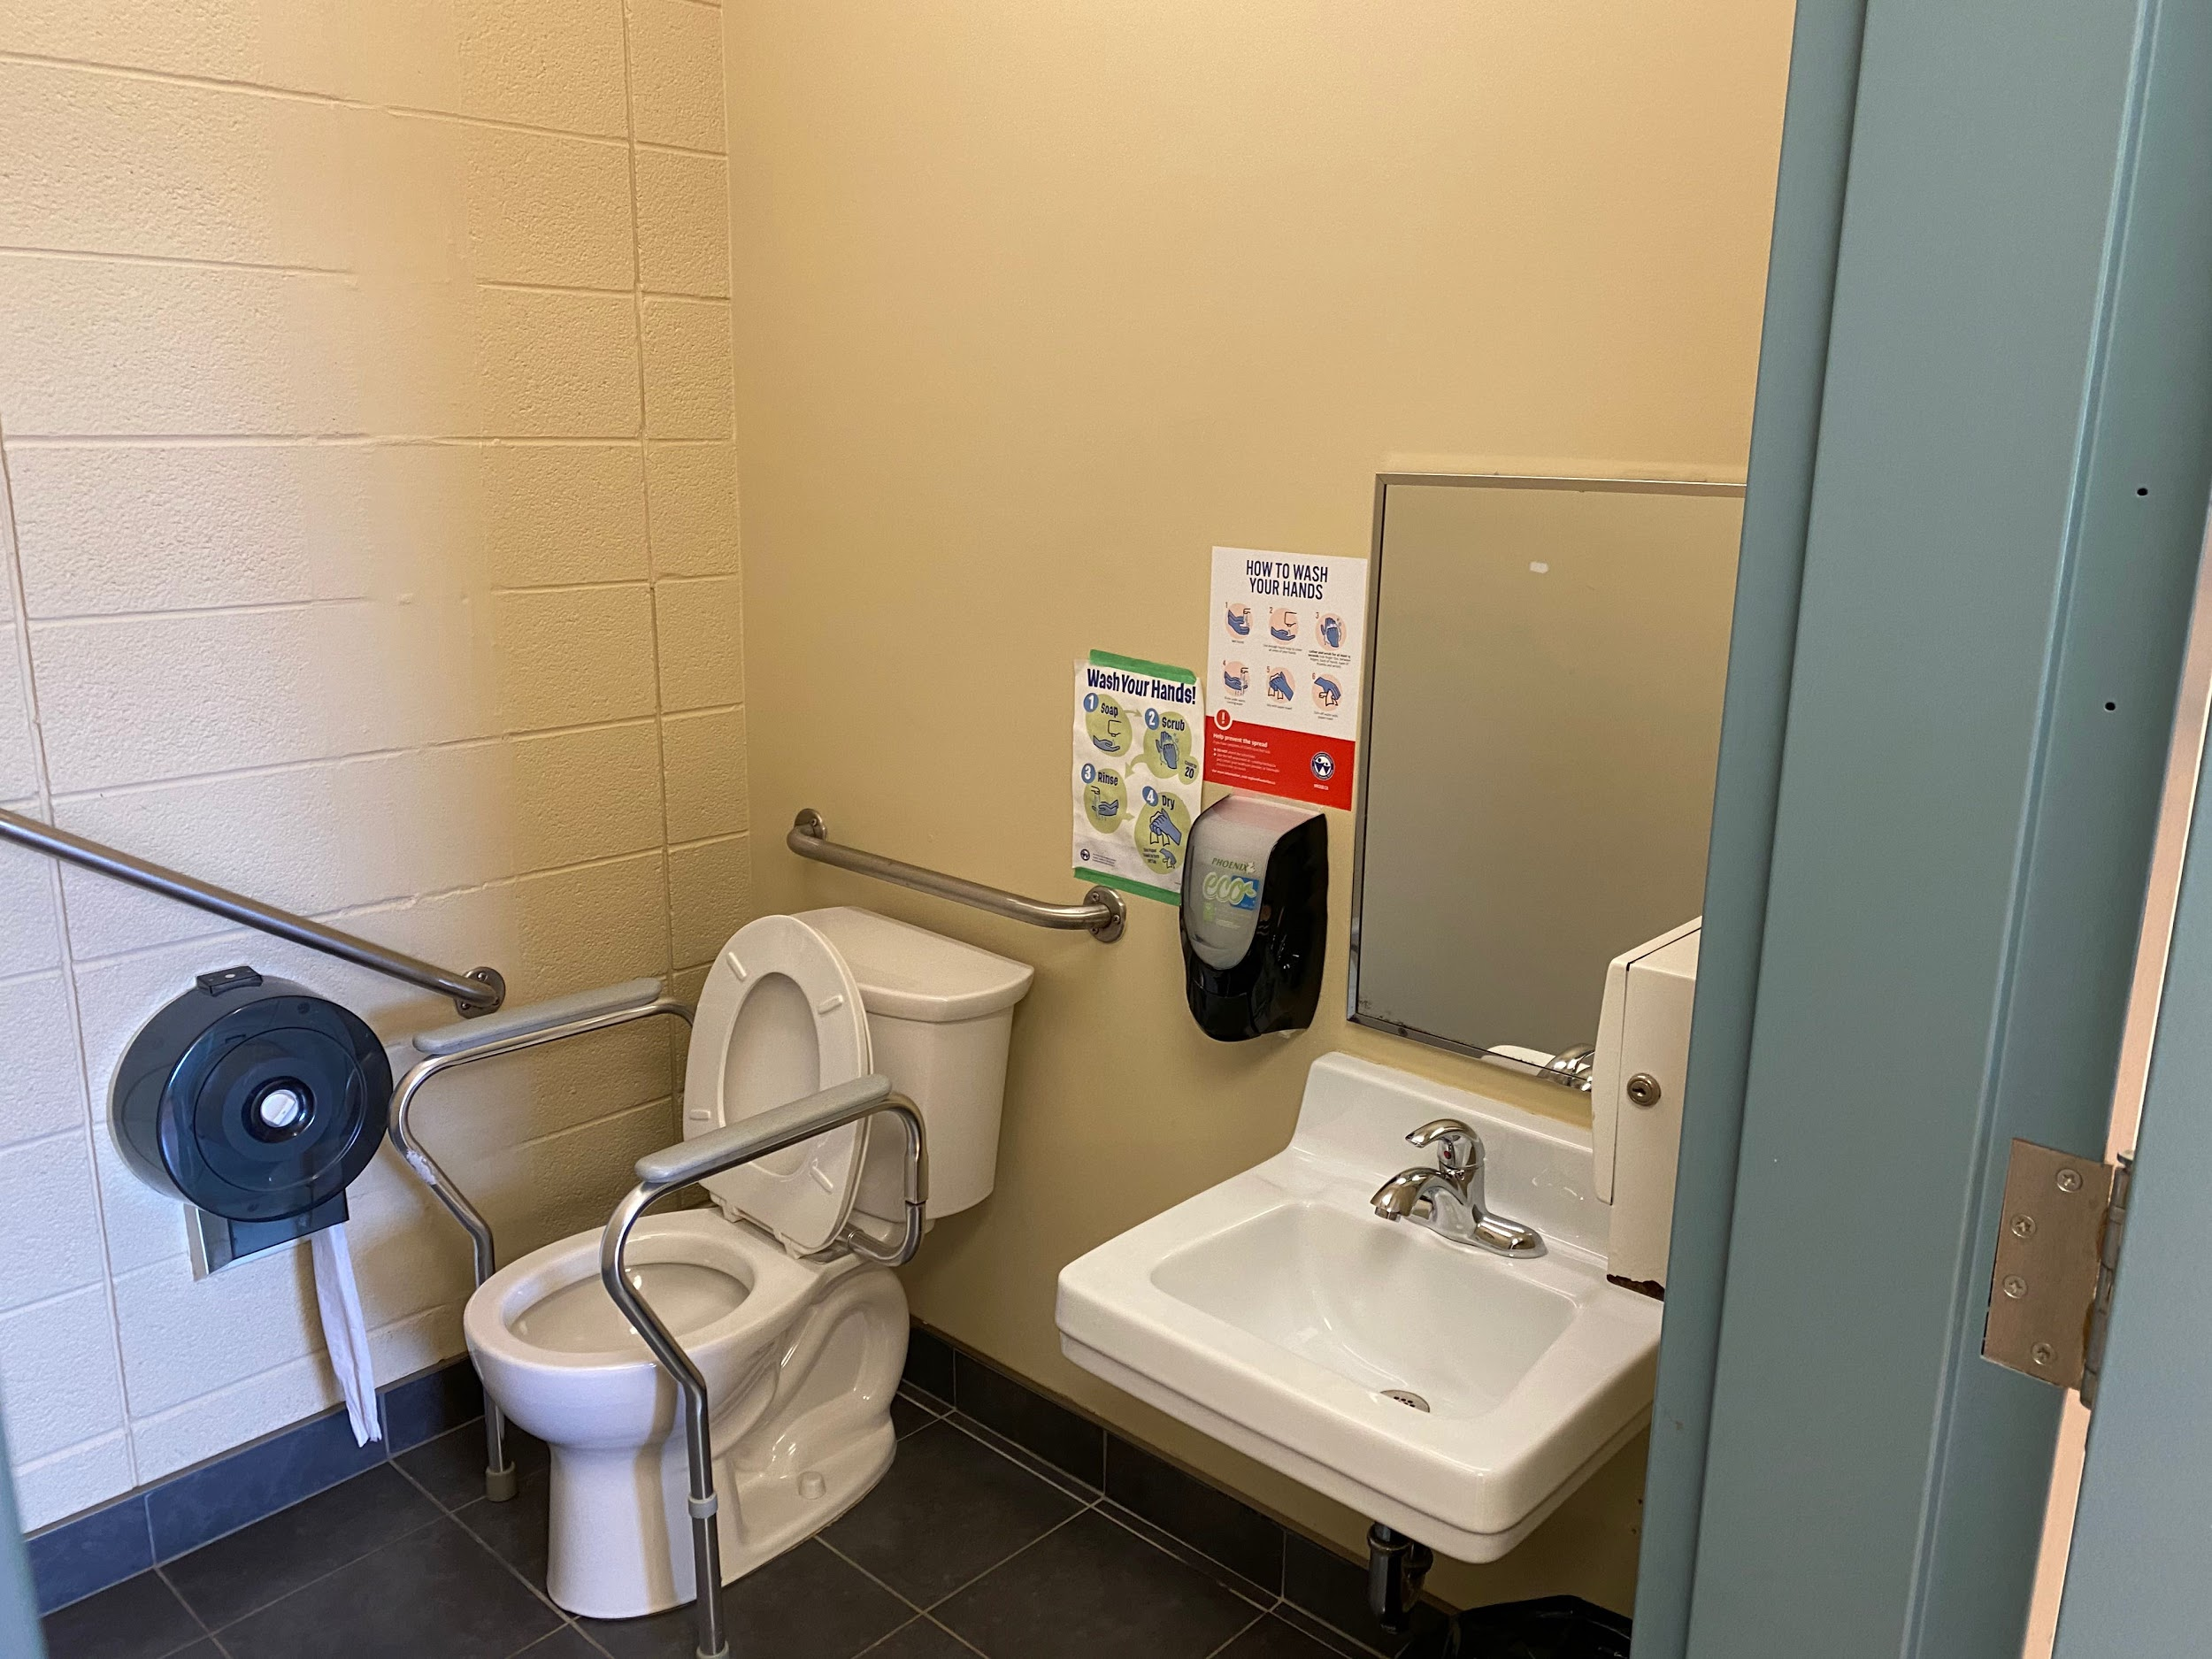
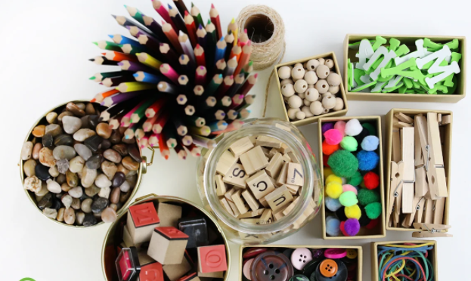
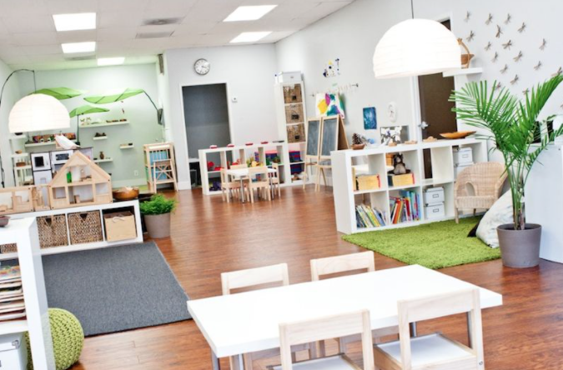
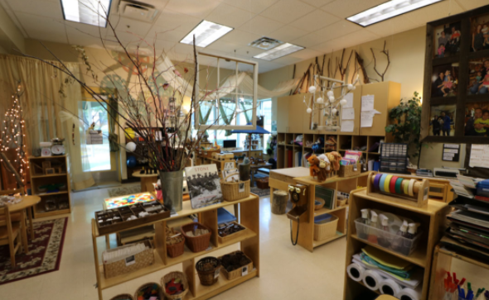
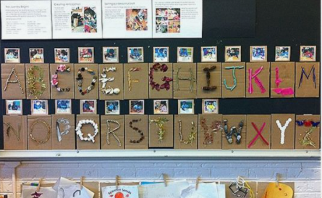
Take a peek into our Kindergarten classrooms!
Each Kindergarten room has a washroom.
Notes:
Mrs. Stumpf: And here are 2 of our 3 Kindergarten classes. They look a little different this year but they include inviting spaces for students to learn through play, inquiry, exploration, and a balance of teacher and student-led learning. Each classroom includes a washroom for our young learners.

Slide 20
Additional Information About our School
Start: 9:05 am
Dismissal: 3:25 pm
Nutrition Breaks: 40 minutes, twice
Bus: arrives in the ringroad, students led to their class lines
Notes:
Mrs. Stumpf: Next year, Glencairn’s school day will start at 9:05 am and go until 3:25pm. Drop off happens in individual class lines and students on the bus will likely be led to their particular class line-ups by a staff member. Nutrition breaks are traditionally 40 minutes including time for eating and time for outdoor play although schedules may have had some adjustments this year and into next year.

Slide 21
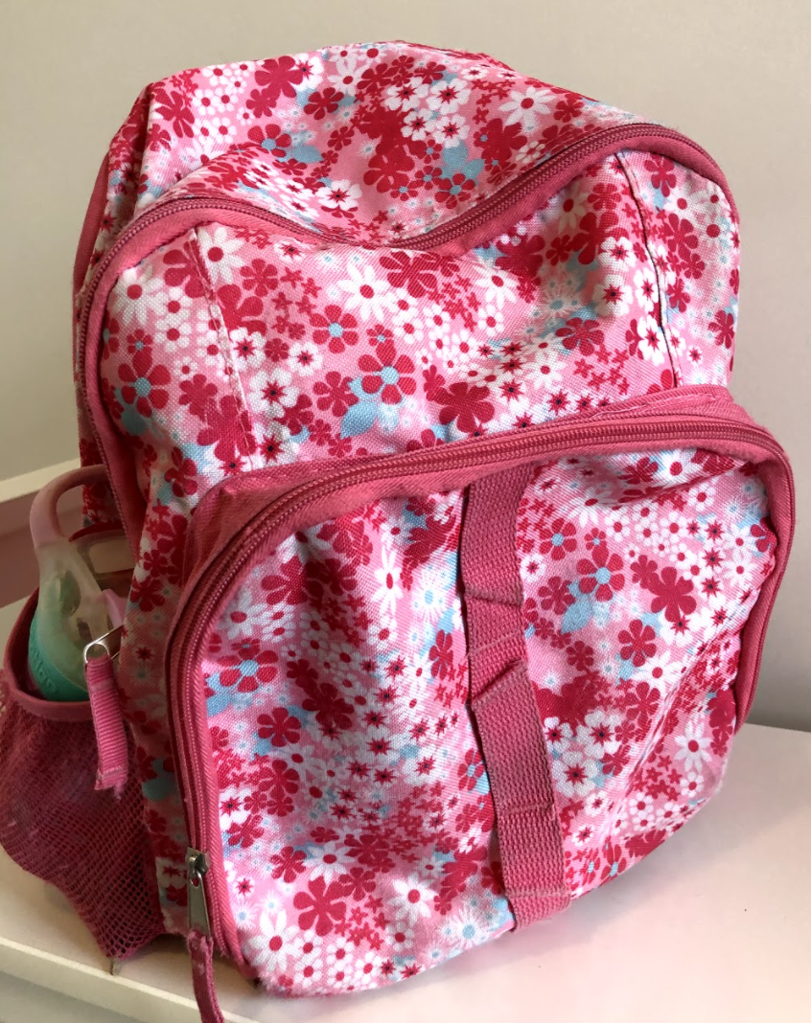
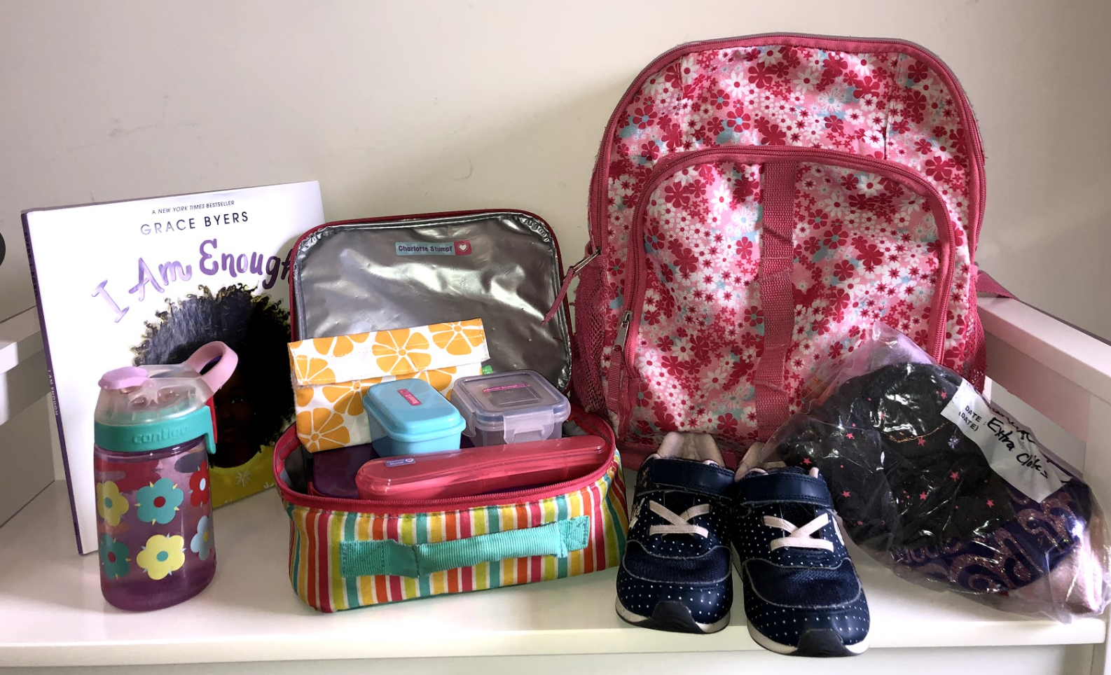
What to have for school:
You will likely need:
A good sized backpack (room for a library book!)
Water Bottle
Lunch(es) (think “independence”)
Indoor Shoes (no laces)
Label, Label, Label!
Notes:
Mrs. Stumpf: We’ve added this slide since many parents ask what items children should bring to school. This may change so be sure to look for information closer to September. Most years, it is great if students can have these items: a good sized backpack (big enough for a library book and all the other items needed), a water bottle, a good-sized lunch (children can get very hungry and we usually eat twice through the day), and indoor shoes. It’s also very important to label all your child’s belongings. One year, I had 3 students with the same boots and 2 pairs were even the same size! That’s a lot to sort out with many friends getting ready at once! Thank you in advance for labeling all of your child’s items!

Slide 22
Community Partners
Notes:
10 min.
Now our community partners are excited to share more about getting ready for school (here is a link to a doc that you may wish to share as well)
This slide will have a video about:
-packing healthy lunches
-dressing for independence (backpacks/shoes/zippers)
-creative exploration
-connecting with your community!

Slide 23
Community Partners
Looking for more opportunities in your community? Click the image below to learn more!
Community Supports in Kitchener
Notes:
Choose the video that applies to your school area

Slide 24
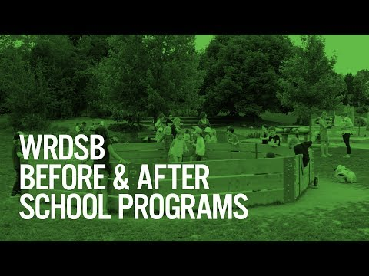
Visit our website for additional information: https://www.wrdsb.ca/beforeafter/ or direct your questions to care@wrdsb.ca
Notes:
(4:37)

Slide 25
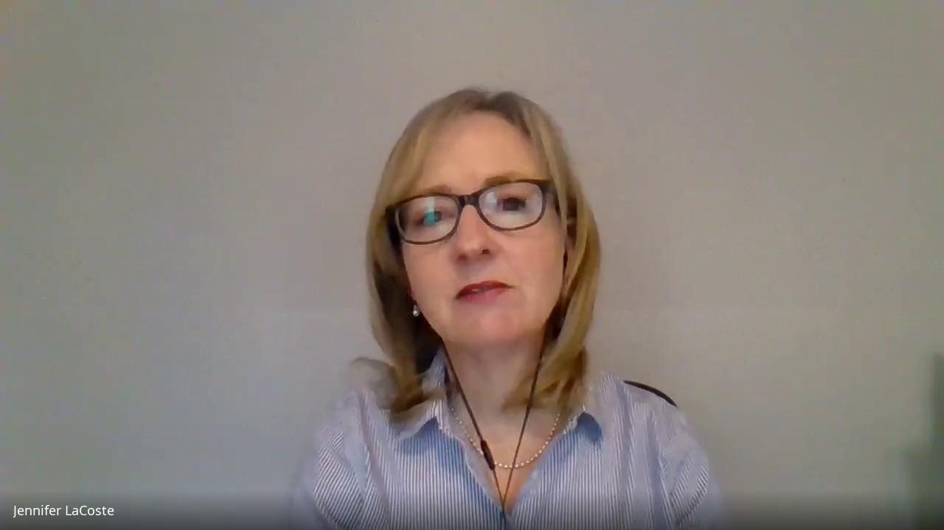
A message from WRDSB’s SLP team!
Notes:
(2:39) Our SLP team has a passion for helping children & their families! Click the image on this slide to read some easy ideas that will go a long way in helping you and your child as you get ready for this exciting school journey. There have also included some ways that you can ask for help if there is anything that you’re wondering about your child’s speech.
Welcome to Kindergarten from our SLPs

Slide 26
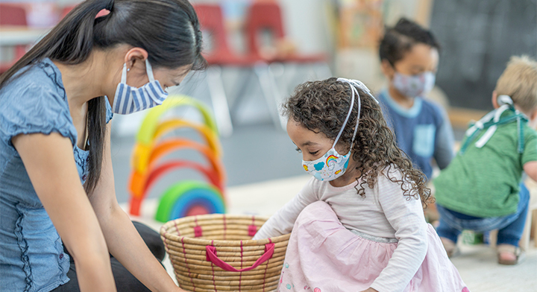
Your child’s safety & wellbeing is our top priority
Notes:
This slide will just be read (see below). We want to ensure families know that their children’s health and safety are of utmost concern without adding our own interpretations of what next year may or may not look like. Please stick to the script on this slide.
Script: “Your child’s safety and well-being are our top priority. This global pandemic has demanded us to be creative and flexible, and to adapt to a changing education environment. At the WRDSB, we work closely with, and take direction from, the Waterloo Region Public Health Department. We don’t know what our next school year will look like, but we are excited to welcome our new Kindergarten students in September!

Slide 27
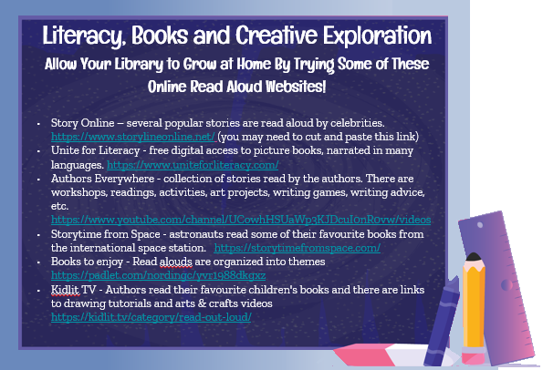
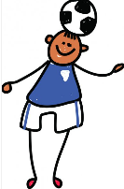
Additional Resources
Download the Welcome to Kindergarten app
There are more WTK Resources to Explore!
Visit the Welcome to Kindergarten website
Key Messages are available in 27 languages!
Parent Resource is available in 29 languages!

Slide 28
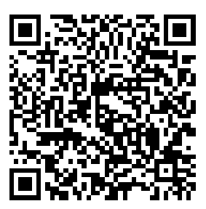
Tell us what you think!
The Learning Partnership is always looking to improve our programs by gathering feedback from families. Please help us by filling out our survey using the QR code or link below.
Link: https://www.surveymonkey.com/r/WTKParent21
QR Code:

Slide 29
Thank you for coming!
Look forward to meeting you in September!
Here you could describe the topic of the section

Slide 30
About The Learning Partnership
The Learning Partnership is a registered Canadian charity (CRA reg’n #140756107 RR 0001) that brings together business, educators and strategic partners to design and deliver innovation education programs focused on early learners in schools across Canada. Our programs build the essential skills and competencies needed in tomorrow’s leaders, innovators and problem solvers. They enhance provincial curricula, are aligned with Canada’s innovation agenda, and are made available to students, parents and educators through the generous support of our education sector partners and funding from corporate, government, foundation and private donors. Learn more at thelearningpartnership.ca.
Welcome to Kindergarten TM is a trademark of The Learning Partnership and is used with permission only.
Here you could describe the topic of the section

