Slide 1
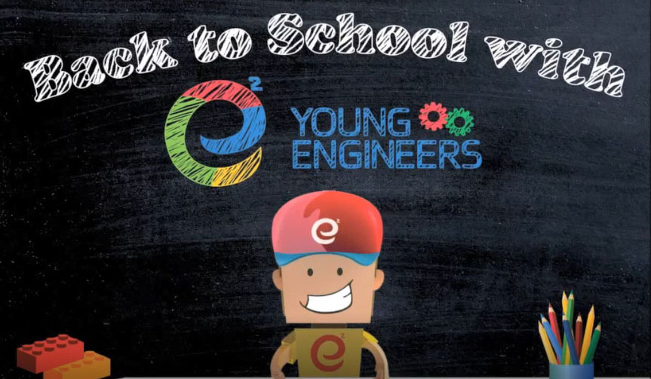
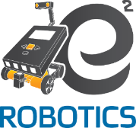
Proven concept!
Affordable!
Learning Math and Science in a fun way!
Our programs last for the entire school year
Science, Technology, Engineering, and Math (STEM) and much more
Target Age groups: 1st – 5th Grade Class Duration: 60 – 75 min.
Building Robots, Learning Algorithm planning, and Coding
Target Age groups: 6th – 9th Grade
Class Duration: 75 – 90 min.
Centre of Cooperation and Advancement survey on Young Engineers’ program in 2012
88% of students attending our classes have improved their math and had grades ranging from 85-100.
81% became more efficient in organizing their days
42% of students indicated that Young Engineers classes made them think about things they want to do in the future!
…plus, learning Problem Solving, Critical Thinking, better Communication
We are approved by Waterloo District School Board to teach Science, Math, and Technology at public schools. Our classes will take place at Groh
For price information and registration please visit our website at : www.kw.e2youngengineers.com
Or give us a call: 519-749-5993

