Slide 1
COURSE SELECTIONS
2019
January 2017

Slide 2
DATES
February 13-Specialty MSIP’s-Phoenix, ECO and Resource
February 14- Grade 9’s
February 15- Grade 10’s
February 19- GRADE 11 ASSEMBLY
February 20- Grade 11’s
February 21- Grade 12 and 12+
February 22- Clean UP
Students have until February 26th 3:00 p.m. to make changes.
Files are then moved from My Way to Trillium
and course changes must be made through a counsellor.

Slide 3
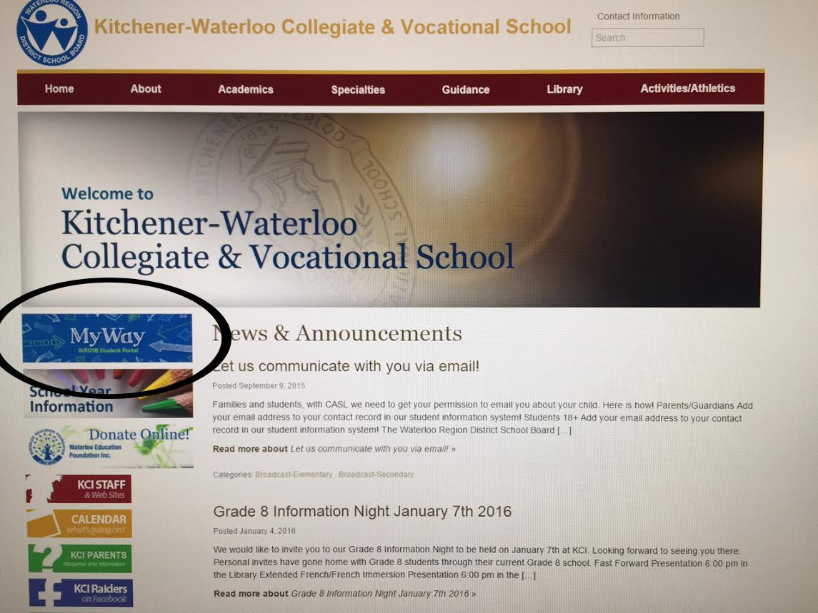
Save this page to desktop or favourites!!!

Slide 4
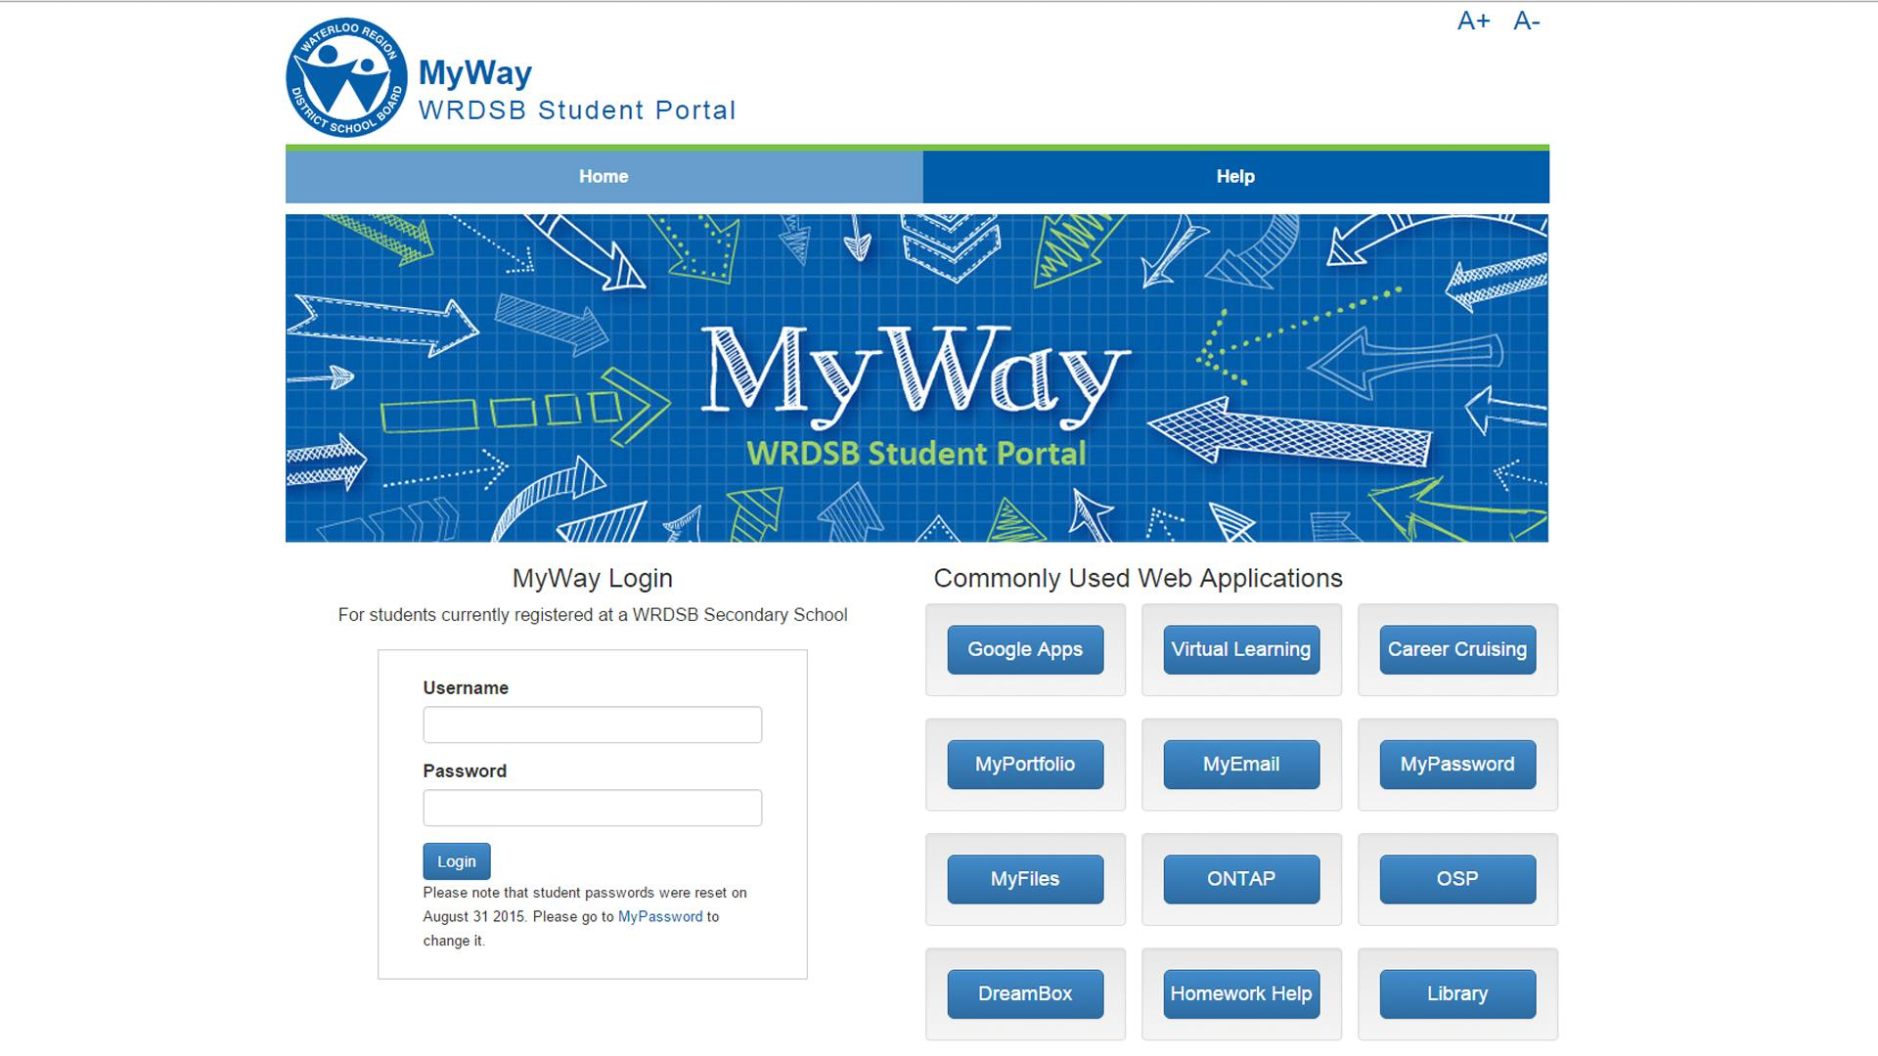
Regular school username and password

Slide 5
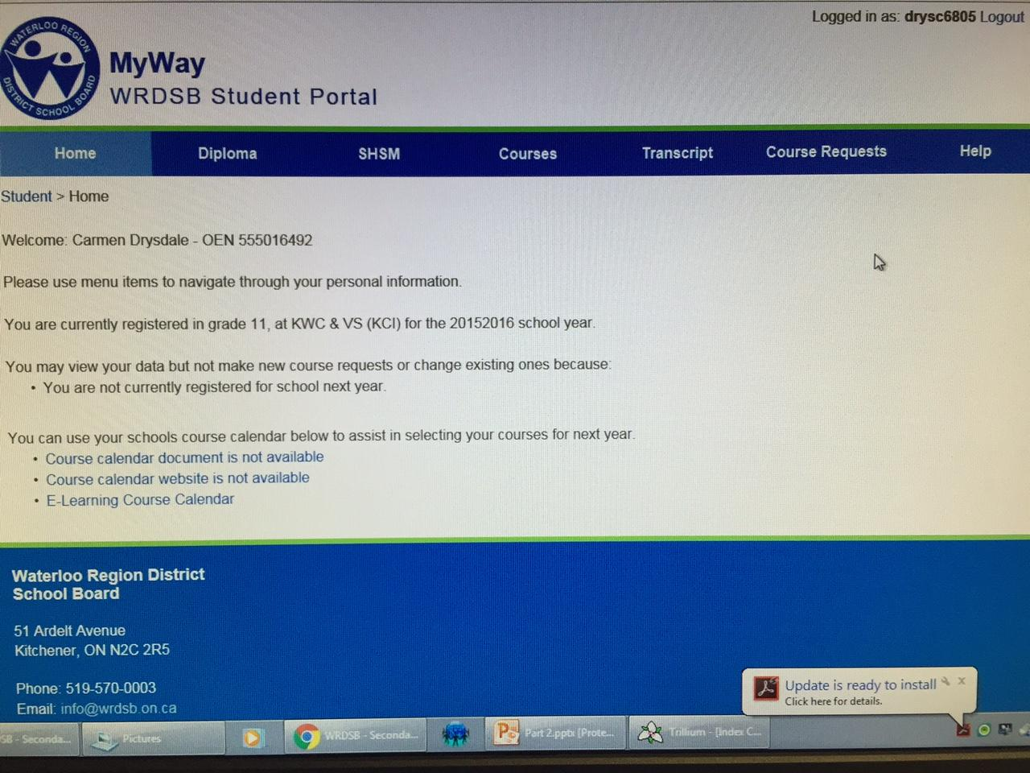
Enter here

Slide 6
Online course selections are completed by students and their counsellor in a
the cafeteria during MSIP
Online course selections are completed by students and their counsellor in a
computer lab during MSIP

Slide 7
THE CAFETERIA
Doesn’t interfere with other classes
Are just another opportunity to use chrome books
Allows for large groups. Ideas are shared amongst staff and students.
In turn this creates a buzz of excitement around course selections.

Slide 8
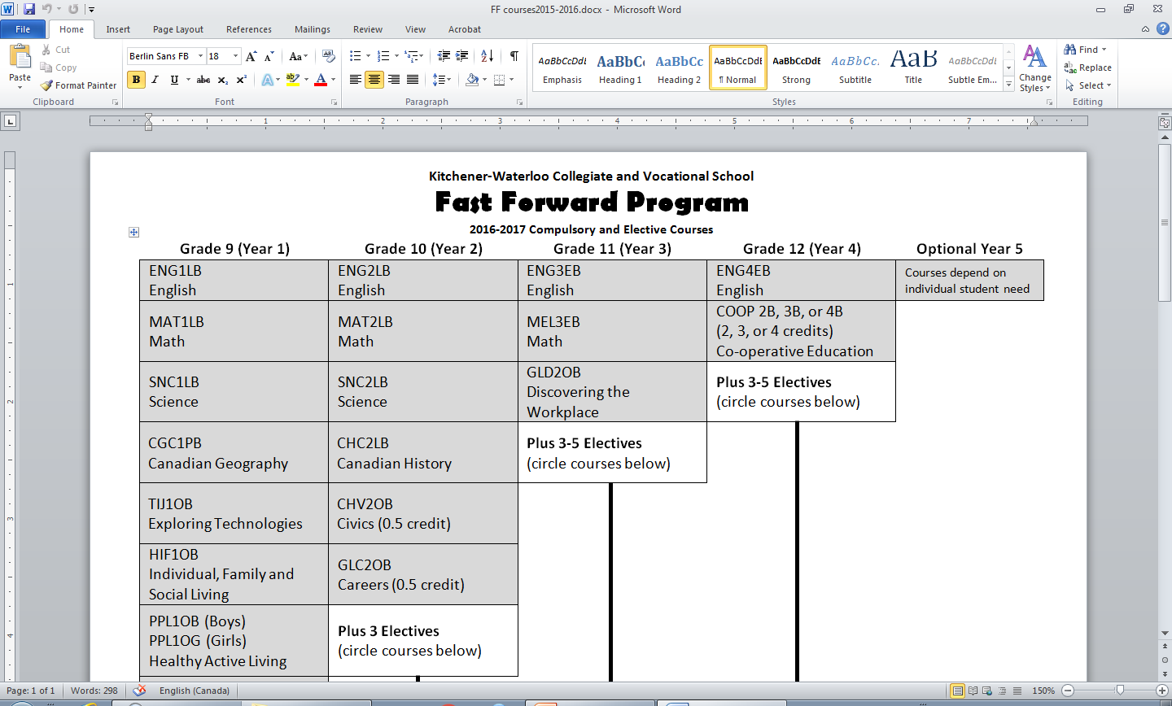
FAST FORWARD SELECTION GUIDE
Fast Forward Course
Planning Sheet

Slide 9
PLANNING SHEET FOR GRADE 10

Slide 10
INSTRUCTION SHEET

Slide 11
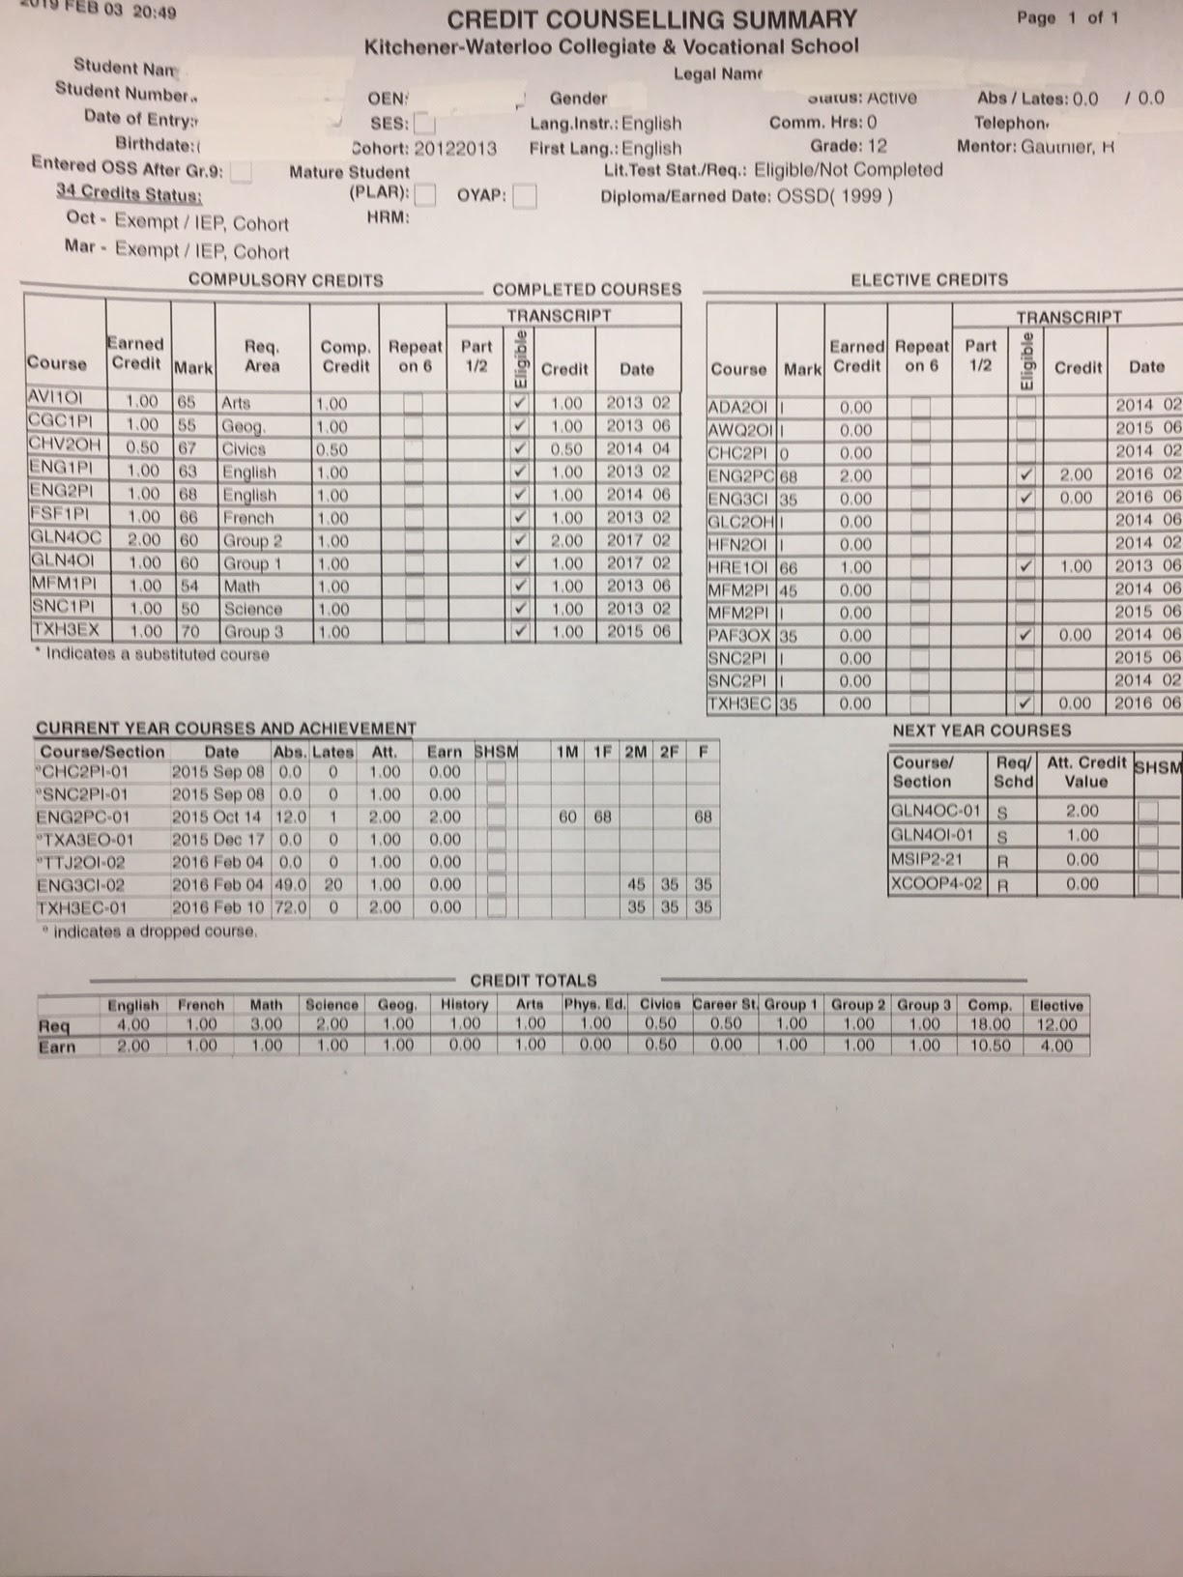
PERSONALIZING THE CCS
You still need your history and your grade 11 English. Let’s discuss the workplace level math. I think you’ll find success with it.
ENG4CI MEL3EI
MEL4EI SNC2PI
CHC2PI POX
Plus two electives. COOP?
GLC2OH-Can we talk about summer school? Call me over.

Slide 12
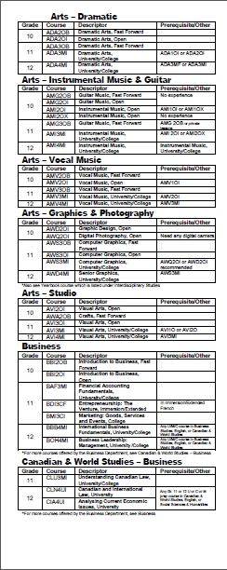

Slide 13
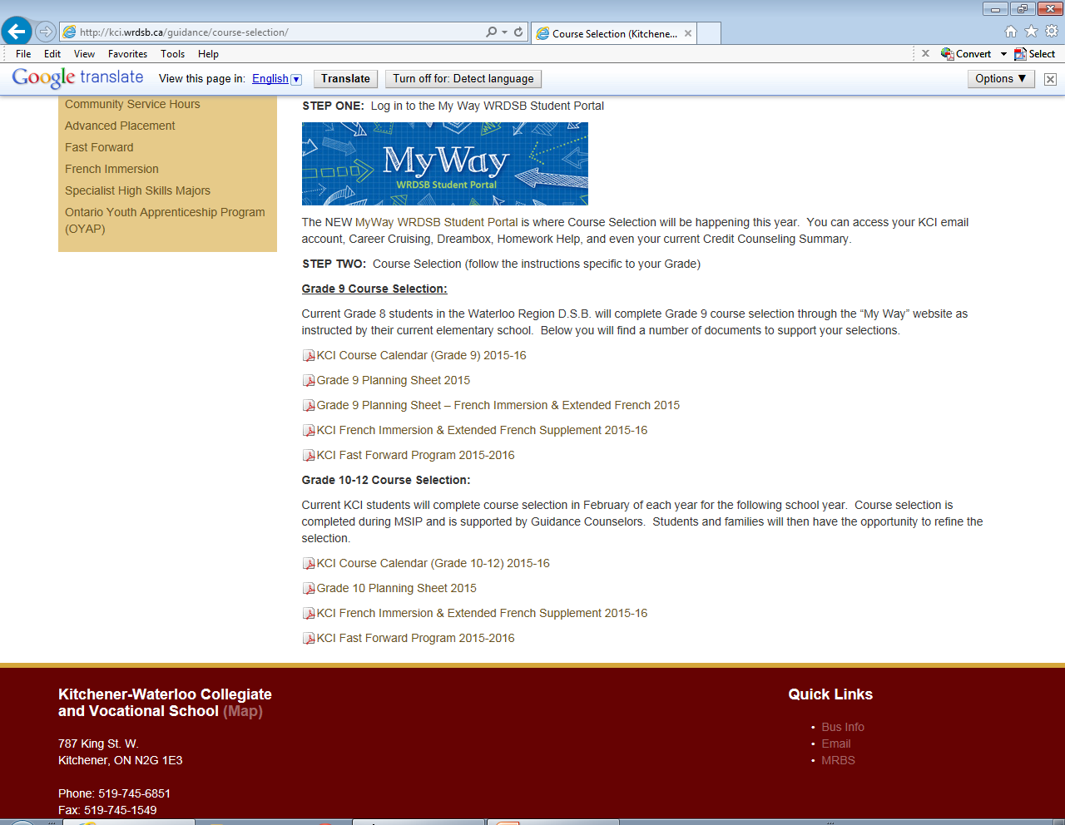

Slide 14
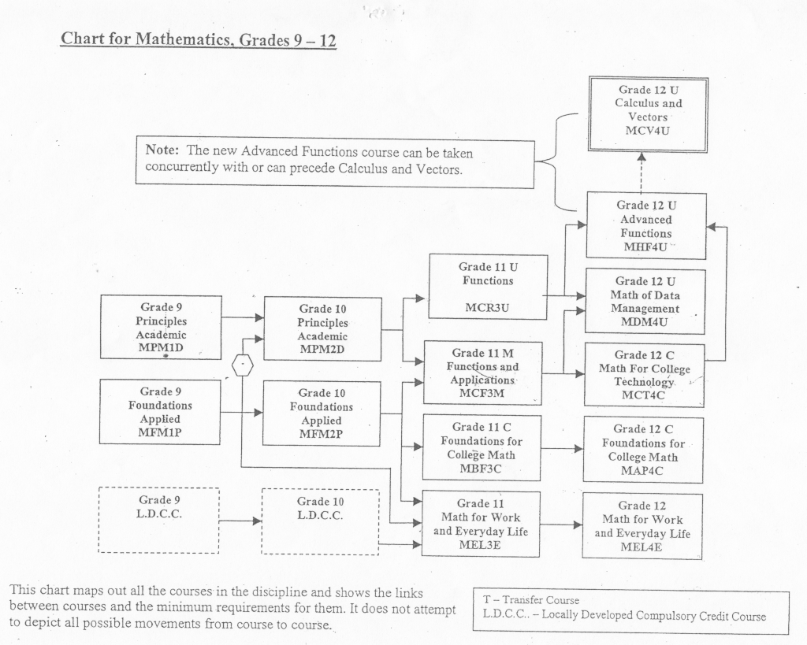
NOTE THE MATH PATHWAYS
A minimum mark of approximately 75% is recommended in all maths to proceed to the next level.

Slide 15
HELPFUL TO KNOW
To to take a grade 11 drama, vocals or visual arts course, a students
requires only one prior course in that subject at that grade 9 OR 10 level.
Each of these courses can count toward university, so a student may
consider reaching ahead to the grade 11 in grade 10.
Students who wish to take grade 11 graphics must complete either grade 10
graphics or grade 10 photography.
. Students wanting to take tech course (T codes) may begin a course in grade
11 as there is no prerequisite.
Students who took BBI1OF may not take BBI2OI.
Students who take ETS4CY may not take ETS4CX and students who take
ETS4UY may not take ETS4UX. They are considered repeat credits.
Students who take IDC4UX may not take IDC4UI. This is also a repeat
credit.
ENG4CI MEL3EI
MEL4EI SNC2PI
CHC2PI POX
Plus two electives. COOP?
GLC2OH-Can we talk about summer school? Call me over.

Slide 16
IN GENERAL
All university programs will require six grade 12 courses at the M
(college/university) or U (university level).
Most science programs will require U level math and two U level sciences.
Most often chemistry and biology are for health sciences. U level math,
physics and chemistry are always needed for Engineering. Review
admission requirement early.
Most university business programs will require two of Data, Advanced
Functions or Calculus. However, some will not accept Data.
Most college programs require grade 12 college English. However, there
are many for which you need only an OSSD.
College science programs usually require two grade 11 or 12 college sciences.
Most college level business programs also require grade 11 or 12 college math.
College now offer multiple degrees. The requirements are the same as university.
ENG4CI MEL3EI
MEL4EI SNC2PI
CHC2PI POX
Plus two electives. COOP?
GLC2OH-Can we talk about summer school? Call me over.

Slide 17
QUESTIONS
Students can fill in a pink appointment slip.
Students can also see if their guidance counsellor is free during MSIP, lunch,
after school or during a spare.
For simple questions, students might also consider sending an e-mail.
Finally, students are encouraged to follow the Guidance classroom
for updates and information.
ENG4CI MEL3EI
MEL4EI SNC2PI
CHC2PI POX
Plus two electives. COOP?
GLC2OH-Can we talk about summer school? Call me over.

