Slide 1
PIC celebrates Black W.O.W.
(Women of Wonder)
Presented by WRDSB
Parent Involvement Committee

Slide 2
BLACK HISTORY MONTH
Black history month was officially recognized in Canada in 1995 in the House of Commons.
The motion was introduced by Dr. Jean Augustine who is one of our Women Of Wonder.
Each year, there has been a different theme and the theme for 2024 is “Black Excellence”.

Slide 3
BLACK W.O.W. (WOMEN OF WONDER)
PIC has created a series of social media posts and biographies celebrating black Canadian women.
This series celebrates some of the notable black women who have contributed to Canada's past, present and future.
Many of these women have broken glass ceilings to become the first black woman or the first black person in their field in Canada or in their home province.

Slide 4
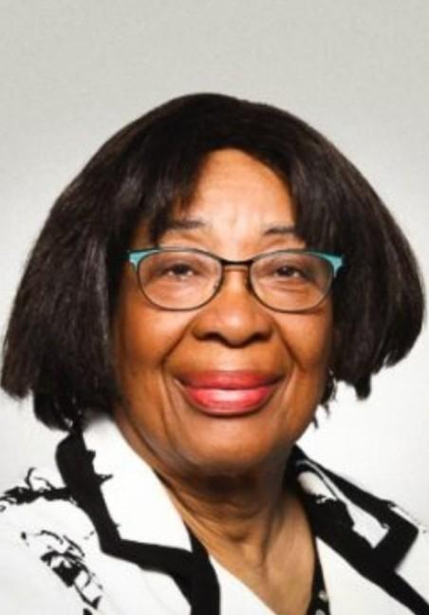
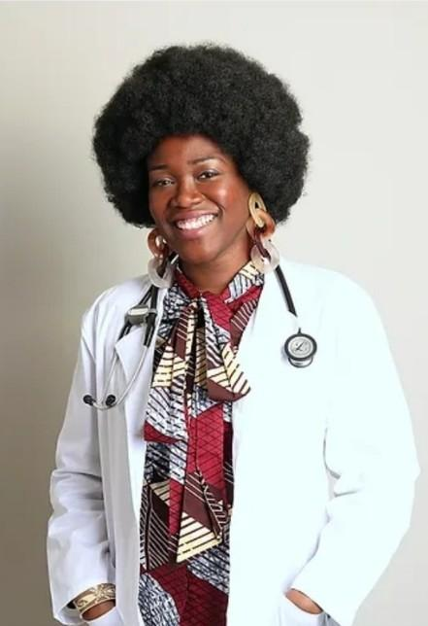
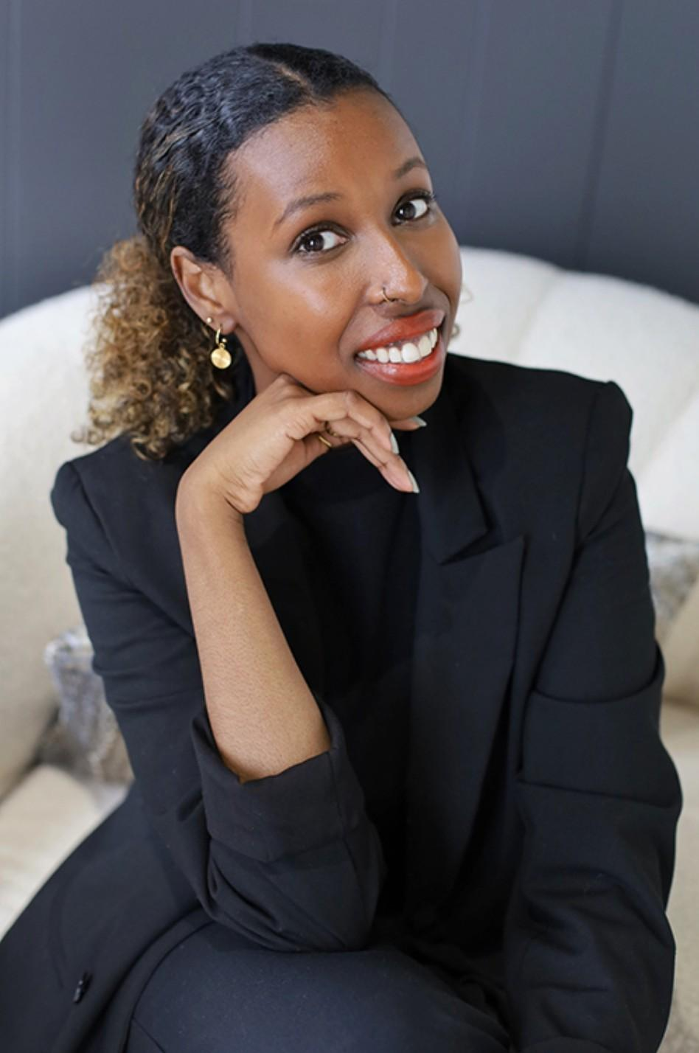
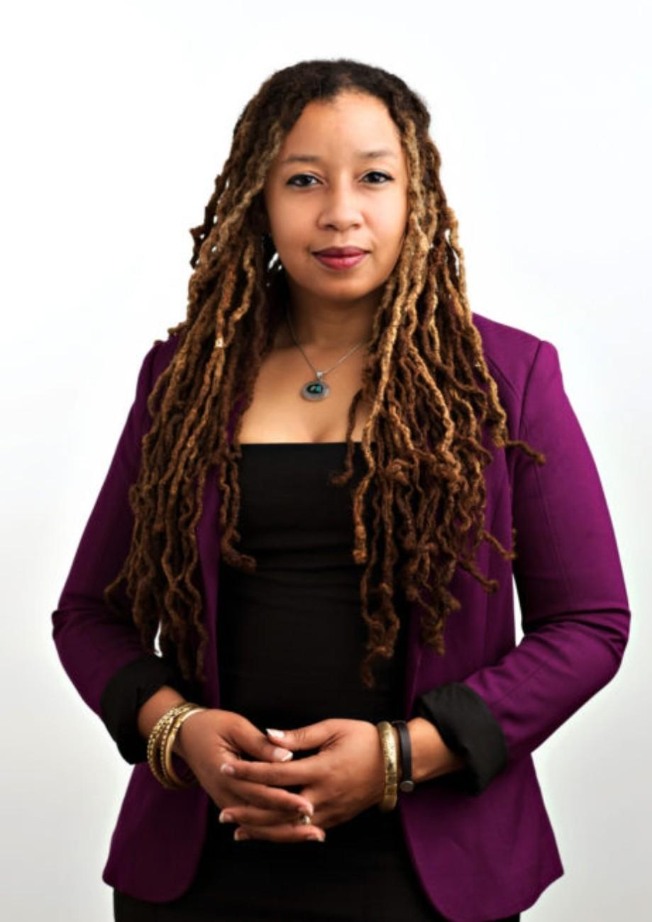
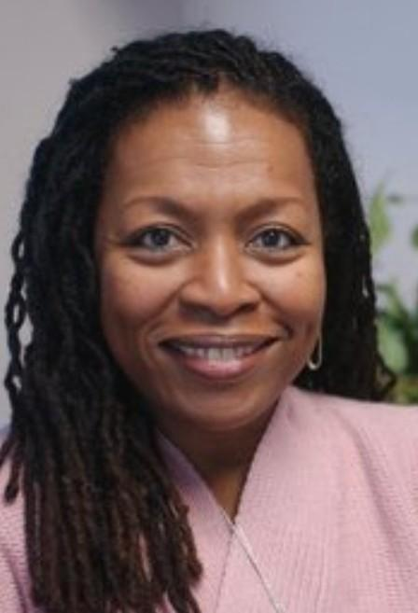
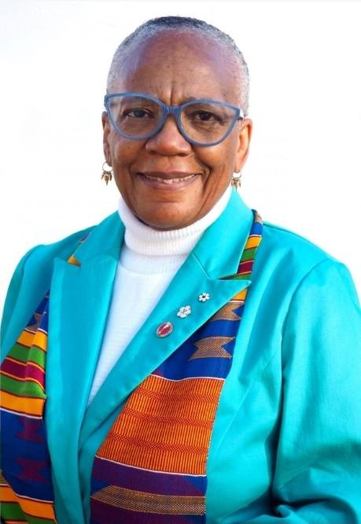
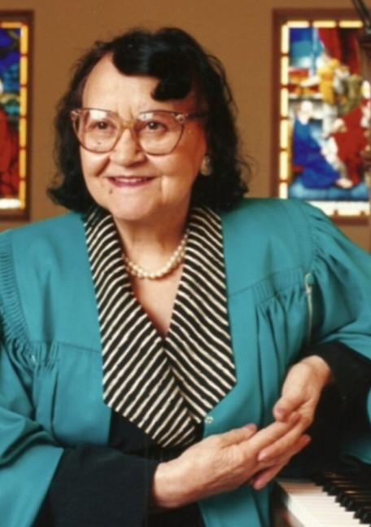
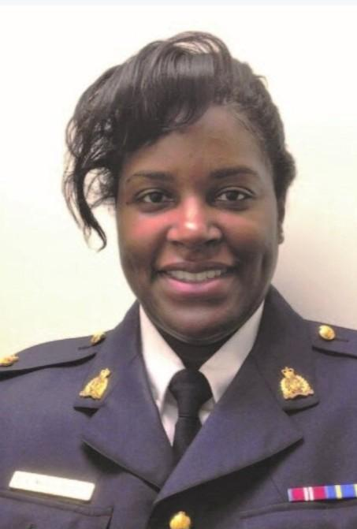
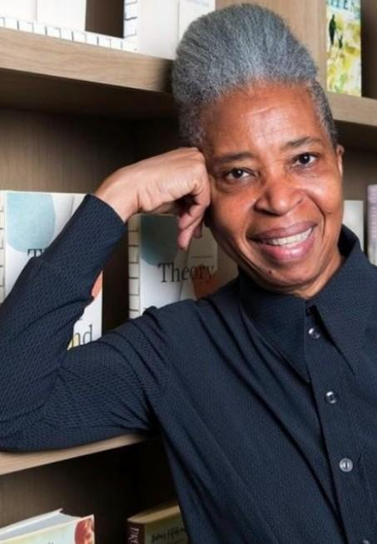
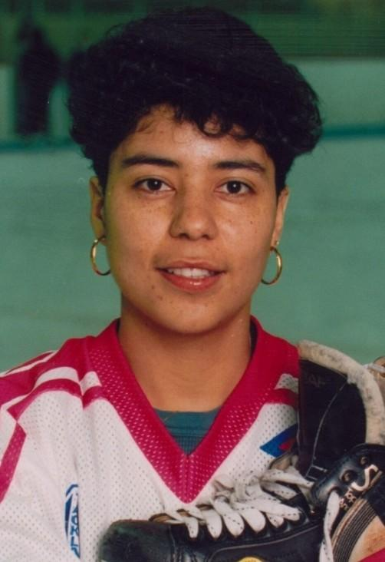
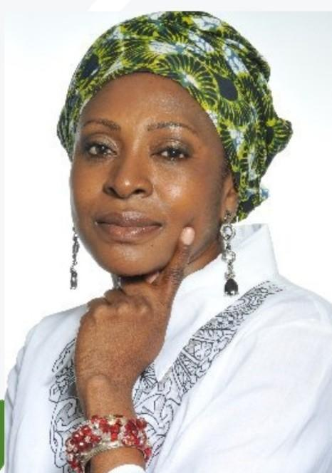
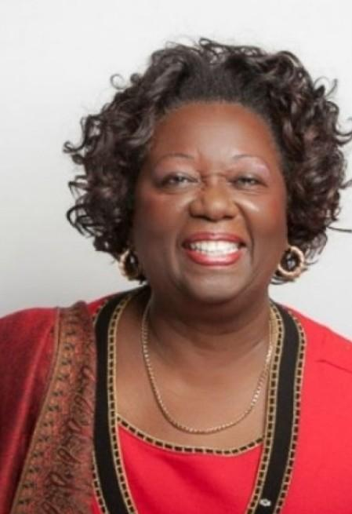
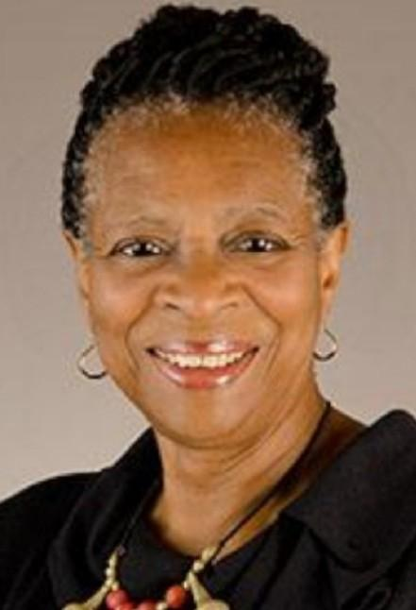
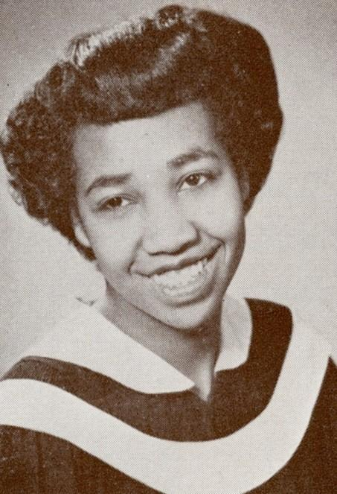
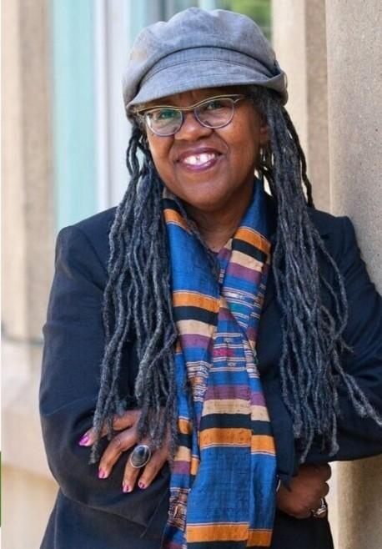
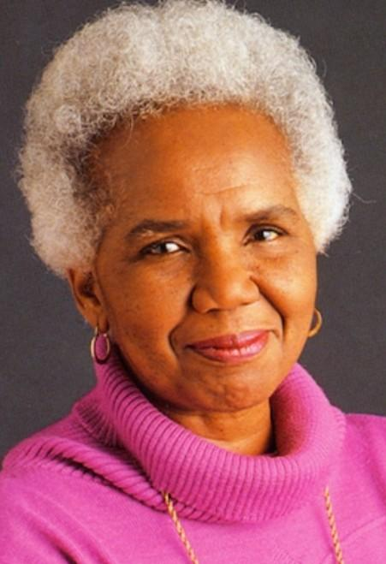
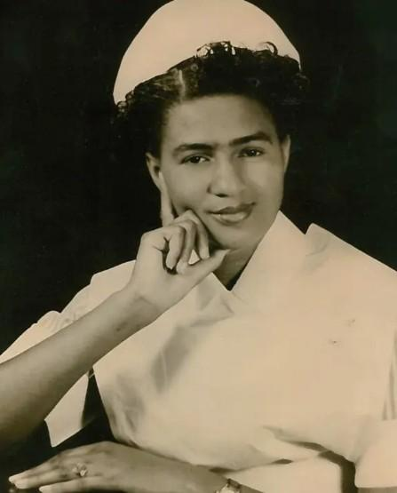
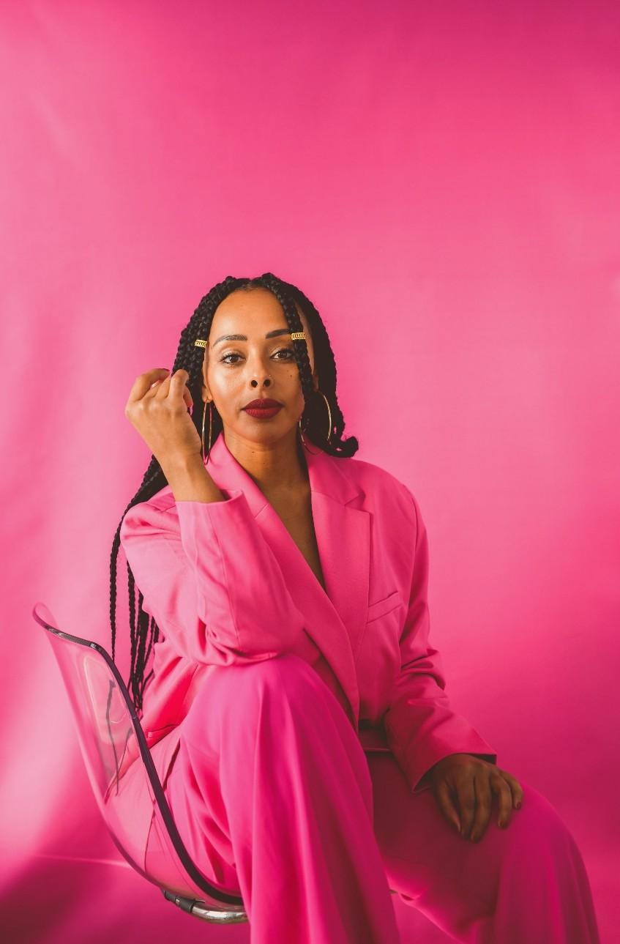
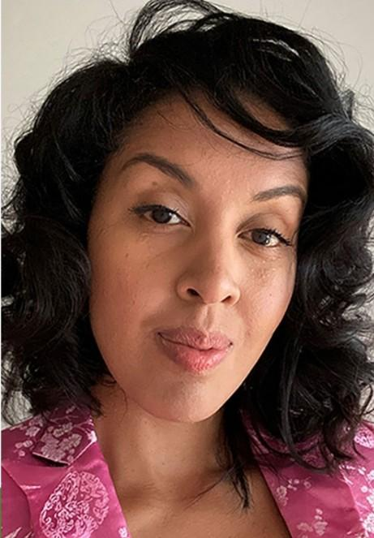
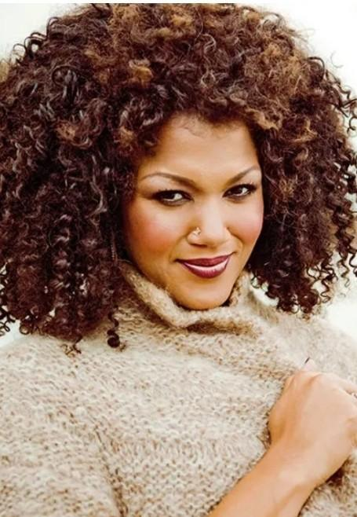
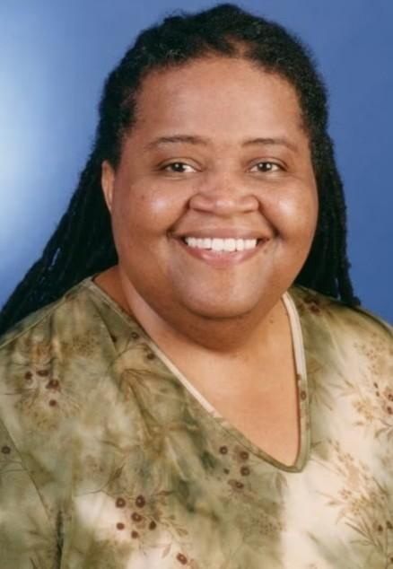
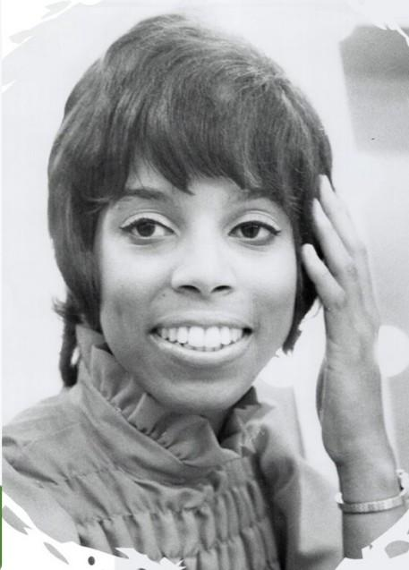
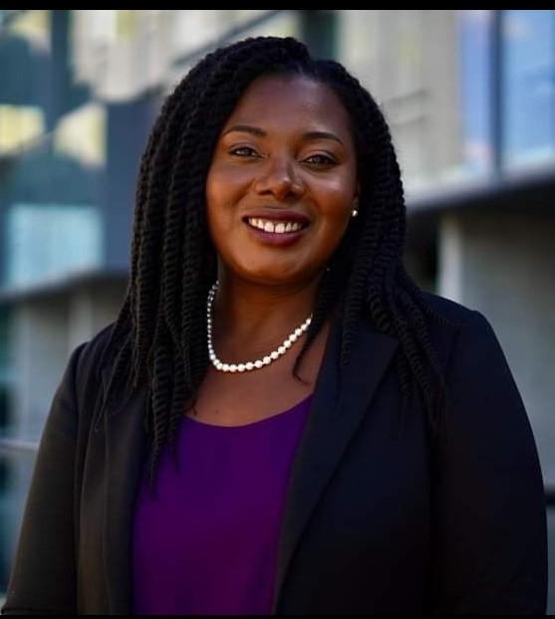

Slide 5
BLACK W.O.W (WOMEN OF WONDER)
Many of these women of wonder represent intersectional identities
🇸🇴 🇹🇹 🇭🇹 🏳️‍🌈 🇯🇲 🇵🇦 🇨🇦 🇬🇩 🇪🇹 ♿
Some are immigrants or born to immigrant parents. Many are multiethnic eg. Afro-Latina, Inuk-Jamaican. Some live with visible and invisible disabilities.
They have all excelled in their fields of academia, performing arts, medicine, law, politics, social justice, community advocacy and activism.
Through their work, they are all champions of human rights in Canada and that's why they are our focus for black history month..

Slide 6
PIC
Contact info:
Website: https://www.wrdsb.ca/pic/
Email : pic@wrdsb.ca
Social Media:
Facebook: WRDSBPIC
Instagram: @pic_wrdsb
X (Twitter): @PicWRDSB

