Slide 1
CREATING AND USING A STUDY OUTLINE

Slide 2
WHAT IS IT?
This is a method to both:
Track each topic you need to know for your exam
AND
A study tool!

Slide 3
HOW DO YOU MAKE IT?
You need your NOTES - preferably IN ORDER
Go through your notes chronologically (in order of time)
Write down the main topic of the note, and any subtopics.
HOW DO I KNOW WHAT THE TOPICS ARE?
Use the titles on your notes!
Subtitles are subtopics!

Slide 4
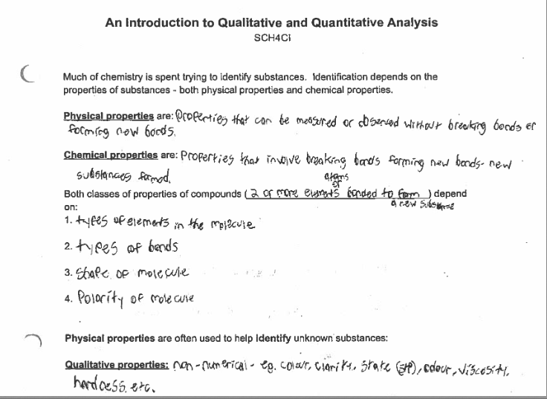
EXAMPLE:

Slide 5
PRO TIP:
Keep a table of contents of all of your notes as you get them through the semester.
You can do this manually by putting a blank piece of paper in the front of your binder - one piece of paper for each subject.
Write the date and the topic covered that day - you can even number your pages and use those to organize your table of contents.

Slide 6
HOW DO I USE IT?
Once you have your outline complete, it now becomes a study tool.
Put your notes away.
Write down everything you can remember about each topic or subtopic (you can type it instead!) WITHOUT looking at your notes.
Star items for which you can recall nothing - these are your priority to study.
As you study, refer back to your study outline and test yourself for what you remember or understand.

