Slide 1
Managing Exam Stress

Slide 2
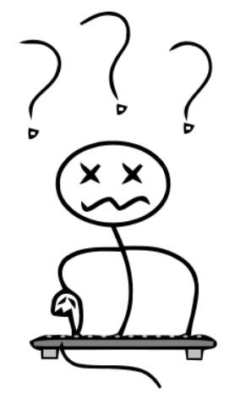
What it Looks Like
Feeling confused
Losing touch with friends
Feeling moody and low
Having trouble making decisions
Feeling overwhelmed
Lack of motivation to do anything
Trouble sleeping or getting out of bed
Tense muscles or headaches
Having an upset stomach or feeling sick
Fidgeting, nail biting, teeth grinding

Slide 3
Why People May Experience It
Worry they might fail
Don't feel prepared
Want to do really well
Don’t have much time to study
Find it hard to understand what they’re studying
Don’t think they will do well
Feel pressure from family
Feel they need to compete with others
Have other things happening in their life

Slide 4
Ways to Avoid Exam Stress

Slide 5
Get Ready to Study
Find a quiet place to study
Reduce the clutter in your study space
Determine what will be on the exam
Choose a study method that suits your learning style
Make a study plan
Take regular breaks
Ask for help

Slide 6
Leading up To Exam Day...
Eat and sleep at the same times each day
Get a good night’s sleep
Give yourself mini rewards
Avoid distractions
Eat a well-balanced diet (avoid junk food)
Take relaxation breaks
Drink plenty of water (not energy drinks)

Slide 7
On Exam Day...
Organise needed materials the night before
Eat a good, light breakfast
Go to the bathroom before the exam starts
Take time to slow your breathing and relax.
Read through the exam paper carefully and underline key words and instructions
Work out how long you have for each question or section
Work on the questions that you find easiest first

