Slide 1
Using Previous Tests to Study

Slide 2
Gather Your Materials
every test from the semester
all the notes from the semester
any corrections you have already made when they were taken up in class

Slide 3
Make
Notes
material that appears multiple times is clearly important
how has the material been tested before?
types of questions on tests are likely similar to the final exam

Slide 4
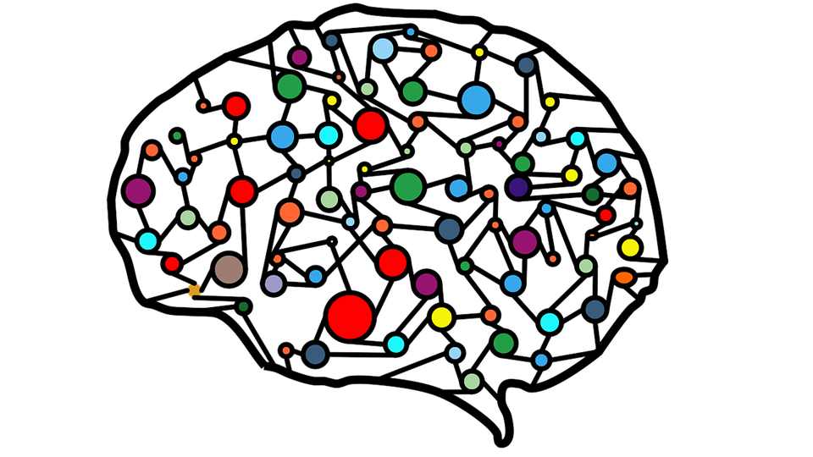
Correct Errors
re-engage with material
verify correct information from notes
solidifies learning
improves understanding
strengthens neural connections to the information

Slide 5
Redo the Tests
answer the questions again without looking at your previous answers
have a friend or parent quiz you
make note of continued errors for further revision
go back to your notes to find the correct answers

Slide 6
Make up New Questions
similar to the types asked before
use notes to determine content
answer them and check your work

Slide 7
Talk to Your Teacher
if you still have questions or are confused, talk to your teacher to clarify concepts

