Slide 1
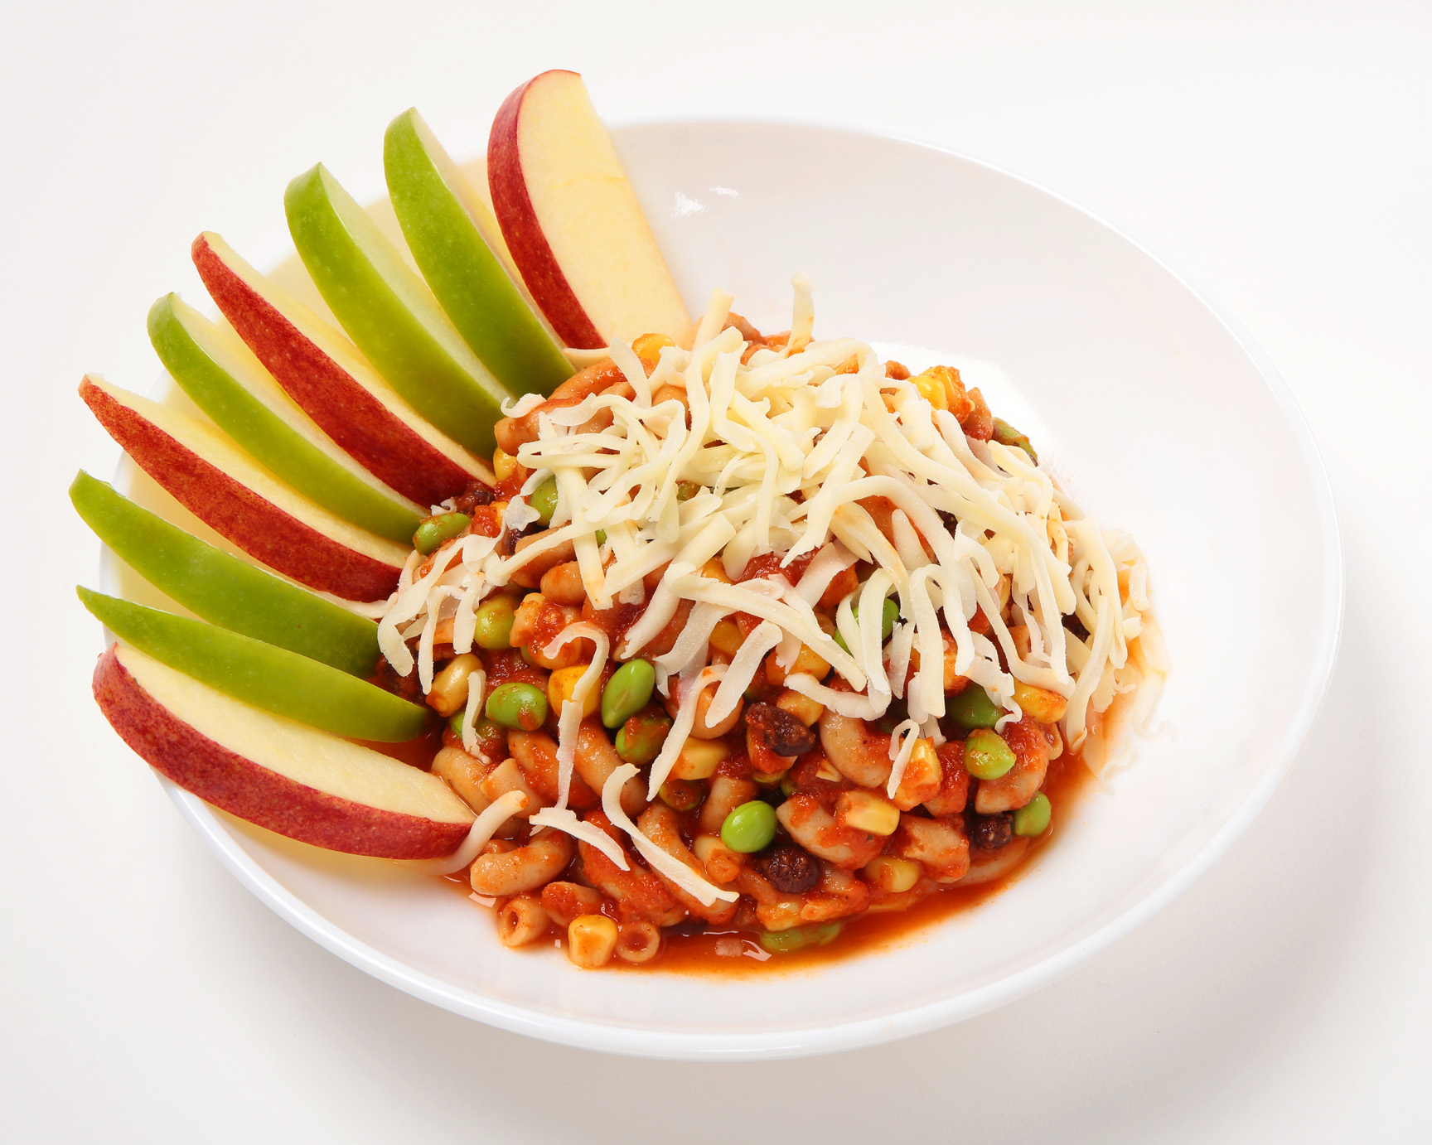
More Lunch Options available online at www.thelunchlady.ca
Including Little Lunches –Just Plain - Larger Servings – Gluten Free - Halal
Try our AWESOME new Smoothie and Wrap Specials.
PREMIUM SMARTER MEALS
Cheese Topped Campfire Chili Macaroni with side Apple Slices (featured) Cal 410 Sod 300mg Fat 9g Pro 11g | $5.75
3 Whole Grain Pancakes with Yogurt/Berries Cal 550 Sod 710mg Fat 4g Pro 13g | $6.25
Teriyaki Chicken Rice Bowl , steamed Veggies & Orange Slices Cal 460 Sod 520mg Fat 4g Pro 20g | $6.25
Smiling Shepherd’s Pie & side Peach Slices Cal 317 Sod 241mg Fat 9g Pro 19g | $6.25
Potato & Cheese Perogies, Power Mix Veggies, side sour cream & Applesauce Cal 465 Sod 610mg Fat 8g Pro 14g | $5.75
Garlic Chicken Penne, Peas & Carrots & side crunchy Apple Slices Cal 385 Sod 285mg Fat 6g Pro 21g | $6.25
Sunshine Sandwich (Egg Pattie and Mozzarella) with side Salsa & Fresh Orange Cal 275 Sod 615mg Fat 9g Pro 16g | $5.75
We are proud to meet PPM150 guidelines and support healthy choices at your school
POPULAR BALANCED LUNCHES
Home-made Macaroni and Cheese and steamed Veggies | $5.00
Baked Chicken Fingers, Whole Grain Rice and Niblet Corn (option - Potato Wedges $5.25) | $5.00
Spaghetti and Mini Beef Meatballs with our kitchen crafted Pasta Sauce | $5.00
Real Cheddar Grilled Cheese Sandwich and Tomato Soup (option - Fresh Veggies $4.75) | $6.00
Cheddar Cheeseburger and Baked Potato Wedges (option- Fresh Veggies $5.80) | $5.95
Pancakes (2) and Turkey Sausage(1), side syrup and Unsweetened Applesauce | $4.75
Potato “Volcano” exploding with Beef Meatballs, Gravy & Niblet Corn | $5.00
Cheese Tortellini with Tomato Sauce and steamed Green Beans | $4.75
Hearty Veggie Chili over Whole Grain Rice | $4.75
BBQ Chicken Drumstick, Potato Wedges and Niblet Corn | $5.00
SEE THE WHOLE MENU ONLINE!
Visit www.thelunchlady.ca ORDER NOW Set up new accounts or use an existing account to login. Select the menu you want from the menu drop down
Order Deadline? – While you can access our site 24/7, please complete your orders or changes 3 school days prior to any delivery date . Contact us if you miss the order deadline and still want to order. Order one lunch or a bunch. Allergies? – It is really important that you call or email us prior to ordering. We can help Sick Child? – We understand . Call by 8am to receive a credit to use another time. Sorry no refunds, credits only. Uncollected lunches are not left at school Order Another Way? – Need an alternate ordering or payment option like e-transfers. Just ask us EVERYONE WINS! Each individually prepared meal includes a contribution to your school, personalized service and all applicable fees.
A WIDE RANGE OF HOT AND COLD SIDES AVAILABLE ONLINE
Warm Soups | Warm Garlic Bread | Smoothies & Yogurt Parfaits
Bakery Treats | Baked Potato Wedges | Milk & Juice
Side Salads | Fresh Fruit & Veggies | Plastic Cutlery
Savoury Snacks | Extra Proteins | Fixings, Dips & Condiments
amin@thelunchlady.ca
519-513-9858

