Slide 1
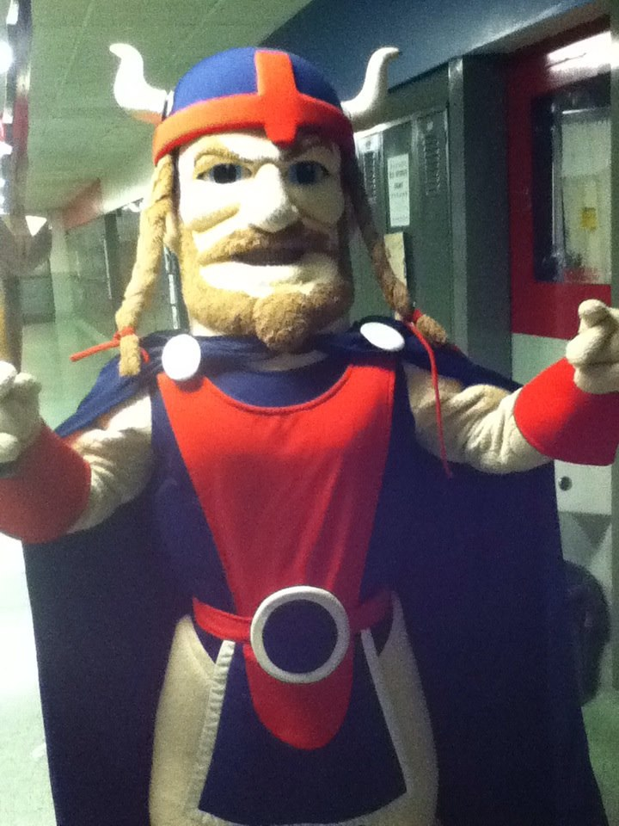
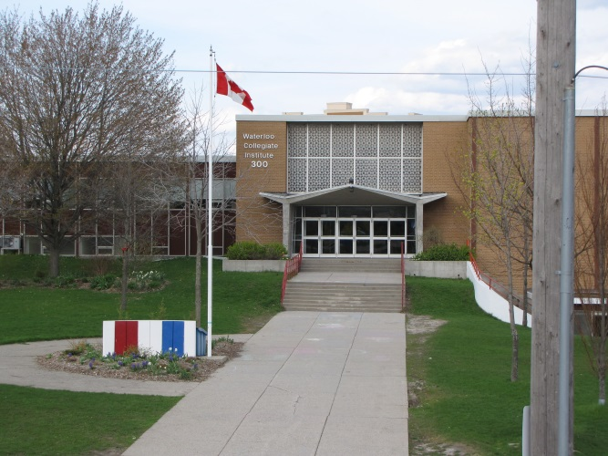
Waterloo Collegiate Institute

Slide 2
Get Involved at WCI!
-Grad Buddies
-Grade 9 party
-Junior Leadership
-Spirit Assemblies
-VIP Program
-Club Fair

Slide 3
Clubs
Debating Team
Math Club
Inter-school Christian Fellowship
Muslim Students Association
Spirit Club
Federal-Provincial Conference Simulation
Human Rights Club
Trivia Club, Unity in Diversity
DECA
Japanese Animation Club
Saturnalia
Skills Canada
WAYVE (Working Against Youth Violence Everywhere)
Gourmet Club
Animal Rights Club
Human Rights Club
Latin Classics Club
E-team
Science Club
Sears Drama Festival Club,
Peer Tutoring
Computer Science Club
Engineering Club
Open Art Studio
Environment Club (The "Green Team")
Gay- Straight Alliance
Fishing Club

Slide 4
WCI Arts

Slide 5
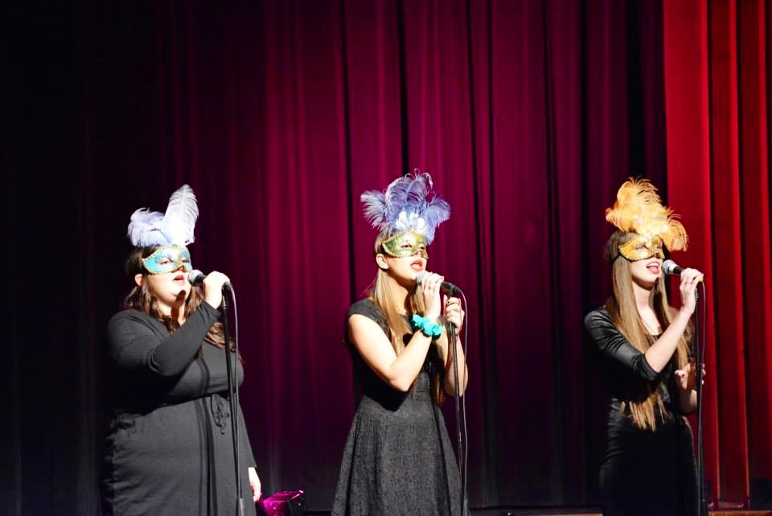
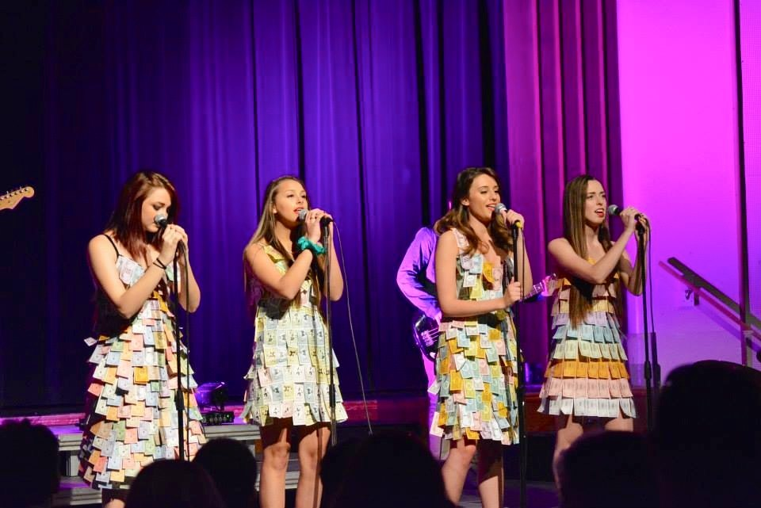
CONCEPT
WCI’S VARIETY SHOW

Slide 6
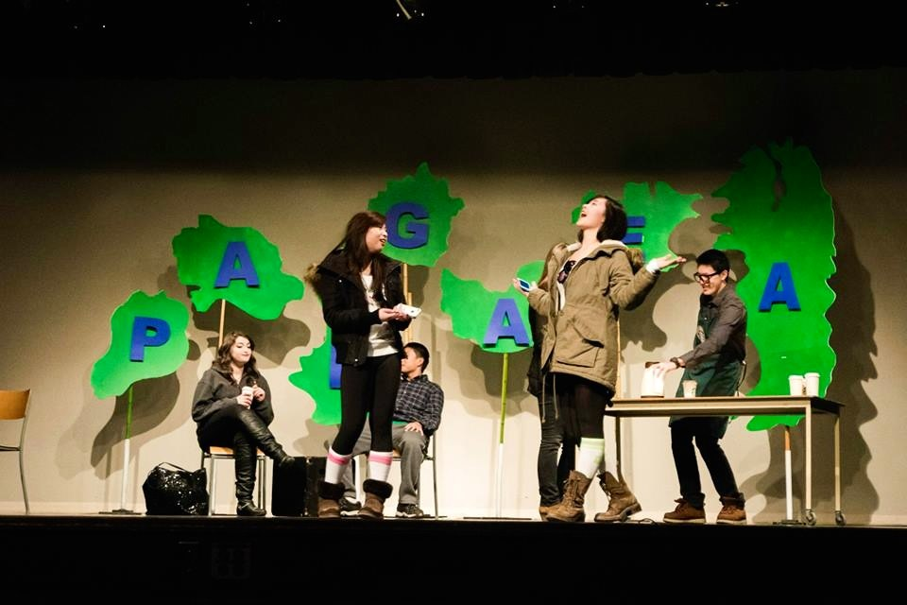
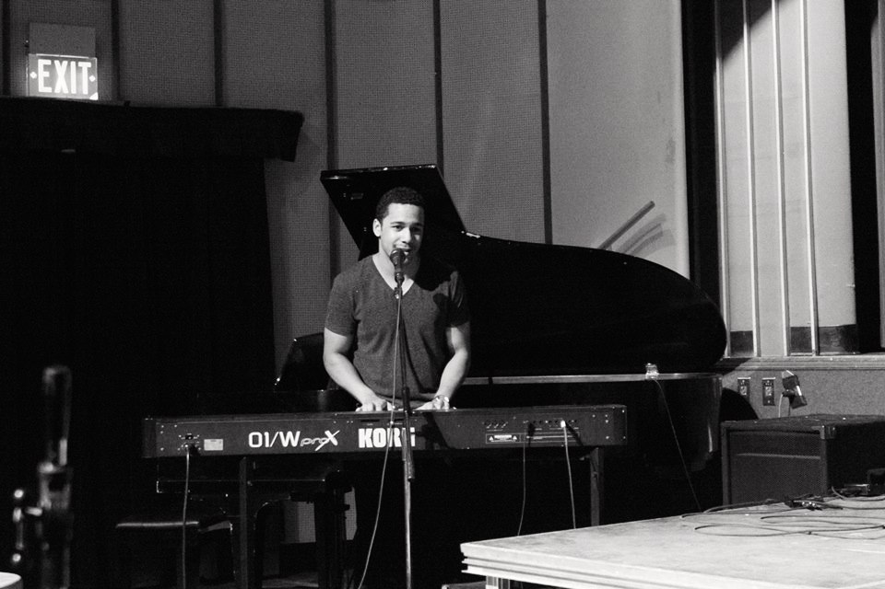
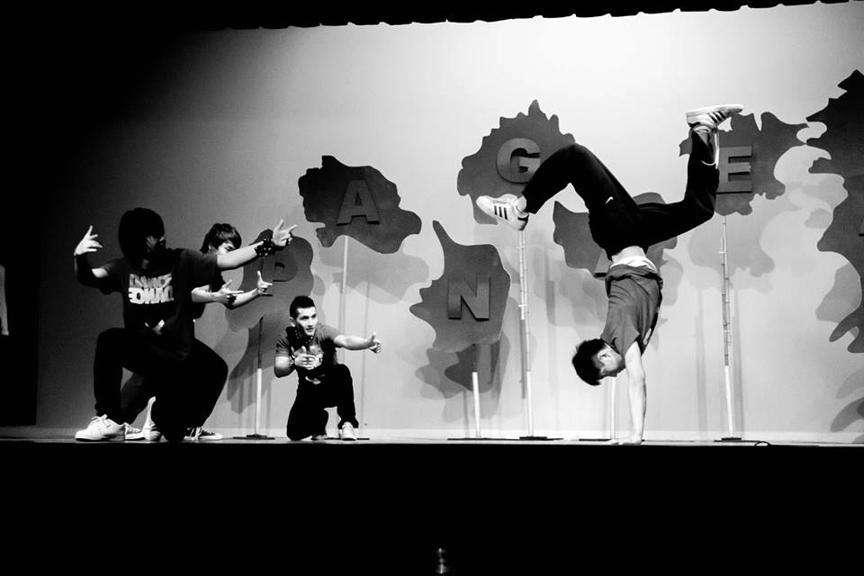
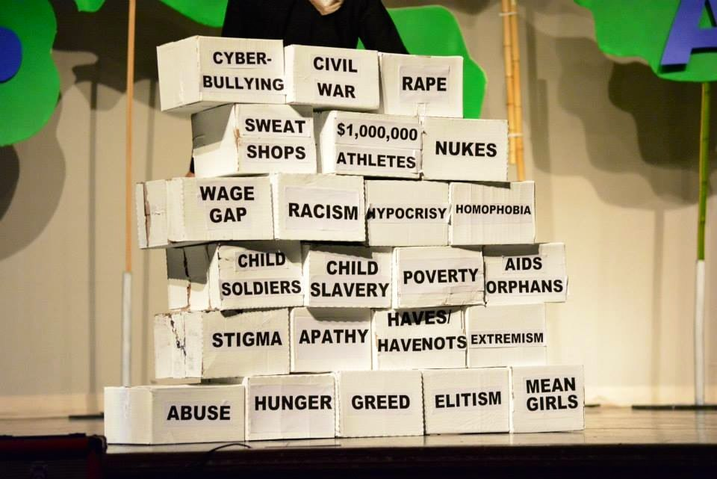
MULTI
WCI’S MULTICULTURAL SHOW

Slide 7
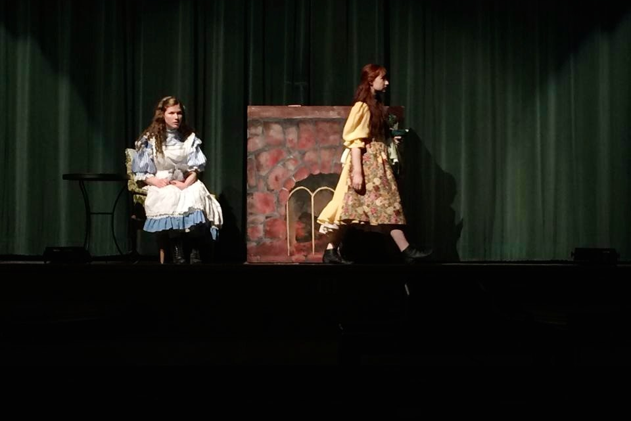
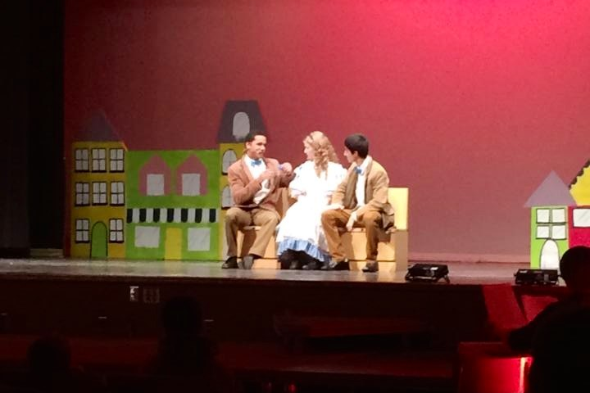
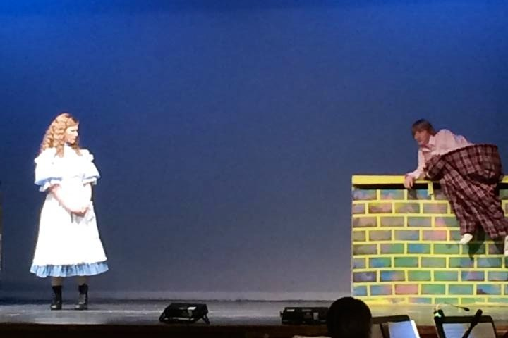
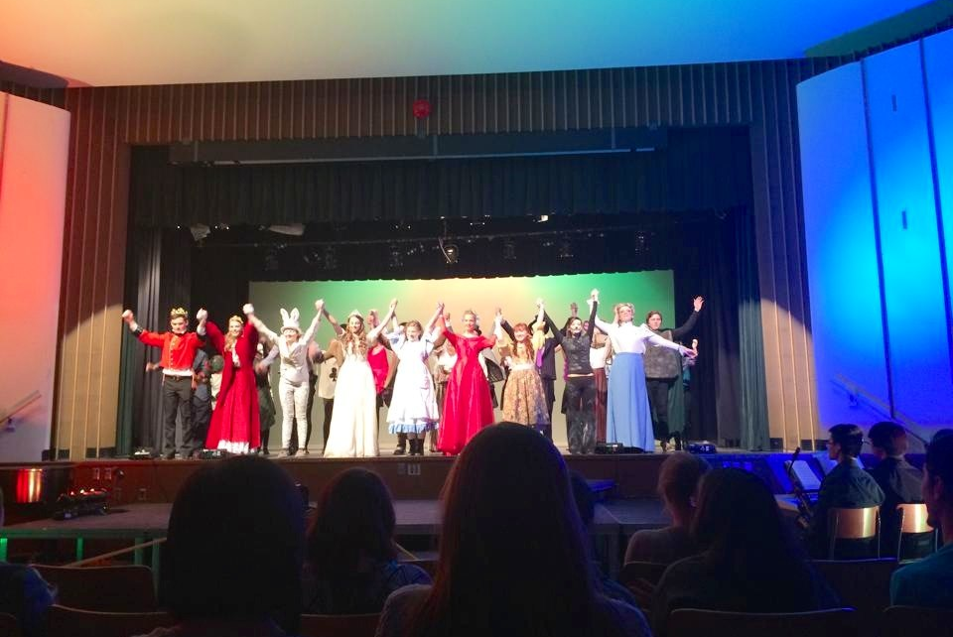
ALICE IN WONDERLAND
WCI’S MUSICAL/PLAY

Slide 8
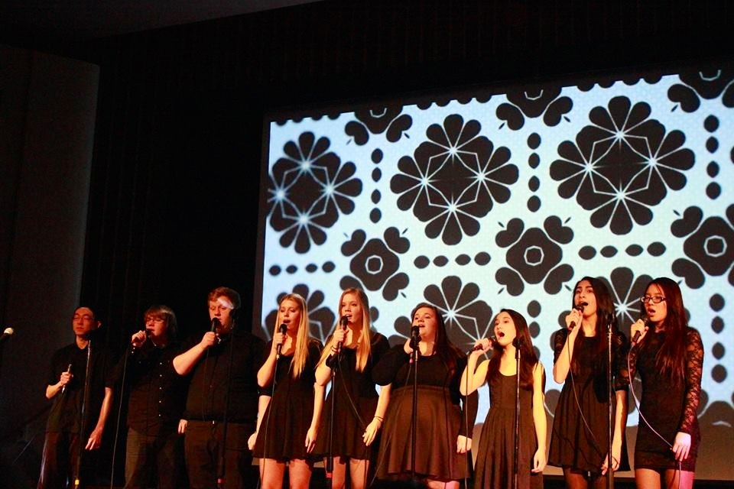
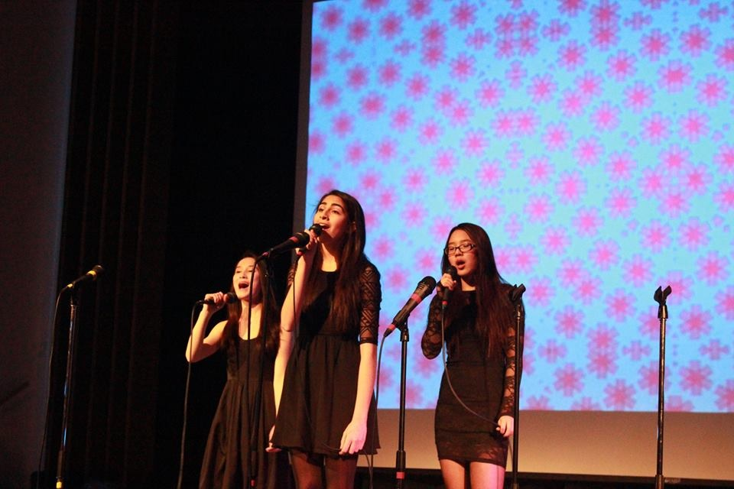
VOCAL PROJECT
WCI’S FIRST ACAPELLA SHOW

Slide 9
ARTS CLUBS
PLASMA DOLPHIN (ONLINE ARTS AND CULTURE MAGAZINE)
WATERLOO GRAPHICS ASSOCIATION
OPEN ART STUDIO
CONCEPT, MULTI, AND MUSICAL ART CREWS
WRITER’S GUILD/NEWSPAPER

Slide 10
MORE ARTS CLUBS
CHOIR
JUNIOR, INTERMEDIATE,SENIOR, CHAMBER ORCHESTRA
BAND
EXPERIMENTAL MUSIC GROUP

Slide 11
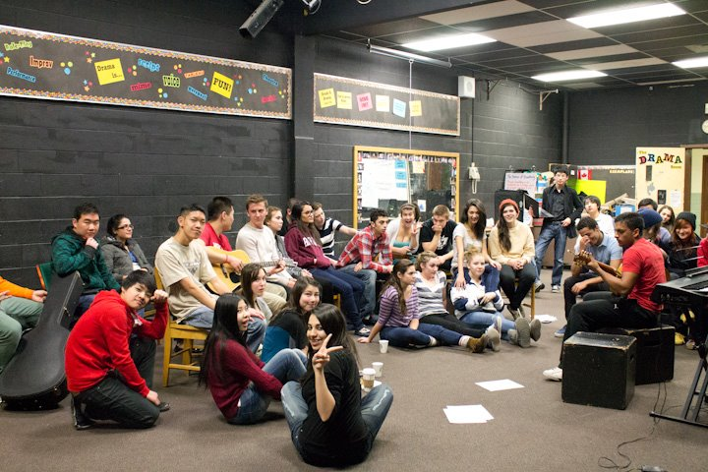
ARTS EVENTS
COFFEE HOUSES
ARTS BALL
WINTER & SPRING MUSIC NIGHT
DANCE MANIA
FESTIVAL OF STRINGS

Slide 12
WCI Athletics

Slide 13
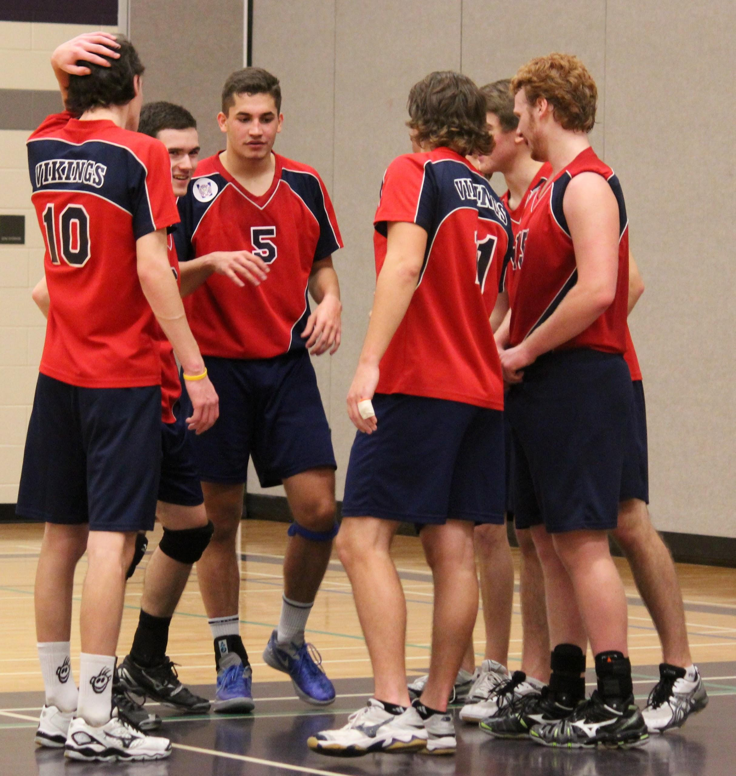
Fall Teams
Girls Basketball
Boys Volleyball
Field Hockey
Football
Tennis
*Cross Country*
Junior Boys Soccer

Slide 14
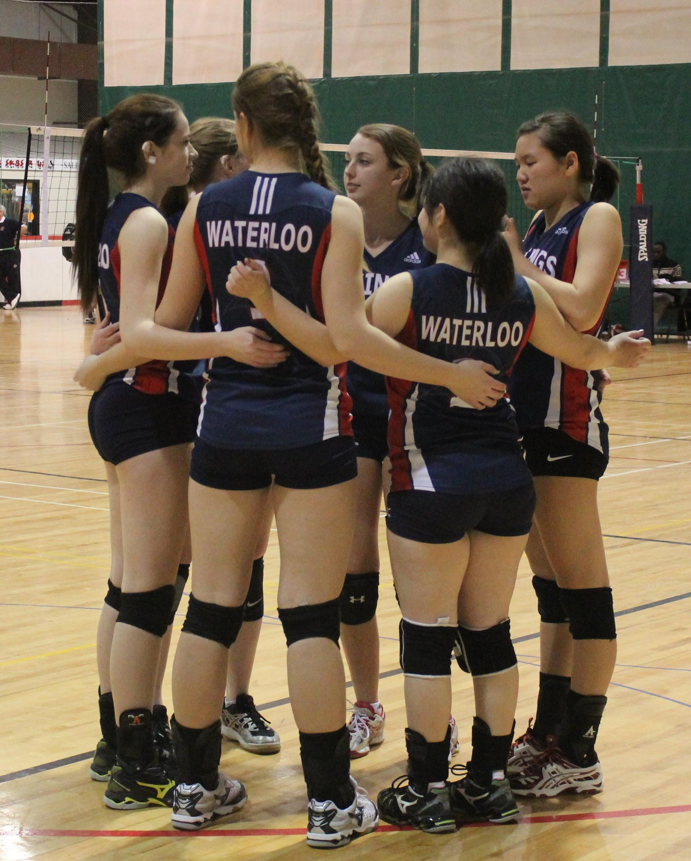
Winter Teams
Girls Volleyball
Boys Basketball
Girls and Boys Hockey
Curling
Alpine and Nordic Skiing
*Swimming*

Slide 15
Spring Teams
Girls and Boys Rugby
Badminton
Tennis
*Track and Field*
Ultimate Frisbee
Soccer

Slide 16
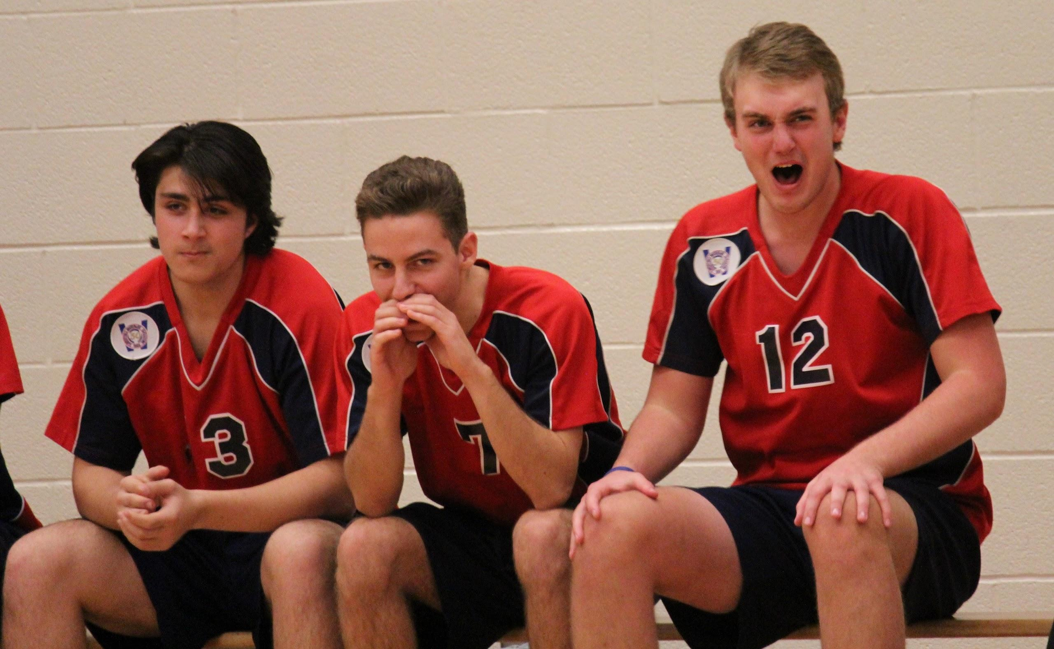
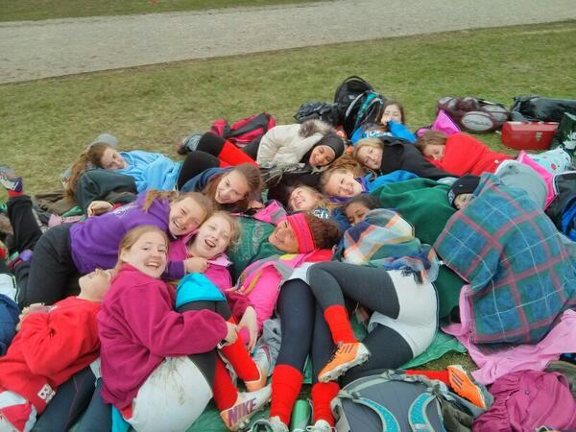
Getting Involved with Athletics
Sports are a great way to make friends
No cut teams allow everyone to participate
Don’t have to be a superstar athlete

